Slide 1
Volume Changes of Concrete
Design and Control of Concrete Mixtures – Chapter 10

Slide 2
Overview
Early age volume changes
Moisture changes
Temperature changes
Curling and warping
Elastic and inelastic deformation
Creep
Chemical changes and effects
Notes:
This module will discuss the volume changes of concrete. We will begin with the early age volume changes: chemical shrinkage, autogenous shrinkage, subsidence, plastic shrinkage, and swelling. We will then discuss moisture and temperature related volume changes, including curling and warping effects. That will be followed by the load-based volume changes of elastic and inelastic deformation and creep. The discussion will be capped with a brief mention of volume changes induced by chemical reactions within the concrete.

Slide 3
Volume Changes of Concrete
Many reasons for volume changes
Understanding volume changes is useful
Restraint of volume changes leads to cracking
Notes:
Concrete undergoes slight changes in volume for various reasons, and understanding the nature of these changes is useful in planning or analyzing concrete work. If concrete is free of any restraints to deform, normal volume changes would be of little consequence. But since concrete in service is usually restrained by foundations, subgrades, reinforcement, or connecting members and significant stresses can develop. This is particularly true of tensile stresses. While quite strong in compression, cracks develop because concrete is relatively weak in tension. Controlling the variables that affect volume changes can minimize high stresses and cracking. For convenience, the magnitude of volume changes is generally stated in linear rather than volumetric units.

Slide 4
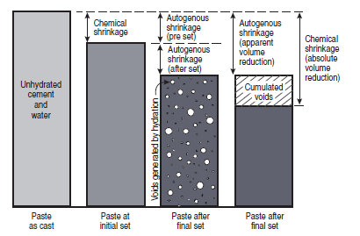
Early Age Volume Changes
Notes:
The volume of concrete begins to change immediately after the water comes into contact with the cement. Early volume changes, within 24 hours, can influence the long-term volume changes and potential crack formation in hardened concrete. Chemical shrinkage refers to the reduction in absolute volume of solids and liquids in paste resulting from cement hydration. The absolute volume of hydrated cement products is less than the absolute volume of cement and water before hydration. This change in volume of cement paste during the plastic state is illustrated
by the first two bars shown here. Chemical shrinkage continues to occur at a microscopic scale as long as cement hydrates. After initial set, the paste cannot deform as much as when it was in a plastic state. Therefore, further hydration and chemical shrinkage is compensated by the formation of voids in the microstructure, as shown in the third bar.

Slide 5
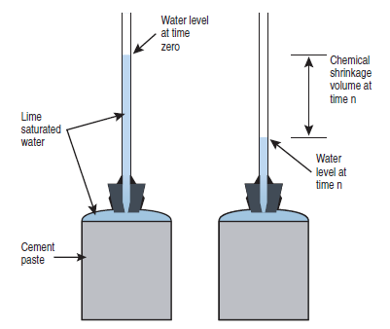
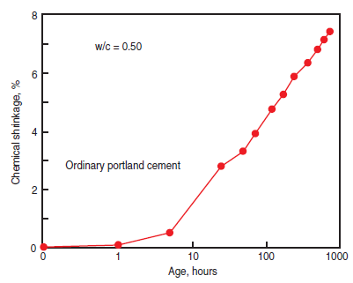
Chemical Shrinkage
Notes:
The amount of volume change due to chemical shrinkage can be estimated from the hydrated cement phases and their densities or it can be determined by physical test as illustrated to the left in accordance withASTMC1608, Standard Test Method for Chemical Shrinkage of Hydraulic
Cement Paste. An example of long-term chemical shrinkage for portland cement paste is illustrated to the right.

Slide 6
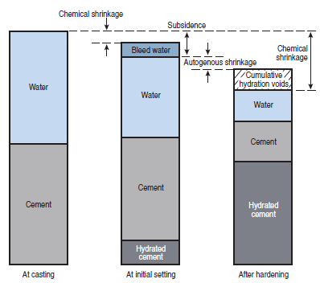
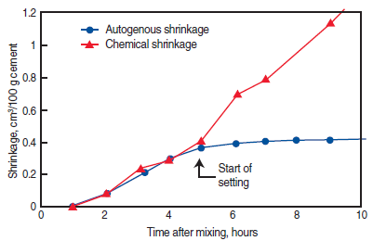
Autogenous Shrinkage
Notes:
Autogenous shrinkage is the macroscopic volume reduction (visible dimensional change) of cement paste, mortar, or concrete caused by cement hydration and is measured in accordance with ASTM C1698, Standard Test Method for Autogenous Strain of Cement Paste and Mortar. The macroscopic volume reduction of autogenous shrinkage is much less than the absolute volume reduction of chemical shrinkage because of the rigidity of the hardened paste structure. Chemical shrinkage is the driving force behind autogenous shrinkage. The relationship between autogenous shrinkage and chemical shrinkage is illustrated in the figures here. When external water is available, autogenous shrinkage
cannot occur. If external water is not available cement hydration consumes pore water resulting in self desiccation of the paste and a uniform reduction of volume. Autogenous shrinkage is most prominent in concrete with a water to cement ratio under 0.42. High-strength, low water to cement ratio (0.30) concrete can experience 200 millionths to 400 millionths of autogenous shrinkage.

Slide 7
Subsidence
Vertical shrinkage before initial set
Caused by bleeding, escaping air, and chemical shrinkage
May be a symptom of lack of consolidation
May lead to cracking over embedments
Notes:
Subsidence refers to the vertical shrinkage of fresh cementitious materials before initial set. It is caused by bleeding, air voids rising to the surface, and chemical shrinkage. Subsidence is also called settlement shrinkage. Subsidence of well-consolidated concrete with minimal bleed water is insignificant. Excessive subsidence is often caused by a lack of consolidation of fresh concrete. Excessive subsidence over embedded items, such as supported steel reinforcement, can result in cracking over embedments. Concretes made with air entrainment, sufficient fine materials, and low water contents can help minimize subsidence cracking. Also, fibers have been reported to reduce subsidence cracking

Slide 8
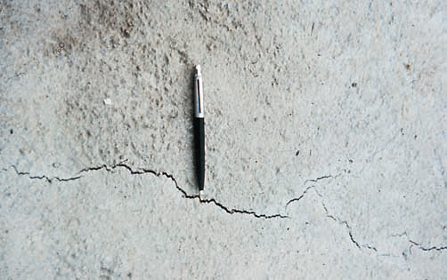
Plastic Shrinkage Cracking
Notes:
Plastic shrinkage refers to volume change occurring while the concrete is still fresh, before hardening. It is usually observed in the form of plastic shrinkage cracks occurring before or during finishing. The cracks often resemble tears in the surface. Plastic shrinkage results from
a combination of chemical and autogenous shrinkage and rapid evaporation of moisture from the surface that exceeds the bleeding rate. Plastic shrinkage cracking can be controlled by minimizing surface evaporation through use of fogging, wind breaks, shading, plastic sheet covers, wet
burlap, spray-on finishing aids (evaporation retarders), and fibers.

Slide 9
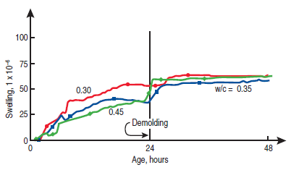
Swelling
Notes:
Concrete, mortar, and cement paste swell in the presence of external water. When water drained from capillaries by chemical shrinkage is replaced by external water, the volume of the concrete mass initially increases. As there is no self desiccation, there is no autogenous shrinkage.
External water can come from wet curing or submersion. Swelling occurs due to a combination of crystal growth, absorption of water, and osmotic pressure. The swelling is not large, only about 50 millionths at early ages. When the external water source is removed, autogenous shrinkage and drying shrinkage reverse the volume change.

Slide 10
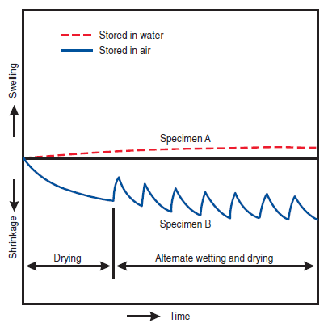
Moisture Changes of Hardened Concrete
Notes:
Hardened concrete expands slightly with a gain in moisture and contracts with a loss in moisture. The effects of these moisture cycles are illustrated schematically in this graph. Specimen A represents concrete stored continuously in water from time of casting. Specimen B represents the same concrete exposed first to drying in air and then to alternate cycles of wetting and drying. For comparative purposes, it should be noted that the swelling that occurs during continuous wet storage over a period of several years is usually less than 150millionths; this is about one-fourth of the shrinkage of air-dried concrete for the same period.

Slide 11
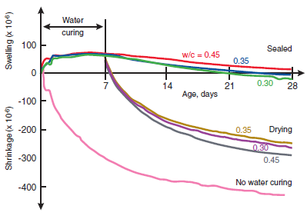
Moisture Changes
Notes:
This graph illustrates swelling of concretes wet cured for 7 days followed by shrinkage when sealed or exposed to air drying. Autogenous
shrinkage reduces the volume of the sealed concretes to a level about equal to the amount of swelling at 7 days. Note that the concretes wet cured for 7 days had less shrinkage due to drying and autogenous effects than the concrete that had no water curing. Tests indicate that the drying shrinkage of small, plain concrete specimens (without reinforcement) ranges from about 400 millionths to 800 millionths when exposed to air at 50% relative humidity. The drying shrinkage of reinforced concrete is less than that for plain concrete, the difference depending on the
amount of reinforcement. Steel reinforcement restricts but does not prevent drying shrinkage. In reinforced concrete structures with normal amounts of reinforcement, drying shrinkage is assumed to be 200 to 300 millionths. After concrete has dried to a constant moisture content at
one relative humidity condition, a decrease in humidity causes it to lose moisture while an increase causes it to gain moisture. The concrete shrinks or swells with each such change in moisture content due primarily to responses of the cement paste. Most aggregates show little response to changes in moisture content, although there are a few aggregates that swell or shrink in response to such changes.

Slide 12
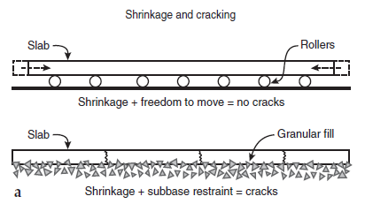
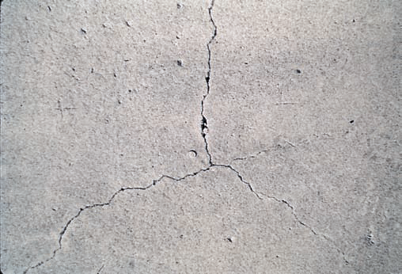
Moisture Changes
Notes:
As drying takes place, concrete shrinks. Where there is no restraint, movement occurs freely and no stresses or cracks develop. If the tensile stress that results from restrained drying shrinkage exceeds the tensile strength of the concrete, cracks can develop. The magnitude of the tensile stress increases with an increased drying rate. Random cracks may develop if joints are not properly provided and the concrete element is restrained from shortening.

Slide 13
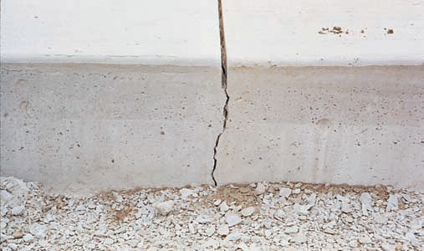
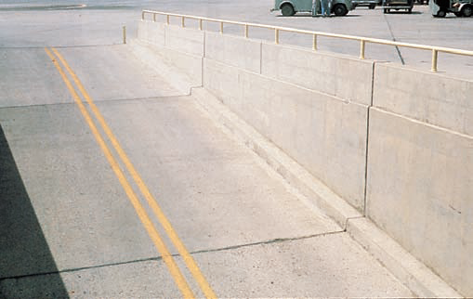
Moisture Changes
Notes:
Contraction joints for slabs on ground should be spaced at distances of 24 to 30 times the slab thickness to control random cracks. Joints in walls are equally important for crack control.

Slide 14
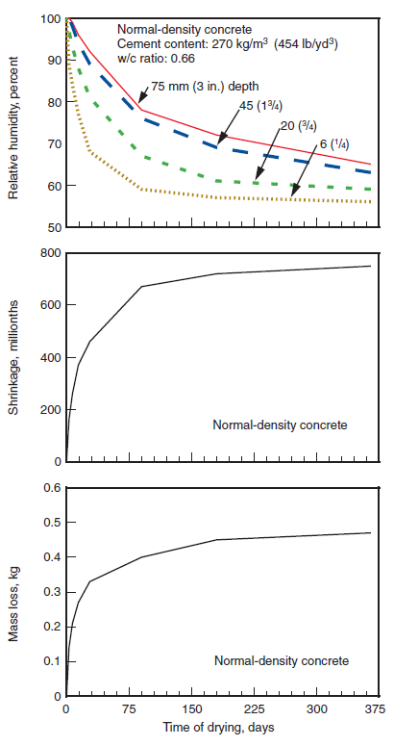
Moisture Changes
Notes:
These graphs illustrate the relationship between drying rate at different depths, drying shrinkage, and mass loss for normal-density concrete.

Slide 15
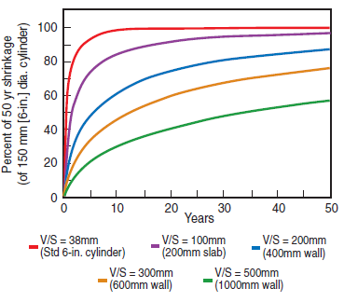
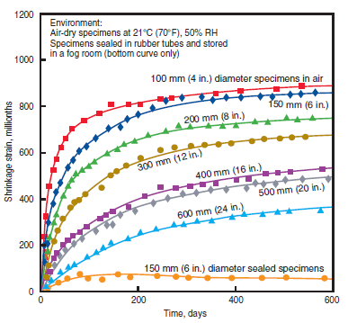
Moisture Changes
Notes:
Shrinkage may continue for a number of years, depending on the size and shape of the concrete. The rate and ultimate amount of shrinkage are usually smaller for large masses of concrete than for small masses; on the other hand, shrinkage continues longer for large masses. Higher
volume-to-surface ratios (larger elements) experience lower shrinkage as shown in these graphs.

Slide 16
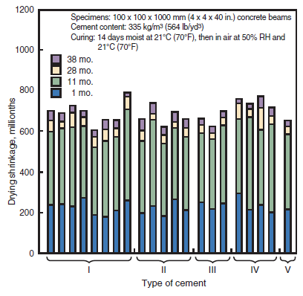
Moisture Changes
Notes:
The rate and amount of drying shrinkage for small concrete specimens made with various cements are shown in this graph. Specimens were initially moist-cured for 14 days at 21°C (70°F), then stored for 38 months in air at the same temperature and 50% relative humidity. Shrinkage
recorded at the age of 38 months ranged from 600 to 790 millionths. An average of 34% of this shrinkage occurred within the first month. At the end of 11 months an average of 90% of the 38-month shrinkage had taken place.

Slide 17
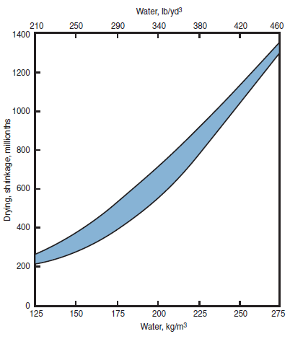
Moisture Changes – Effect of Materials
Notes:
The most important controllable factor affecting drying shrinkage is the amount of water per unit volume of concrete. Typically, about half the water in concrete mixtures is consumed by the chemical reaction of hydration and the other half is necessary to achieve workability and finishability during placement. Water that is not bled during placement, remains in the hardened concrete to eventually evaporate and contribute to drying shrinkage. The results of tests illustrating the water content to shrinkage relationship are shown here. Shrinkage can be minimized
by keeping the water content of concrete as low as possible. Any practice that increases the water requirement of the cement paste, such as the use of high slumps without superplasticizers, excessively high freshly mixed concrete temperatures, high fine-aggregate contents, or use of small-size coarse aggregate, will increase shrinkage. Also, anything that decreases bleeding, such as accelerators, air entrainment, and fibers, can result in greater drying shrinkage.

Slide 18
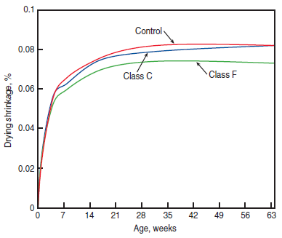
Moisture Changes – Effect of Materials
Notes:
The shrinkage of concretes with different types of cement at different ages is generally very similar. However, this does not mean that all cements or cementing materials have similar shrinkage. Cements containing limestone may exhibit similar or less drying shrinkage depending on the fineness. Fly ash and slag cement have little effect on shrinkage at normal dosages. This graph shows that concretes with normal dosages of selected fly ashes performed similar to the control concrete made with only portland cement as the cementing material. However, very fine SCMs, such as silica fume that increase water demand can also increase shrinkage properties in concrete mixtures if not accounted for in the design.

Slide 19
Moisture Changes – Effect of Materials
Aggregates restrain shrinkage
Second greatest influence behind total water content
Quartz, granite, feldspar, limestone, and dolomite produce lower shrinkage
Notes:
Aggregates in concrete, especially coarse aggregate, physically restrain the shrinkage of hydrating and drying cement paste. Paste content affects the drying shrinkage of mortar more than that of concrete. Drying shrinkage is also highly dependent on the type of aggregate. Except for total water content, the type of aggregate has the greatest influence on the drying shrinkage potential. Studies have shown that the type of aggregate can increase the drying shrinkage by as much as 120% to 150%. Quartz, granite, feldspar, limestone, and dolomite aggregates generally produce concretes with lower drying shrinkages.

Slide 20
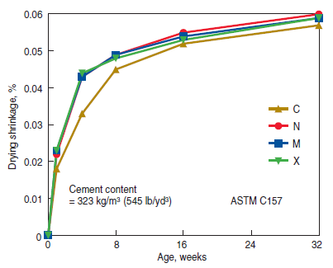
Moisture Changes – Effect of Materials
Notes:
Most chemical admixtures have little effect on shrinkage. However, the use of accelerators such as calcium chloride will increase drying shrinkage of concrete. Despite reductions in water content, some water-reducing admixtures can increase drying shrinkage, particularly those that contain an accelerator to counteract the retarding effect of the admixture. Air entrainment has little or no effect on drying shrinkage. High-range water reducers usually have little effect on drying shrinkage, as shown in this graph.

Slide 21
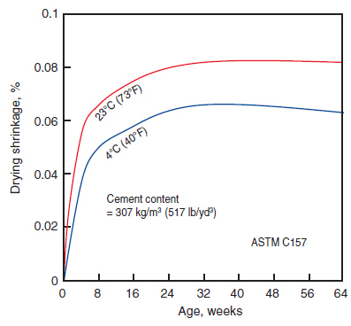
Moisture Changes – Effect of Curing
Notes:
The amount and type of curing can affect the rate and ultimate amount of drying shrinkage. Curing compounds, sealers, and coatings can trap free moisture in the concrete for long periods, resulting in delayed shrinkage. Wet curing methods, such as fogging or wet burlap, hold off
shrinkage until curing is terminated, after which the concrete dries and shrinks at a normal rate. Cooler initial curing temperatures can reduce shrinkage, shown in this graph. Steam curing will also reduce drying shrinkage.

Slide 22
Temperature Changes of Hardened Concrete
Concrete expands as temperature rises
Average value about 10 millionths per degree Celsius (5.5 millions per degree Fahrenheit)
Range: 6-13 millionths/degree Celsius
(3.2-7.0 millionths/degree Fahrenheit)
Notes:
Concrete expands slightly as temperature rises and contracts as temperature falls, although it can expand slightly as free water in the concrete freezes. Temperature changes may be caused by environmental conditions or by cement hydration. An average value for the coefficient
of thermal expansion of concrete is about 10 millionths per degree Celsius (5.5 millionths per degree Fahrenheit), although values ranging from 6 to 13 millionths per degree Celsius (3.2 to 7.0 millionths per degree Fahrenheit) have been observed.

Slide 23
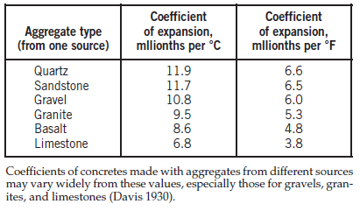
Temperature Changes
Notes:
Thermal expansion and contraction of concrete varies with factors such as aggregate type, cement content, water-cement ratio, temperature range, concrete age, and relative humidity. Of these, aggregate type has the greatest influence. This table shows some experimental values of the
thermal coefficient of expansion of concretes made with aggregates of various types. These data were obtained from tests on small concrete specimens in which all factors were the same except aggregate type. In each case, the fine aggregate was of the same material as the coarse aggregate. The thermal coefficient of expansion for steel is about 12 millionths per degree Celsius (6.5 millionths per degree Fahrenheit), which is comparable to that for concrete. The coefficient for reinforced concrete can be assumed as 11 millionths per degree Celsius (6 millionths per degree Fahrenheit), the average for concrete and steel.

Slide 24
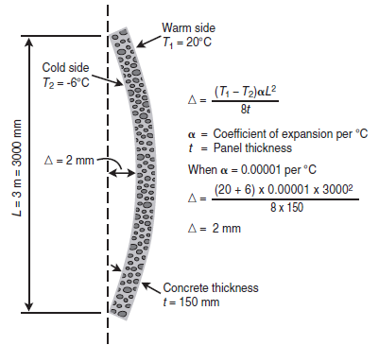
Temperature Changes
Notes:
Temperature changes that result in shortening can crack concrete members that are highly restrained by another part of the structure or by ground friction. Calculations show that a large enough temperature drop will crack concrete regardless of its age or strength, provided the coefficient of expansion does not vary with temperature and the concrete is fully restrained. Precast wall panels and slabs on ground are susceptible to bending and curling caused by temperature gradients that develop when concrete is cool on one side and warm on the other. The calculated amount of curling in a wall panel is illustrated here.

Slide 25
Temperature Changes – Low Temps
Subfreezing volume changes depend on moisture content and behavior, aggregate type
Low temperatures also increase strength of moist concrete---little effect on dry concrete
Notes:
Concrete continues to contract as the temperature is reduced below freezing. The amount of volume change at subfreezing temperatures is greatly influenced by the moisture content, behavior of the water (physical state-–ice or liquid), and type of aggregate in the concrete. Subfreezing temperatures can significantly increase the compressive and tensile strength and modulus of elasticity of moist concrete. Dry concrete properties are not as affected by low temperatures.

Slide 26
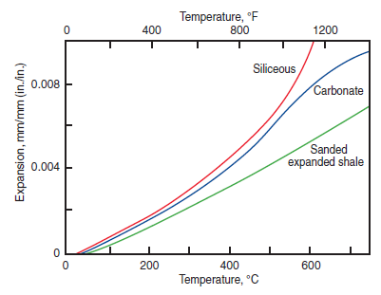
Temperature Changes – High Temps
Notes:
Temperatures greater than 95°C (200°F) that are sustained for several months or even several hours can have significant effects on concrete. The total amount of volume change of concrete is the sum of volume changes of the cement paste and aggregate. At high temperatures, the paste shrinks due to dehydration while the aggregate expands. For normal-aggregate concrete, the expansion of the aggregate exceeds the paste shrinkage resulting in an overall expansion of the concrete. Some aggregates such as expanded shale, andesite, or pumice with low coefficients
of expansion can produce a very volume-stable concrete in high-temperature environments. Some aggregates undergo extensive and abrupt
volume changes at a particular temperature, causing disruption in the concrete.

Slide 27
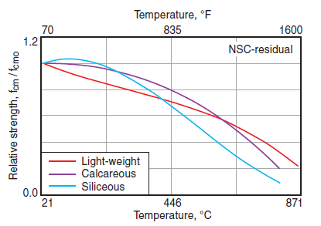
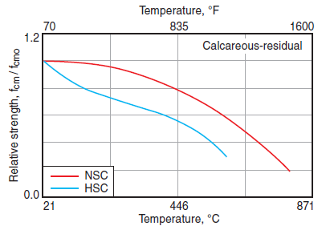
Temperature Changes – High Temps
Notes:
Besides volume change, sustained high temperatures can also have other, usually irreversible, effects such as a reduction in strength, modulus of elasticity, and thermal conductivity. Creep increases with temperature. Above 100°C (212°F), the paste begins to dehydrate resulting in significant
strength losses. Strength decreases with increases in temperature until the concrete loses essentially all its strength. The effect of high-temperature exposure on compressive strength of concretes made with various types of aggregate is illustrated in graph on the left. Several factors including concrete moisture content, aggregate type and stability, cement content, exposure time, rate of temperature rise, age of concrete, restraint, and existing stress all influence the behavior of concrete at high temperatures. The graph on the right shows the difference in response between normal-strength concrete and high-strength concrete with calcareous aggregate. If stable aggregates are used and strength reduction and the effects on other properties are accounted for in the mix design, high quality concrete can be exposed to temperatures of 90°C to 200°C (200°F to 400°F) for long periods.

Slide 28
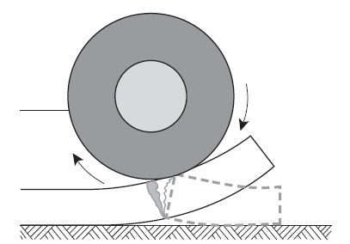
Curling and Warping
Notes:
In addition to horizontal movement caused by changes in moisture and temperature, curling and warping of slabs on ground can be a problem. This is caused by differences in moisture content and temperature between the top and bottom of slabs. Curling and warping are intimately related to the shrinkage potential of the concrete mixture. While the terms have been used interchangeably for the past century, there is a difference between “curling” and “warping” due to the difference in the cause of the distortion. Curling is the deformation of the slab due to a difference in temperature between the surface and the bottom of the slab. If the slab surface is cooler than the slab bottom, the surface contracts causing the slab edges to curl upward. Slab “warping” is the deformation of the slab surface profile due to a difference in moisture between the surface and bottom of the slab. As with a sponge, if the slab surface is allowed to dry and the bottom is kept moist, the edges will tend to warp upward. A slab will assume a reverse curl when the surface is wetter or warmer than the bottom. Curling can be reduced or eliminated by using design and construction techniques that minimize shrinkage potential and by using techniques described earlier to reduce temperature and moisture-related volume changes.

Slide 29
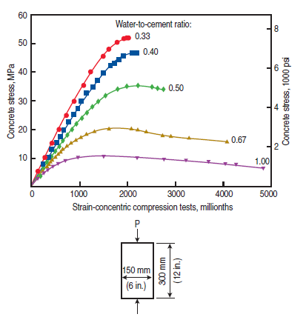
Elastic and Inelastic Deformation
Notes:
The series of curves in this graph illustrate the amount of compressive stress and strain that results instantaneously due to loading of unreinforced concrete. With water-cement ratios of 0.50 or less and strains up to 1500 millionths, the upper three curves show that strain is
closely proportional to stress; in other words, the concrete is almost elastic. The upper portions of the curves and beyond show that the concrete is inelastic. The curves for high-strength concrete have sharp peaks, whereas those for lower-strength concretes have long and relatively flat
peaks. The graph also shows the sudden failure characteristics of higher strength, low water to cement ratio, concrete cylinders.

Slide 30
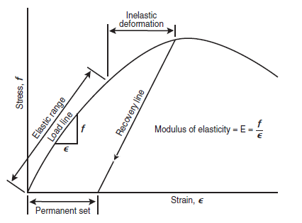
Elastic/Inelastic Deformation
Notes:
When load is removed from concrete in the inelastic zone, the recovery line usually is not parallel to the original line for the first load application. Therefore, the amount of permanent set may differ from the amount of inelastic deformation. The term “elastic” is not favored for general discussion of concrete behavior because frequently the strain may be in the inelastic range. For this reason, the term “instantaneous strain” is often used. The ratio of stress to strain in the elastic range of a stress-strain curve for concrete defines the modulus of elasticity (E) of that concrete. Normal-density concrete has a modulus of elasticity of 14,000 MPa to 41,000 MPa (2,000,000 psi to 6,000,000 psi), depending on factors such as compressive strength and aggregate type.

Slide 31
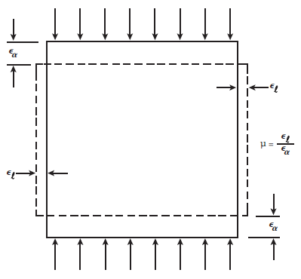
Poisson’s Ratio
Notes:
When a block of concrete is loaded in uniaxial compression, as in this schematic, it will compress and simultaneously develop a lateral strain or bulging. The ratio of lateral to axial strain is called Poisson’s ratio, μ. A common value used is 0.20 to 0.21, but the value may vary from 0.15 to 0.25 depending upon the aggregate, moisture content, concrete age, and compressive strength. Poisson’s ratio is generally of no concern to the structural designer, but is used in special applications.

Slide 32
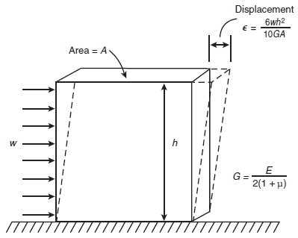
Shear and Torsional Strain
Notes:
Concrete, like other materials, deforms under shear forces. The shear strain produced is important in determining the load paths or distribution of forces in indeterminate structures—for example where shear-walls and columns both participate in resisting horizontal forces in a concrete building frame. The amount of movement, while not large, is significant in short, stubby members. In larger members, flexural strains are much greater and more significant to designers. Calculation of the shear modulus (modulus of rigidity), G, is shown in this schematic; G varies with the strength and temperature of the concrete. Plain rectangular concrete members can also fail in torsion, that is, a twisting action caused by bending about an axis parallel to the wider face and inclined at an angle of about 45 degrees to the longitudinal axis of a member. Microcracks develop at low torque. However, concrete behaves reasonably elastic up to the maximum limit of the elastic torque.

Slide 33
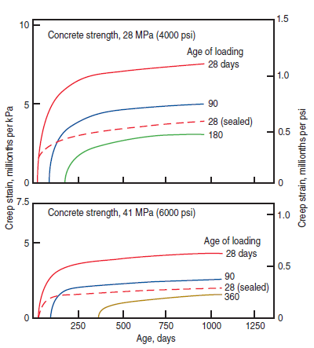
Creep
Notes:
When concrete is loaded, the deformation caused by the load can be divided into two parts: a deformation that occurs immediately (elastic strain) and a time-dependent deformation that begins immediately but continues at a decreasing rate as long as the concrete is loaded. This latter deformation is called creep. The amount of creep is dependent upon (1) the magnitude of the applied stress, (2) the age and strength of the concrete when stress is applied, and (3) the length of time the concrete is stressed. It is also affected by other factors related to the quality of the concrete and conditions of exposure, such as: (1) type, amount, and maximum size of aggregate; (2) type of cementing materials; (3) amount of
cement paste; (4) size and shape of the concrete element; (5) volume to surface ratio of the concrete element; (6) amount of steel reinforcement; (7) prior curing conditions; and (8) the ambient temperature and humidity. The creep curves shown in here are based on tests
conducted under laboratory conditions in accordance with ASTM C512, Standard Test Method for Creep of Concrete in Compression. The two 28-day curves for each concrete strength show that creep of concrete loaded under drying conditions is greater than creep of concrete sealed against drying.

Slide 34
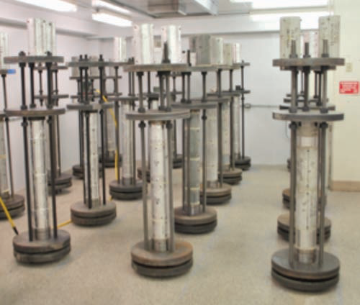
Creep
Notes:
Within normal stress ranges, creep is proportional to stress. In relatively young concrete, the change in volume or length due to creep is largely unrecoverable; in older or drier concrete it is largely recoverable. Concrete specimens loaded at a late age will creep less than those loaded at an early age.

Slide 35
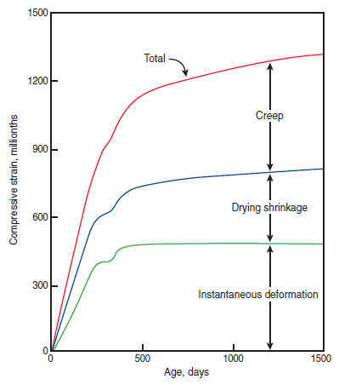
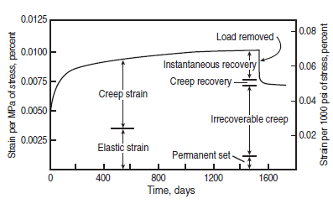
Creep
Notes:
The graph on the left illustrates recovery from the elastic and creep strains after load removal. A combination of strains occurring in a reinforced column is illustrated in the graph on the right. The curves represent deformations and volume changes in a 14th-story column of a 76-story reinforced concrete building while under construction. The 400-mm x 1200-mm (16-in. x 48-in.) column contained 2.08% vertical reinforcement and was designed for 60-MPa (9000-psi) concrete.

Slide 36
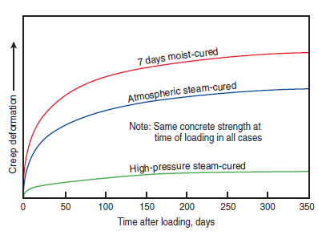
Creep
Notes:
The method of curing prior to loading has a marked effect on the amount of creep in concrete. The effects on creep of three different methods of curing are shown here. Note that very little creep occurs in concrete that is cured by high-pressure steam (autoclaving). Note also that atmospheric steam-cured concrete has considerably less creep than 7-day moist-cured concrete. The two methods of steam curing shown in this graph reduce drying shrinkage of concrete about half as much as they reduce creep.

Slide 37
Chemical Changes and Effects
Carbonation shrinkage
Sulfate expansion
Alkali-aggregate expansion
Notes:
Some volume changes of concrete result from chemical reactions; these may take place shortly after placing and finishing or later due to reactions within the hardened concrete in the presence of water or moisture. Hardened concrete containing some moisture reacts with
carbon dioxide present in air, a reaction that results in a slight shrinkage of the surface paste of the concrete. The effect, known as carbonation, is not destructive but actually increases the chemical stability and strength of the concrete. Because so little of a concrete element carbonates, carbonation shrinkage of cast-in-place concrete is insignificant and is usually not considered in engineering practice. Sulfate attack of concrete can occur where soil and groundwater have a high sulfate content and measures to reduce sulfate attack, such as use of a low water to cementing materials ratio, have not been taken. The attack is greater in concrete that is exposed to wetting and drying, such as foundation walls and posts. Sulfate attack usually results in an expansion of the concrete because of the formation of solids from the chemical action or salt crystallization. The amount of expansion in severe circumstances has been significantly higher than 0.1%, and the disruptive effect within the concrete can result in extensive cracking and disintegration. Certain aggregates can react with alkali hydroxides in concrete, causing expansion and cracking over a period of years. The reaction is greater in those parts of a structure exposed to moisture. There are two types of alkali-reactive
aggregates, siliceous and carbonate. Alkali-aggregate reaction expansion may exceed 0.5% in concrete and can cause the concrete to fracture and break apart.

Slide 38
Summary
Early age volume changes
Moisture changes
Temperature changes
Curling and warping
Elastic and inelastic deformation
Creep
Chemical changes and effects
Notes:
This module discussed the volume changes of concrete. We began with the early age volume changes and then discussed moisture and temperature related volume changes, including curling and warping effects. That was followed by the load-based volume changes of elastic and inelastic deformation and creep. The discussion was capped with a brief mention of volume changes induced by chemical reactions within the concrete.

Slide 39
Questions
?

