Slide 1
Cold Weather Concreting
Design and Control of Concrete Mixtures – Chapter 17

Slide 2
Overview
Effect of Cold Weather
Adjusting Concrete Mixtures
Concreting Process
Curing
Maturity Concept
Notes:
This presentation will discuss concreting in cold weather conditions. The discussion will begin with the effects of cold weather on concrete and will follow with various options available in mix design to counteract cold weather. Next, the concreting process will be covered, with specific emphasis on the part of curing that is maintaining suitable temperature. The presentation will wrap up with a discussion of the maturity concept.

Slide 3
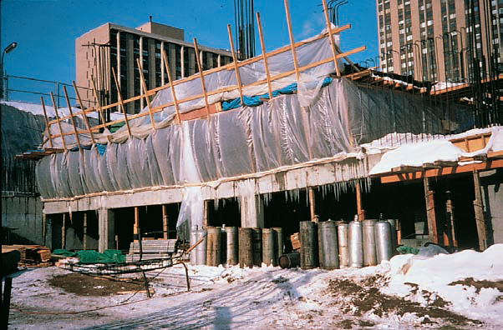
Cold Weather Concreting
Notes:
Concrete can be placed safely without damage from freezing in cold climates if certain precautions are taken. Cold weather is defined by ACI Committee 306 as existing when the air temperature has fallen to, or is expected to fall below 4°C (40°F) during the protection period. Under these circumstances, all materials and equipment needed for adequate protection and curing must be on hand and ready for use before concrete placement is started. During cold weather, the concrete mixture and its temperature should be adapted to the construction procedure and ambient weather conditions. Preparations should be made to protect the concrete from excessively low temperatures using: enclosures, windbreaks, portable heaters, insulated forms, and blankets to maintain a suitable concrete temperature. Concrete must be delivered at the proper temperature and the temperature of forms, reinforcing steel, the ground, or other concrete on which the fresh concrete is cast must also be considered. Concrete should not be cast on frozen concrete or on frozen ground. Forms, reinforcing steel, and embedded fixtures must be free of snow and ice at the time concrete is placed. Thermometers and proper storage facilities for test cylinders should be available to verify that precautions are adequate.

Slide 4
Effect of Freezing on Fresh Concrete
Notes:
Concrete gains very little strength at low temperatures. Freshly mixed concrete must be protected against the disruptive effects of freezing (shown) until the degree of saturation of the concrete has been sufficiently reduced by the process of hydration. The time at which this reduction is accomplished corresponds roughly to the time required for the concrete to attain a compressive strength of 3.5 MPa (500 psi). At normal temperatures and water-cement ratios less than 0.60, this occurs within the first 24 hours after placement. Significant ultimate strength reductions, up to about 50%, can occur if concrete is frozen within a few hours after placement or before it attains a compressive strength of 3.5 MPa (500 psi). Concrete exposed to deicers should attain a compressive strength of 35 MPa (4,500 psi) prior to repeated cycles of freezing and thawing. Concrete that has been frozen just once at an early age can be restored to nearly normal strength by providing favorable subsequent curing conditions. Such concrete, however, will not be as resistant to weathering nor as impermeable. The critical period after which concrete is not seriously damaged by one or two freezing cycles is dependent upon the concrete ingredients and conditions of mixing, placing, curing, and subsequent drying. For example, air-entrained concrete is less susceptible to damage by early freezing than non-air-entrained concrete.

Slide 5
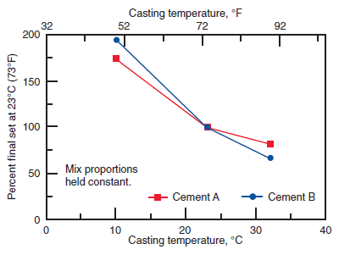
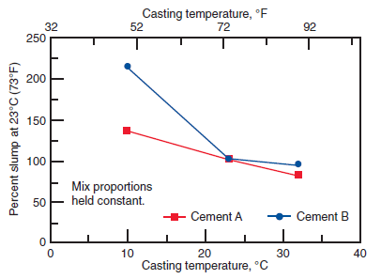
Strength Gain of Concrete
Notes:
Temperature affects the rate at which hydration of cement occurs-–low temperatures retard hydration and consequently retard the hardening and strength gain of concrete. If hardened concrete is frozen and kept frozen above about minus 10°C (14°F), it will still be able to gain strength slowly. However, below that temperature, cement hydration and concrete strength gain cease. The graphs on the left illustrate the effect of cool temperatures on setting time of concrete. The graph on the right illustrates the effects of casting temperature on slump.

Slide 6
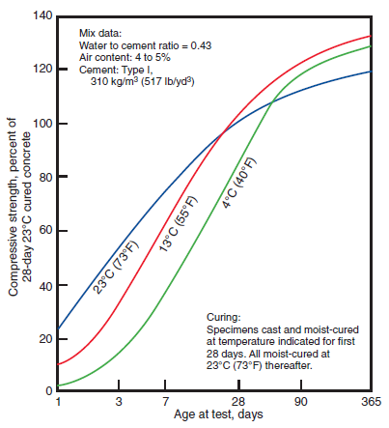
Strength Gain of Concrete
Notes:
These graphs show the age-compressive strength relationship for concrete that has been cast and cured at various temperatures. Note in the graph on the right that concrete cast and cured at 4°C (40°F) and 13°C (55°F) had relatively low strengths for the first week; but after 28 days—when all specimens were moist-cured at 23°C (73°F)—strengths for the 4°C (40°F) and 13°C (55°F) concretes grew faster than the 23°C (73°F) concrete and at one year they were slightly higher.

Slide 7
Heat of Hydration
Notes:
Concrete generates heat during hardening as a result of the chemical reaction by which cement reacts with water to form a hard, stable paste. The heat generated is called heat of hydration; it varies in both amount and rate for different cements. Dimensions of the concrete placement, ambient air temperature, initial concrete temperature, water-cement ratio, admixtures, and the composition, fineness, and amount of cementitious material all affect heat generation and buildup. Heat of hydration is useful in winter concreting as it contributes to the heat needed to provide a satisfactory curing temperature. This is especially true even without other temporary heat sources, particularly in more massive elements. This picture shows a concrete pedestal being covered with a tarpaulin just after the concrete was placed. Tarpaulins and insulated blankets are often necessary to retain the heat of hydration more efficiently and keep the concrete as warm as possible. Thermometer readings of the concrete’s temperature will indicate whether the covering is adequate. The heat liberated during hydration will offset to a considerable degree the loss of heat during placing, finishing, and early curing operations. As the heat of hydration subsides, the need to cover the concrete becomes even more important.

Slide 8
Special Concrete Mixtures
Notes:
High strength at an early age is desirable in cold weather construction to reduce the length of time temporary protection is required. The additional cost of high-early-strength concrete is often offset by earlier reuse of forms and shores, savings in the shorter duration of temporary heating, earlier setting times that allows the finishing of flatwork to begin sooner, and earlier use of the structure. High-early-strength concrete can be obtained by using one or a combination of the following: 1. Type III or HE high-early-strength cement; 2. Additional portland cement [60 kg/m³ to 120 kg/m³ (100 lb/yd³ to 200 lb/yd³)]; and 3. Set accelerating admixtures Principal advantages occur during the first 7 days. At a 4°C (40°F) curing temperature, the advantages of Type III cement are more pronounced and persist longer than at the higher temperature, as shown in this graph. Small amounts of a set accelerating admixture can be used to accelerate the setting and early-age strength development of concrete in cold weather. Set accelerators containing chlorides should not be used where there is an in-service potential for corrosion, such as in concrete members containing steel reinforcement or where aluminum or galvanized inserts will be used. Chlorides are not recommended for concretes exposed to soil or water containing sulfates or for concretes susceptible to alkali-aggregate reaction.

Slide 9
Special Concrete Mixtures
Notes:
Set accelerators must not be used as a substitute for proper curing and frost protection. Specially designed accelerating admixtures allow concrete to be placed at temperatures down to -7°C (20°F). The purpose of these admixtures is to reduce the time of initial setting, but not necessarily to speed up strength gain. Covering concrete to keep out moisture and to retain heat of hydration is still necessary. Furthermore, traditional antifreeze solutions, as used in automobiles, should never be used. The quantity of these materials needed to appreciably lower the freezing point of concrete is so great that strength and other properties can be seriously affected. Since the goal of using special concrete mixtures during cold weather concreting is to reduce the time of setting, a low water-cement ratio, low-slump concrete is particularly desirable, especially for cold-weather flatwork. In addition, bleed water is minimized so that finishing can be accomplished more quickly. Concrete mixtures with higher slumps provided by water or retarding water-reducing admixtures usually take longer to set.

Slide 10
Air-Entrained Concrete
Notes:
Entrained air is particularly desirable in any concrete that will be exposed to freezing weather while in service. Concrete that is not air entrained can suffer strength loss and internal as well as surface damage as a result of freezing and thawing, as shown in this graph. Air entrainment provides the capacity to absorb stresses due to ice formation within the concrete. Air entrainment should always be used for construction during the freezing months. The exception is concrete work done under roof where there is no chance that rain, snow, or water from other sources can saturate the concrete and where there is no chance of freezing.

Slide 11
Air-Entrained Concrete
Notes:
There is a likelihood of water saturating a concrete floor during construction. This picture shows conditions in the upper story of an apartment building during winter construction. Snow accumulated on the top deck and when heaters were used below to warm the deck below, then the snow melted. Water ran through floor openings down to a level that was not being heated. The water-saturated concrete froze, which caused a strength loss, particularly at the floor surface. This could also result in greater deflection of the floor and a surface that is less wear-resistant than originally designed. Steel trowelled (burnished) floor finishes should not be used when entrained air content is specified for slabs. Entrained air may promote blistering and delamination of the slab surface. In addition, the intense energy applied to the slab surface densifies that surface, removing the entrained air content leaving the surface vulnerable to surface scaling deterioration in cold weather conditions.

Slide 12
Temperature of Concrete
Notes:
The temperature of fresh concrete as mixed should not be less than shown in Lines 1, 2, or 3 of this table for the respective thickness of section. Note that lower concrete temperatures are recommended for more massive concrete sections because heat generated during hydration is dissipated less rapidly in heavier sections. Also note that at lower ambient air temperatures more heat is lost from concrete during transporting and placing. Therefore, the recommended concrete temperatures as mixed are higher for colder weather. There is little advantage in using fresh concrete at a temperature much above 21°C (70°F). Higher concrete temperatures do not afford proportionately longer protection from freezing because the rate of heat loss is greater. Also, high concrete temperatures are undesirable since they increase thermal shrinkage after hardening, require more mixing water for the same slump, and contribute to the possibility of plastic shrinkage cracking (caused by rapid moisture loss through evaporation). Therefore, the temperature of the concrete as mixed should not be more than 8°C (15°F) above the minimum recommended in the table.

Slide 13
Temperature of Concrete
Notes:
The temperature of aggregates varies with weather and type of storage. Frozen aggregates must be thawed to avoid aggregate pockets in the concrete after batching, mixing, and placing. If thawing takes place in the mixer, excessively high water contents in conjunction with the cooling effect caused by melting ice must be considered. At air temperatures consistently above -4°C (25°F) it is seldom necessary to heat aggregates. At temperatures below freezing, in addition to heating the mixing water, often only the fine aggregate needs to be heated to produce concrete of the required temperature. Three of the most common methods for heating aggregates are: (1) storing in bins or weigh hoppers heated by steam; (2) storing in silos heated by hot air or steam; and (3) stockpiling over heated slabs, steam vents, or pipes. Although heating aggregates stored in bins or weigh hoppers is most commonly used, the volume of aggregate that can be heated is often limited and quickly consumed. Circulating steam through pipes over which aggregates are stockpiled is a recommended method for heating aggregates. Stockpiles can be covered with tarpaulins to retain and distribute heat and to prevent formation of ice. Live steam can be injected directly into the aggregate pile to heat it, but the resultant variable moisture content in aggregates might result in erratic mixing-water control and must be accurately measured and accounted for in batching. Avoid heating methods that may promote hot spots in the aggregates of greater than 100°C (212°F) or average temperatures greater than 65°C (150°F). Care should be taken to prevent scorching the aggregates. Of the ingredients used to make concrete, mixing water is the easiest and most practical to heat. Water can store about five times as much heat per unit weight as can cement and aggregate. For cement and aggregates, the average specific heat can be assumed as 0.925 kJ (0.22 Btu) compared to 4.187 kJ (1.0 Btu) for water. This graph shows the effect of temperature of materials on temperature of fresh concrete. If the weighted average temperature of aggregates and cement is above 0°C (32°F), the proper mixing water temperature for the required concrete temperature can be selected from the graph. To avoid the possibility of a quick or flash set of the concrete when either water or aggregates are heated to above 38°C (100°F), they should be combined in the mixer first,
before the cement is added. If this mixer-loading sequence is followed, water temperatures up to the boiling point can be used, provided the aggregates are cold enough to reduce the final temperature of the aggregates and water mixture to appreciably less than 38°C (100°F).

Slide 14
Cooling After Protection
Notes:
To avoid cracking of the concrete due to sudden temperature change at the end of the curing period, ACI Committee 306 requires that the source of heat and cover protection be slowly removed. The maximum allowable temperature drop during the first 24 hours after the end of the protection is shown in this table. The temperature drops apply to surface temperatures. Notice that the cooling rates for surfaces of mass concrete (thick sections) are lower than they are for thinner members.

Slide 15
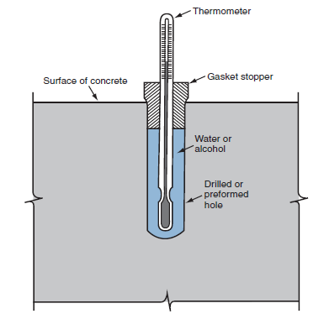
Monitoring Concrete Temperature
Notes:
Calibrated thermometers are needed to check the concrete temperatures as delivered, as placed, and as maintained. An inexpensive pocket thermometer is shown on the left. After the concrete has hardened, temperatures can be checked with special surface thermometers or with an ordinary thermometer that is kept covered with insulating blankets. A simple way to check temperature below the concrete surface is shown on the right. Instead of filling the hole with a fluid, it can be fitted with insulation. In that application the bulb would remain exposed.

Slide 16
Monitoring Concrete Temperature
Notes:
Concrete test cylinders must be maintained at a temperature between 16°C (60°F) and 27°C (80°F) at the jobsite for up to 48 hours until they are taken to a laboratory for. For concrete mixtures with a specified strength of 40 MPa (6,000 psi) or greater, the initial curing temperature shall be between 20°C and 26°C (68°F and 78°F). During this period, cylinders should be kept in a curing box and covered with a nonabsorptive, nonreactive plate or impervious plastic bag. The temperature in the box should be accurately controlled by a thermostat. Cylinders stripped of molds after the first 24±8 hours must be wrapped tightly in plastic bags or laboratory curing started immediately. When cylinders with strengths less than 40 MPa (6000 psi) are picked up for delivery to the laboratory, they must be maintained at a temperature of 16°C (60°F) to 27°C (80°F) until they are placed in the laboratory curing room. Cylinders with strengths of 40 MPa (6000 psi) or greater must be maintained at a temperature of 20°C (68°F) to 26°C (78°F). In addition to laboratory cured cylinders, it is useful to field cure some test cylinders in order to monitor actual jobsite curing conditions in cold weather. Differences in the surface to volume ratios between cylinders and the structure, in conjunction with differences in mass, make correlating field cured cylinder strengths to in-place strengths difficult. When placed on a formwork ledge just below a heated, suspended floor, possible high temperatures there will not duplicate the average temperature in the slab, or the lowest temperature on top of the slab. Still, field cured cylinders are more indicative of actual concrete strength than laboratory-cured cylinders. Particular care should be taken to protect compressive strength test cylinders from freezing; their small mass may not generate enough heat of hydration to protect them. Cast-in-place cylinders and nondestructive testing methods as well as maturity techniques are helpful in monitoring in place concrete strength.

Slide 17
Cold Weather Concreting on Ground
Different procedures than above ground:
Thaw ground
Use of heat of hydration for curing
Simpler insulation
Venting required for enclosure heaters
Hydronic heaters can be used
Notes:
Concreting on ground during cold weather involves some extra preparation. Placing concrete on the ground involves different procedures than those used at an upper level: (1) the ground must be thawed before placing concrete; (2) cement hydration will furnish some of the curing heat; (3) construction of enclosures is much simpler and use of insulating blankets may be sufficient; (4) in the case of a floor slab, a vented heater is required if the area is enclosed; and (5) hydronic heaters can be used without concern for carbonation. Once cast, footings should be backfilled as soon as possible with unfrozen fill. Concrete should never be placed on a frozen subgrade or backfilled with frozen fill. Once these frozen materials thaw, uneven settlements may occur and cause cracking. Concrete placement temperatures should not be higher than ACI 306 minimum values by more than 11°C (20°F) to reduce rapid moisture loss and the potential development of plastic shrinkage cracks. When the subgrade is frozen, the surface region can be thawed by (1) steaming; (2) spreading a layer of hot granular material where the grade elevations allow it; (3) removing and replacing with unfrozen fill; (4) covering the subgrade with insulation for a few days; or (5) using hydronic heaters under insulated blankets. Placing concrete for floor slabs and exposed footings should be delayed until the ground thaws and warms sufficiently to ensure that it will not freeze again during the protection and curing period. Slabs can be cast on ground at ambient temperatures as low as 2°C (35°F) as long as the minimum concrete temperature as placed is not less than ACI recommendations. Although surface temperatures need not be higher than a few degrees above freezing, they also should preferably not be more than 5°C (10°F) higher than the minimum placement temperature. Because of the risk of surface imperfections that might occur on exterior concrete placed in late fall and winter, many concrete contractors choose to delay concrete placement until spring.

Slide 18
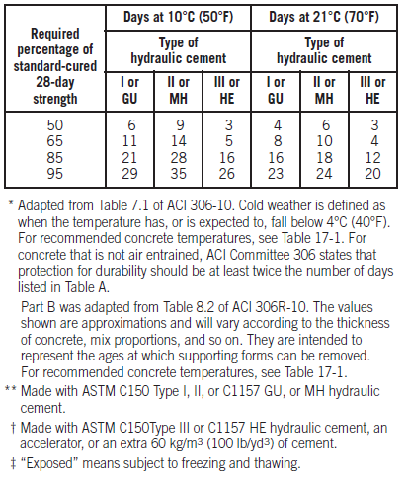
Concreting Above Ground
Notes:
Working above ground in cold weather usually involves several different approaches in comparison to work at ground level: 1. The concrete mixture may not need to be changed to generate more heat because portable heaters can be used to heat the undersides of floor and roof slabs. However, there are advantages to having a mix that will produce a high strength at an early age; for example, artificial heat can be cut off sooner, and forms can be recycled faster. 2. Enclosures must be constructed to retain the heat under floor and roof slabs. 3. Portable heaters used to warm the underside of formed concrete can be direct fired heating units (without venting). Before placing concrete, the heaters under a formed deck should be turned on to preheat the forms and melt any snow or ice remaining on top. Temperature requirements for surfaces in contact with fresh concrete are the same as those discussed on the previous slide. Metallic embedments at temperatures below the freezing point may result in local freezing that decreases the bond between concrete and steel reinforcement. ACI Committee 306 suggests that a reinforcing bar having a cross-sectional area of about 650 mm² (1 in.²) should have a temperature of at least -12°C (10°F) immediately before being surrounded by fresh concrete at a temperature of at least 13°C (55°F). Caution and additional study are required before definitive recommendations can be formulated. Good concrete placement practice suggests heating surfaces of formwork and large embedments to no more than 5°C (10°F) above and no less than 8°C (15°F) below the temperature of the concrete mixture. When concrete strength development is not determined, a conservative estimate can be made if adequate protection at the recommended temperature is provided for the duration of time found in these tables. However, the actual amount of insulation and length of the protection period should be determined from the monitored in place concrete temperature and the desired strength. A correlation between curing temperature, curing time, and compressive strength can be determined from laboratory testing of the particular concrete mixture used in the field

Slide 19
Notes:
When slab finishing is completed, insulating blankets or other insulation must be placed on top of the slab to ensure that proper curing temperatures are maintained. The insulation value (R) necessary to maintain the concrete surface temperature of walls and slabs above ground at 10°C (50°F) or above for 7 days may be estimated from Figure 17-16. To maintain a temperature for longer periods, more insulation is required. ACI 306 has additional graphs and tables for slabs placed on ground at a temperature of 2°C (35°F).

Slide 20
Notes:
Insulation can be selected based on R values provided by insulation manufacturers or by using the information in this table. Corners and edges are particularly vulnerable during cold weather. As a result, the thickness of insulation for these areas, especially on columns, should be about three times the thickness that is required for walls or slabs. On the other hand, if the ambient temperature rises much above the temperature assumed in selecting insulation values, the temperature of the concrete may become excessive. This increases the probability of thermal shock and cracking when forms are removed. Temperature readings of insulated concrete should therefore be taken at regular intervals and should not vary from ambient air temperatures by more than the values given in ACI 306. The maximum temperature differential between the concrete interior and the concrete surface should be about 20°C (35°F) to minimize cracking. The weather forecast should be checked and appropriate action taken for expected temperature changes. Columns and walls should not be cast on foundations at temperatures below 0°C (32°F) because chilling of concrete in the bottom of the column or wall will retard strength development.

Slide 21
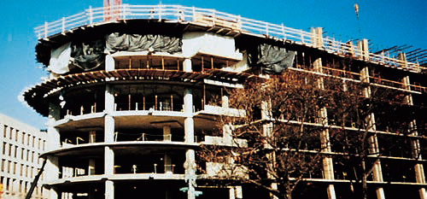
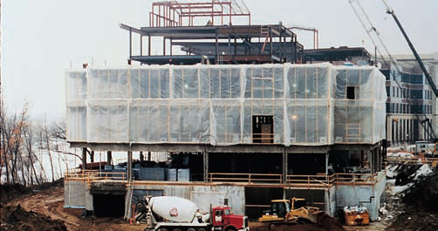
Enclosures
Notes:
Heated enclosures are very effective for protecting concrete in cold weather, but are expensive. Enclosures can be of wood, canvas tarpaulins, or polyethylene film. Prefabricated, rigid plastic enclosures are also available. Plastic enclosures that admit daylight are the most popular but temporary heat in these enclosures can prove expensive. When enclosures are being constructed below a deck, the framework can be extended above the deck to serve as a windbreak. Typically, a height of 2 m (6 ft) will protect concrete and construction personnel against biting winds that cause temperature drops and excessive evaporation. Wind breaks may be taller or shorter depending on anticipated wind velocities, ambient temperatures, relative humidity, and concrete placement temperatures. Enclosures can be quickly transported using flying forms; more often, though, they must be removed so that the wind will not interfere with maneuvering the forms into position. Similarly, enclosures can be built in large panels with the windbreak included; much like gang forms.

Slide 22
Insulating Materials
Notes:
Heat and moisture can be retained in the concrete by covering it with commercial insulating blankets or batt insulation. The effectiveness of insulation can be determined by placing a thermometer under it and in contact with the concrete. If the temperature falls below the minimum required, additional insulating material, or material with a higher R value, should be applied. Corners and edges of concrete are most vulnerable to freezing. In view of this, temperatures at these locations should be checked more often. For maximum efficiency, insulating materials should be kept dry and in close contact with concrete or formwork. Concrete pavements can be protected from cold weather by spreading 300 mm (1 ft) or more of dry straw or hay on the surface for insulation. Tarpaulins, polyethylene film, or waterproof paper should be used as a protective cover over the straw or hay to make the insulation more effective and prevent it from blowing away. The straw or hay should be kept dry or its insulation value will drop considerably. Insulating blankets for construction are made of fiberglass, sponge rubber, open cell polyurethane foam, vinyl foam, mineral wool, or cellulose fibers. The outer covers are made of canvas, woven polyethylene, or other tough fabrics that will withstand rough handling. The R value for a typical insulating blanket is about 1.2 m² • °C/W for 50 to 70 mm thickness, (7°F • hr • ft²)/Btu, but since R values are not marked on the blankets, their effectiveness should be checked with a thermometer. If necessary, they can be used in multiple layers to attain the desired insulation.

Slide 23
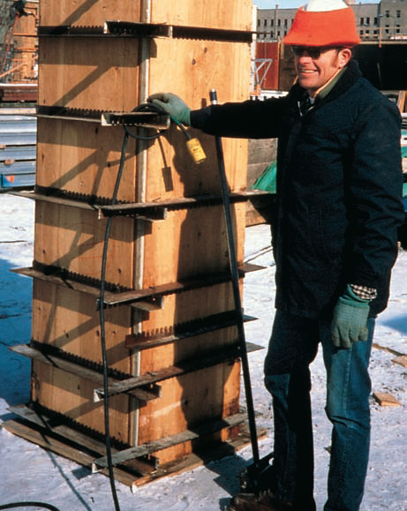
Insulating Concrete Forms
Notes:
Stay-in-place insulating concrete forms (ICF) became popular for cold-weather construction in the 1990s. ICFs (shown on the left) can be used to successfully place concrete in ambient temperatures as low as -29°C (-20°F). Forms built for repeated use often can be economically insulated with commercial blanket or batt insulation. The insulation should have a tough moisture proof covering to withstand handling abuse and exposure to the weather. Rigid insulation can also be used (shown on the right).

Slide 24
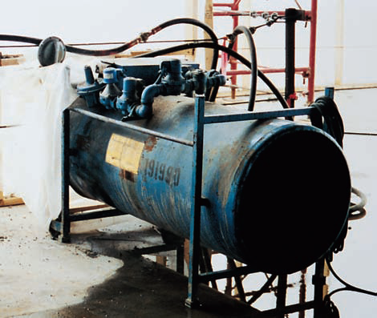
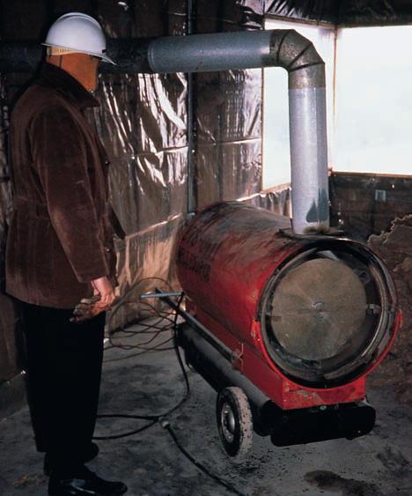
Heaters
Notes:
Three types of heaters are used in cold weather concrete construction: direct fired, indirect fired, and hydronic systems. Indirect fired heaters are vented to remove the products of combustion. Where heat is supplied to the top surface of fresh concrete vented heaters are required. Carbon dioxide (CO₂) in the exhaust must be vented to the outside and prevented from reacting with the fresh concrete (bottom). Direct fired units can be used to heat the enclosed space beneath concrete placed for a floor or a roof deck (right). Any heater burning a fossil fuel produces carbon dioxide (CO₂); this gas will combine with calcium hydroxide on the surface of fresh concrete to form a weak layer of calcium carbonate that interferes with cement hydration. The result is a soft, chalky surface that will dust under traffic. Depth and degree of carbonation depend on concentration of CO₂, curing temperature, humidity, porosity of the concrete, length of exposure, and method of curing. Direct-fired heaters, therefore, should not be permitted to heat the air over concreting operations-–at least until 24 hours have elapsed. In addition, the use of gasoline-powered construction equipment should be restricted in enclosures during that time. If unvented heaters are used, immediate wet curing or the use of a curing compound will minimize carbonation. Carbon monoxide (CO) is not usually a problem unless the heater is using recirculated air. A salamander is an inexpensive combustion heater without a fan that discharges its combustion products directly into the surrounding air; heating is accomplished by radiation from its metal casing. Salamanders are fueled by coke, oil, wood, or liquid propane. They are one form of a direct-fired heater. A primary disadvantage of salamanders is the high temperature of their metal casing; a definite fire hazard. Salamanders should be placed so that they will not overheat formwork or enclosure materials. When placed on floor slabs, they should be elevated to avoid scorching the concrete.

Slide 25
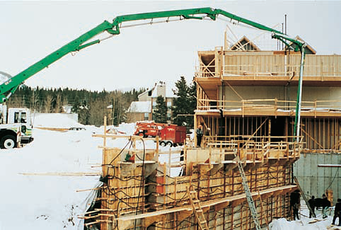
Hydronic Systems
Notes:
Hydronic systems transfer heat by circulating a glycol/water solution in a closed system of pipes or hoses. These systems transfer heat more efficiently than forced air systems without the negative effects of exhaust gases and drying of the concrete from air movement. The specific heat of water/glycol solutions is more than six times greater than air. As a result, hydronic heaters can deliver very large quantities of heat at low temperature differentials of 5°C (10°F) or less between the heat transfer hose and the concrete. Cracking and curling induced by temperature gradients within the concrete are nearly eliminated as is the danger of accidentally overheating the concrete and in potentially damaging long term strength gain. Typical applications for hydronic systems include thawing and preheating subgrades. They are also used to cure elevated and on-grade slabs, walls, foundations, and columns. To heat a concrete element, hydronic heating hoses are usually laid on or hung adjacent to the structure and covered with insulated blankets and sometimes plastic sheets. Usually, construction of temporary enclosures is not necessary. Hydronic systems can be used over areas much larger than would be practical to enclose. If a heated enclosure is necessary for other work, hydronic hoses can be sacrificed (left under a slab on grade) to make the slab a radiant heater for the structure built above.

Slide 26
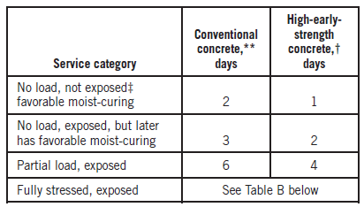
Notes:
After concrete is in place, it should be protected and kept at the recommended temperatures listed on Line 4 of the table on top. These curing temperatures should be maintained until sufficient strength is gained to withstand exposure to low temperatures, anticipated environment, and construction and service loads. The length of protection required to accomplish this will depend on the cement type and amount, whether accelerating admixtures were used, and the loads that must be carried. Recommended minimum periods of protection are given in the tables on the bottom. The duration of heating structural concrete requiring full service loading before forms and shores are removed should be based on the adequacy of in-place compressive strengths rather than an arbitrary time period. If no data are available, a conservative estimate of the length of time for heating and protection can be made using the bottom tables. Concrete retained in forms or covered with insulation seldom loses enough moisture at 5°C to 13°C (40°F to 55°F) to impair curing. However, a positive means of providing moist curing is needed to offset drying from low wintertime humidity and from the dry air produced by heaters used in enclosures during cold weather. Live steam exhausted into an enclosure around the concrete is an excellent method of curing because it provides both heat and moisture. Liquid membrane forming compounds can be used for early curing of concrete surfaces within heated enclosures. Rapid cooling of concrete at the end of the heating period should be avoided. Sudden cooling of the concrete surface while the interior is still warm may cause thermal cracking, especially in massive sections such as bridge piers, abutments, dams, and large structural members; thus cooling should be gradual. A safe temperature differential between a concrete wall and the ambient air temperature can be obtained from ACI 306. Gradual cooling can be accomplished by lowering the heat or by simply shutting off the heat and allowing the heat to dissipate.

Slide 27
Form Removal and Reshoring
Notes:
It is good practice in cold weather to leave forms in place as long as possible. Even within heated enclosures, forms serve to distribute heat more evenly and help prevent drying and local overheating. If the curing temperatures listed on Line 4 of the top table are maintained, the bottom left table can be used to determine the minimum time in days that vertical support for forms should remain in place. Before shores and forms are removed, fully stressed structural concrete should be tested to determine if in-place strengths are adequate. In-place strengths can be monitored using one of the following: (1) field-cured cylinders; (2) probe penetration tests; (3) cast-in-place cylinders; (4) pullout testing; or (5) maturity testing. Many of these tests are indirect methods of measuring compressive strength; they require correlation in advance with standard cylinders before estimates of in-place strengths can be made. If in-place compressive strengths are not documented, the bottom right table lists conservative time periods in days to achieve various percentages of the standard laboratory cured 28-day strength. The engineer issuing project drawings and specifications in cooperation with the formwork contractor must determine what percentage of the design strength is required. Vertical forms can be removed sooner than shoring and temporary falsework.

Slide 28
Maturity Concept
Notes:
The maturity concept is based on the principle that strength gain in concrete is a function of curing time and temperature. The maturity concept, as described in ACI 306R and ASTM C1074 can be used to evaluate strength development. Two maturity methods to estimate the in-place concrete strength are shown here. The first method is based on the Nurse-Saul function, also called Time-Temperature Factor method. This method is simple and very popular. However, it fails to recognize the fact that maturity increases disproportionately at elevated temperatures and that this increase depends on the type(s) of cementitious materials used and the water-to-cementitious materials ratio. Therefore, the Time-Temperature Factor method typically underestimates the strength development at elevated temperatures. The “Equivalent Age” maturity function is based on the Arrhenius equation;
this function presents maturity in terms of equivalent age of curing at a specified temperature. The Time-Temperature Factor method presents maturity
in terms of °C•hr. Most maturity equipment uses a datum temperature of 0°C, which further simplifies the calculation. Given this simplification, maturity is typically calculated using metric units.

Slide 29
Maturity Method
Notes:
To monitor the strength development of concrete in place using the maturity concept, the following information must be available:
The strength-maturity relationship of the concrete used in the structure. The results of compressive strength tests at various ages on a series of cylinders made of a concrete similar to that used in the structure; this must be done to develop a strength-maturity curve. These cylinders are cured in a laboratory at 23°C ± 2°C (73°F ± 3°F).
A time-temperature record of the concrete in place. Temperature readings are obtained by placing expendable thermistors or thermocouples at varying depths in the concrete. The location giving the lowest values provides the series of temperature readings to be used in the computation.

Slide 30
Maturity Method
Notes:
This graph shows an example using the maturity concept. Before construction begins, a calibration curve is drawn plotting the relationship between compressive strength and the maturity factor for a series of test cylinders (of the particular concrete mixture proportions) cured in a laboratory and tested for strength at successive ages. The maturity concept is imprecise and somewhat limited. However, the concept is useful in checking the curing of concrete and in estimating strength in relation to time and temperature. It presumes that all other factors affecting concrete strength have been properly controlled. With these limitations in mind, the maturity method has gained greater acceptance as a surrogate for measuring the compressive strength of the concrete for removal of shoring or opening a pavement to traffic. It is no substitute for quality control and proper concreting practices.

Slide 31
Summary
Effect of Cold Weather
Adjusting Concrete Mixtures
Concreting Process
Curing
Maturity Concept
Notes:
This presentation discussed concreting in cold weather conditions. The discussion began with the effects of cold weather on concrete and followed with various options available in mix design to counteract cold weather. Then, the concreting process was covered, with specific emphasis on the part of curing that is maintaining suitable temperature. The presentation wrapped up with a discussion of the maturity concept.

Slide 32
Questions
?

