Slide 1
Sustainability
Design and Control of Concrete Mixtures – Chapter 2
Notes:
Design and Control of Concrete Mixtures, 15th edition, Chapter 2 – Sustainability

Slide 2
Overview
Introduction to Sustainability
Ratings Systems
Concrete Sustainability
Life-Cycle Analysis
Notes:
This chapter will provide an introduction to sustainable development and concrete’s role in sustainability.

Slide 3
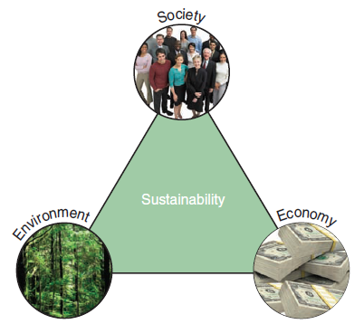
What is Sustainability?
“Meeting the needs of the present generation without compromising the ability of future generations to meet their needs.”
Notes:
In the pioneering report of the World Commission on Environment and Development, Our Common Future, sustainable development is defined as “meeting the needs of the present generation without compromising the ability of future generations to meet their needs.” Embedded in the concept of sustainability is a balance of social, economic, and environmental principles.

Slide 4
Sustainability Aspects
Energy conservation and atmosphere
Water management and resources
Site selection and development
Indoor environmental quality
Material quality and resources
Functional resilience
Notes:
The leading nationally recognized sustainability programs focus primarily on energy conservation and atmosphere, water management and resources, site selection and development, indoor environmental quality, and material quality and resources. Another factor that increasingly coming into play is functional resilience, or the ability of a structure to serve the original purpose and be adapted for future use.

Slide 5
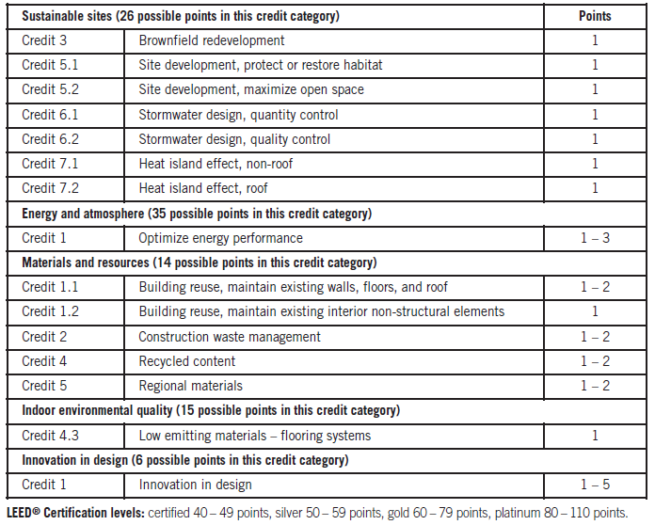
Ratings Systems
Notes:
Several organizations have developed ratings systems that attempt to quantify improvements in green performance. For example, concrete use can contribute to credit in fifteen categories in the United States Green Building Council’s Leadership in Energy and Environmental Design for New Construction and Major Renovations 2009 (LEED 2009) .

Slide 6
Concrete Sustainability
Durability
Safety
Disaster Resistance
Energy Performance
Indoor Air Quality
Acoustics
Stormwater Management
Site Remediation
Recycling
Locally Produced
Carbon Dioxide Sink
Concrete Ingredients and Sustainability
Notes:
The principles of sustainable development are easily incorporated in the design and proportioning of concrete mixtures and exhibited readily through applications in service.

Slide 7
Durability
Ability to resist weathering action, chemical attack, and abrasion while maintaining desired engineering properties
Longevity
  Pantheon in Rome (AD 125)
Notes:
Durability is one of the most important contributions to sustainable development. This translates directly to longevity of the structure. A structure that satisfies the needs of several generations is considered sustainable development.

Slide 8
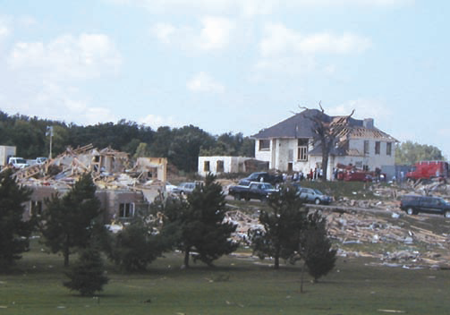
Disaster Resistance
Tornado, Hurricane, and Wind Resistance
Fire Resistance
Earthquake Resistance
Blast Resistance
Notes:
Properly designed reinforced concrete is resistant to storms, floods, fire, and earthquakes. These structures can also provide blast protection for occupants. The concrete home shown still standing survived a tornado in Wisconsin.

Slide 9
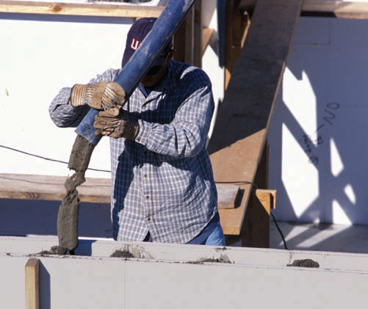
Energy Performance
Thermal Mass
Fuel Consumption
Heat-Island Reduction
Lighting Efficiency
Notes:
Concrete can enhance overall energy performance in several applications including thermal mass, fuel consumption, heat-island reduction, and lighting efficiency. Insulating concrete forms (shown) provide thermal mass and high levels of insulation, key components for net-zero energy use
buildings.

Slide 10
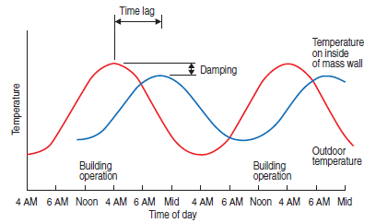
Thermal Mass
(CAC 2007).
Notes:
One of the key aspects of thermal mass is it can shift energy demand to off-peak time periods as shown in this plot.

Slide 11
Fuel Consumption
1% to 11% improvement for heavy trucks
3% to 17% improvement for smaller vehicles
Notes:
Studies demonstrate the lower fuel consumption for vehicles traveling on concrete pavements. Current research shows an increase between one and eleven percent for heavy trucks and three to seventeen percent for smaller vehicles.

Slide 12
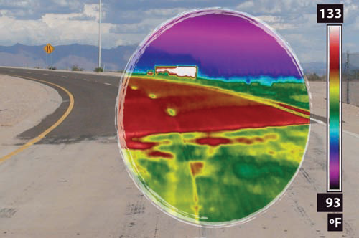
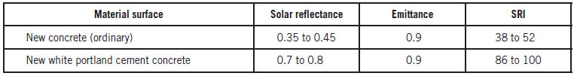
Heat-Island Reduction
(Berdahl and Bretz 1994; Pomerantz, Pon, and Akbari 2000; Levinson and Akbari 2001; and Pomerantz and others 2002)
Notes:
Light-colored concrete materials have higher solar reflectance, also called albedo, which reduces the heat-island effect. The picture here shows a thermal image of a pavement transition in Mesa, Arizona. Note the temperature difference between the concrete pavement and the asphalt pavement. The SRI of new concrete greatly exceeds the threshold value of 29 for most green building standards and rating systems.

Slide 13

Indoor Air Quality
Notes:
Concrete contains low to negligible amounts of volatile organic compounds. Decorative concrete flooring created using a sandblast
stencil technique eliminates the need for carpeting or other flooring materials that can impair indoor air quality.

Slide 14
Acoustics
STC of 44 to 58 plain
STC up to 63 dressed
Highway sound barriers
Textured pavement
Notes:
Concrete can provide excellent acoustical control. The STC value is roughly the number of decibels that sound is reduced going through the wall. As cast, unfinished concrete has an STC ranging from 44 to 58. If the wall is then dressed with furring, insulation, and wallboard, the value jumps to as high as 63. In addition to building acoustics, concrete is used as highway sound barriers and many methods have been developed to produce quiet concrete pavements.

Slide 15
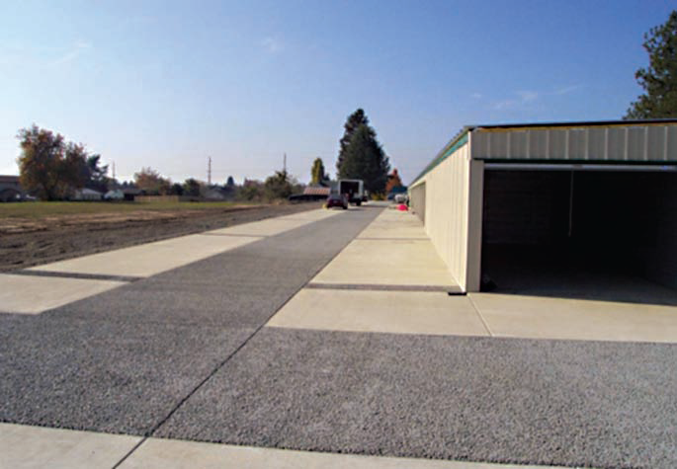
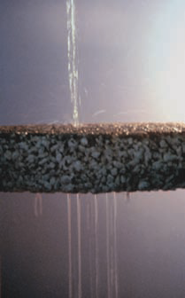
Stormwater Management
Notes:
Pervious concrete allows for infiltration of water, reducing runoff from the site. The image on the right shows a side view of water percolating
through pervious concrete.

Slide 16
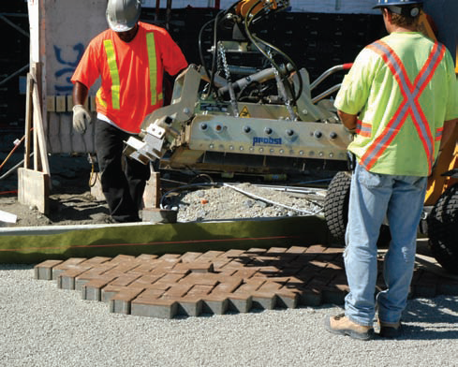
Permeable Grid Paver Systems
Notes:
An alternative to pervious concrete is a permeable grid paver system. Interlocking concrete pavers allow water to infiltrate between the units.

Slide 17
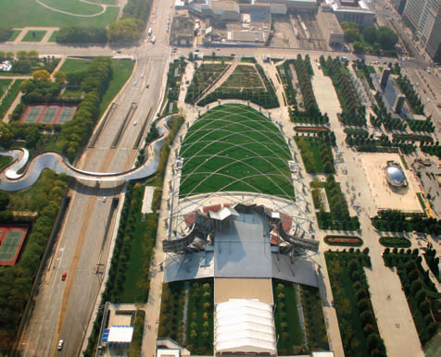
Green Roofs
Notes:
Green roofs can be made to support small plants and shrubs or built to support much larger vegetation. The image shows Chicago’s Millennium Park, which is an extensive green roof covering a commuter rail station and two parking garages.

Slide 18
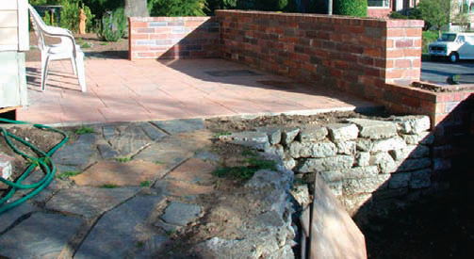
Rainwater Catchment Systems
Notes:
Concrete cisterns collect rainfall and store it for later use in non-potable applications such as toilet flushing and irrigation. Treatment systems can purify the rainwater suitable for drinking, bathing, and other potable uses.

Slide 19
Site Remediation
Brownfields
Solidification/stabilization
Radioactive waste
Notes:
Cement-based solidification/stabilization treatment is well suited for remediation of brownfields and has been successfully implemented in a number of brownfield sites.

Slide 20
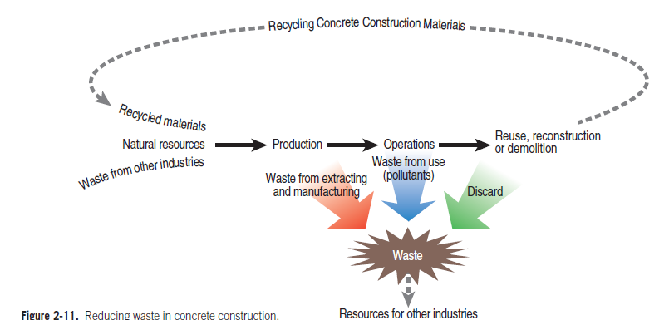
Recycling
Notes:
Many concrete materials can be recycled after initial use.

Slide 21
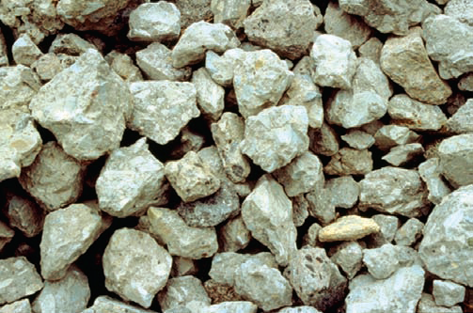
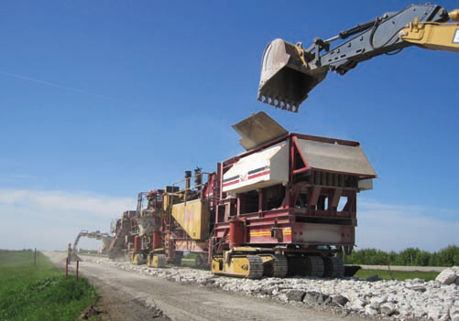
Recycled Concrete Aggregate
Notes:
Concrete from demolished structures can be recycled and is commonly reused as fill or road base. Paving trains can recycle existing concrete pavement. The crushed concrete can be used as aggregate in new concrete or as base material.

Slide 22
Recycled Materials
Post-consumer
  Crushed concrete and masonry
Pre-consumer (industrial by-products)
  Fly ash, slag cement, silica fume
  Air-cooled slag aggregate
  Alternative fuels
Notes:
Many concrete structures already incorporate one or more forms of pre-consumer recycled materials in the form of industrial by-products. Also, many cement plants utilize industrial wastes and discarded tires as alternative fuels for the kiln.

Slide 23
Locally Produced
Abundant raw materials
Usually manufactured within 500 km (300 miles)
Ready mixed concrete within 150 km (100 miles)
Precast concrete within 300 km (200 miles)
Notes:
Most of the components of concrete are manufactured within 500 km or 300 miles of a concrete plant. Most ready mixed concrete plants will be within 150 km or 100 miles of the project site. These short distances minimize fuel requirements and associated energy and emissions from transporting and handling.

Slide 24
Carbon Dioxide Sink
Concrete absorbs carbon dioxide - carbonation
Higher surface area increases absorption
Over 100 years, 57% of calcination is absorbed
Notes:
During the life of a concrete structure, the concrete absorbs carbon dioxide in a process called carbonation. This may be viewed as a loop in the carbon cycle as it reabsorbs much of the carbon dioxide that was released during the calcination of limestone in the cement manufacturing process.

Slide 25
Concrete Ingredients and Sustainability
Cement – 7-15% of concrete material
  Recycled raw materials
  Alternate fuels
  Supplementary cementitious material
Aggregate – 60-75% of concrete material
  Recycled concrete aggregate
  Air-cooled slag
Notes:
A key benefit of concrete is the ability to modify the concrete constituents and proportions to best meet the sustainability goals of a particular application. Two examples are cement and aggregate. Both of these ingredients can utilize recycled materials.

Slide 26
Life-Cycle Analysis
Life-Cycle Cost Analysis
Notes:
Life-cycle analysis is a tool used to select building materials and influence design choices. A life-cycle cost analysis is the practice of accounting for all expenditures incurred over the service life of a particular structure.

Slide 27
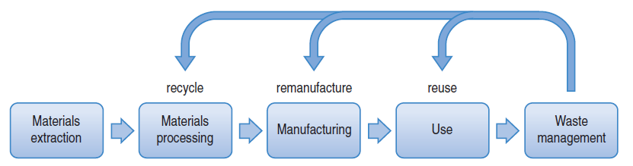
Life Cycle Assessment and Inventory
Notes:
A life-cycle assessment, or LCA, is an environmental assessment of the life-cycle of a product or process. A life cycle inventory, or LCI, is the first portion of an LCA. It includes all of the materials and energy inputs as well as any emissions to air, water and land from the various stages shown in this graphic.

Slide 28
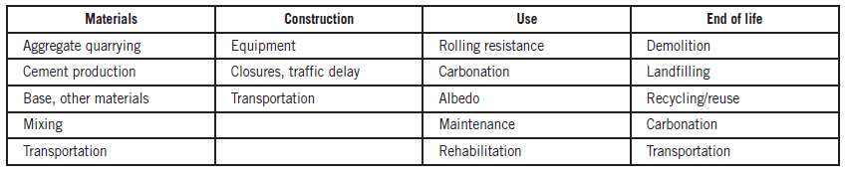
LCA - Pavements
Notes:
An LCA provides a consistent methodology applied across all products and at all stages of their production, transport, use, and recycling at end of life or disposal. This table demonstrates the life cycle phases and components for concrete pavements.

Slide 29
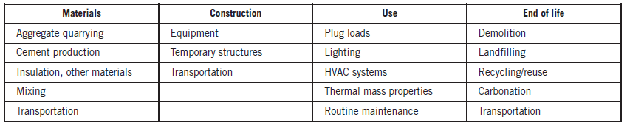
LCA - Buildings
Notes:
This table demonstrates the life cycle phases and components for concrete buildings.

Slide 30
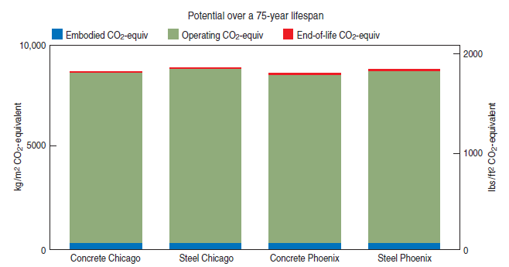
LCA at the MIT Concrete Sustainability Hub
Notes:
At the Massachusetts Institute of Technology Concrete Sustainability Hub, a team of professors, researchers, and students are using LCA to evaluate and improve the environmental performance of buildings and pavements. Preliminary analyses from MIT indicate that the operation components of the infrastructure---primarily heating and cooling systems for buildings and rolling resistance for pavements---hold the most potential for large-scale improvement.

Slide 31
Summary
Introduction to Sustainability
Ratings Systems
Concrete Sustainability
Life-Cycle Analysis
Notes:
In summary, this chapter provided a brief introduction to the principles of sustainability and sustainable development and briefly touched upon the sustainable development rating systems that are used today. It covered in brief detail a variety of ways in which concrete passively and actively is involved in sustainable development and then closed out with a discussion of life-cycle analysis.

Slide 32
Questions
?

