Slide 1
Mixing Water for Concrete
Design and Control of Concrete Mixtures – Chapter 5

Slide 2
Overview
Standards
Sources
Effects of Impurities
Interactions with Admixtures
Notes:
In this module, we will discuss the standards for mixing water for concrete and the sources from which we obtain mixing water. We will then go through a summary of the most common impurities and their effects on concrete. We will end the discussion with a brief mention of the interactions between mixing water with impurities and chemical admixtures.

Slide 3
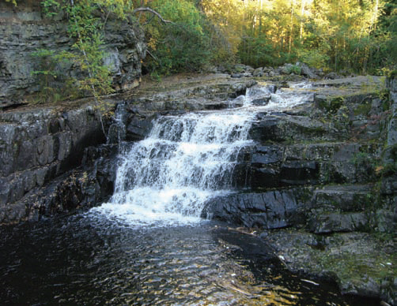
Water
Notes:
Water is a key ingredient in concrete, that when mixed with portland cement, forms a paste that binds the aggregates together. Water causes the hardening of concrete through hydration. Hydration is a chemical reaction between cement and water to form cementitious hydration products. Water needs to be of suitable quality for use in concrete as to not adversely impact the potential properties of concrete. Almost any water that is drinkable and has no pronounced taste or odor, also known as potable water, can be used as mixing water in concrete.

Slide 4
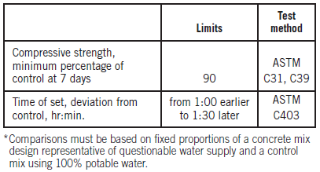
ASTM C1602
Notes:
Many waters that are not fit for drinking are suitable for use in concrete. Acceptance criteria for water to be used in concrete are given in ASTM C1602. Potable water can be used in concrete without any testing or qualification. Water of questionable suitability, including non-potable water or water from concrete production operations, can be used in concrete if it is qualified for use by requirements shown in this table. The requirements evaluate the impact of the questionable water on strength and setting time of concrete---performance characteristics.

Slide 5
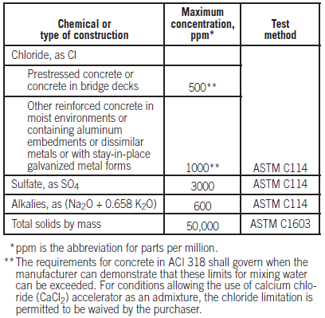
ASTM C1602
Notes:
ASTM C1602 includes optional limits, shown here, for limits on the chemistry and total solids content by mass in the combined mixing water. Optional limits have to be invoked in project specifications or in purchase orders. The concrete supplier is required to maintain documentation
on these characteristics. ASTMC1602 also establishes minimum testing frequencies to qualify mixing water in conformance with the
requirements. More frequent testing is required when water has a higher concentration of solids (higher density).

Slide 6
Sources of Mixing Water
Municipal water supply
Municipal reclaimed water supply
Site-sourced water
Water from concrete operations
Other sources
Notes:
When considering water quality in concrete production, it is important to account for all sources of water in the mixture. By far, the greatest volume of mixing water in concrete is from batch water which may be from either a municipal water supply, a municipal reclaimed water
supply, site-sourced water, or water from concrete production operations. Other sources of batch water include free moisture on aggregates, ice, jobsite addition by the truck operator, and liquid chemical admixtures.

Slide 7
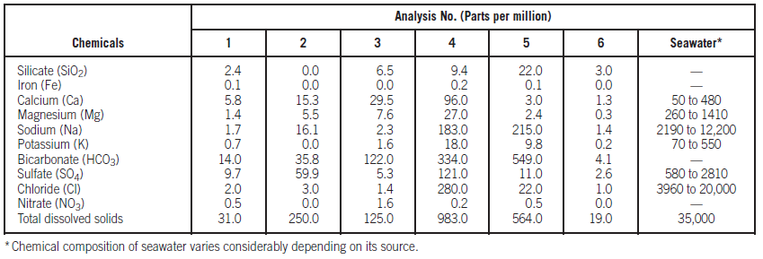
Municipal Water Supply
Notes:
Municipal water supply systems get their water from a variety of locations including; aquifers, lakes and rivers, and the sea through desalination. Six typical analyses of city water supplies and seawater are shown in in this table. These waters approximate the composition of domestic water
supplies for most of the cities over 20,000 population in the United States and Canada. Water from any of these sources is suitable for use in concrete.

Slide 8
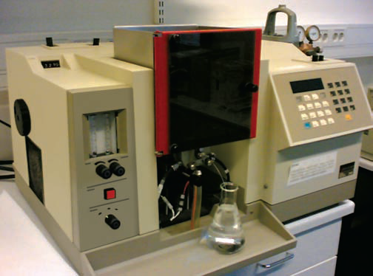
Municipal Water Supply
Notes:
An atomic absorption spectrophotometer, shown here, can be used to detect concentration of elements in the laboratory analysis of water. Municipal water is purified, disinfected through chlorination, and sometimes fluoridated, prior to use as drinking water.

Slide 9
Municipal Reclaimed Water
Treated wastewater
Used for nonpotable applications
Notes:
Reclaimed water is wastewater treated to remove solids and certain impurities. It is typically used for nonpotable applications uses such as irrigation, dust control, fire suppression, concrete production, and construction.

Slide 10
Site-Sourced Water
Paving projects, remote sites
Wells, ponds, rivers
May contain: silt, organic impurities
Notes:
Many large concrete paving projects and remote construction sites use site source water either from shallow wells, ponds, or rivers. These natural sources of water are typically not a concern. When they contain significant amounts of suspended particles such as silt and contain organic impurities and algae, additional testing is warranted.

Slide 11
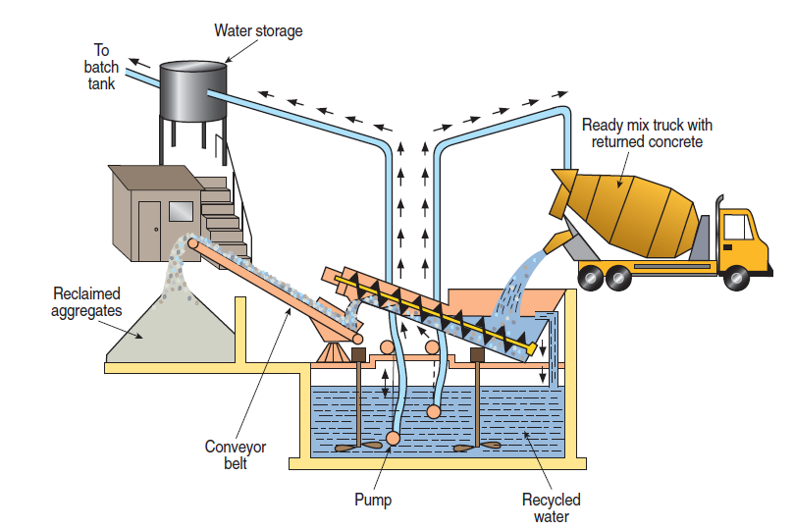
Recycled Water
(Water from Concrete Production)
Notes:
Recycled water from concrete production is primarily a mixture of: water, partially or completely hydrated cementitious materials, and aggregate fines resulting from processing returned concrete. Recycled water and can include truck wash water, and stormwater at the concrete plant. Most
of this water is recirculated to keep equipment clean. However, at some point, management of process water and stormwater is required for permit compliance. Given the strict regulations on discharge of water from concrete plants, the industry must look at recycling some of the
process and stormwater generated at ready mixed concrete plants. In most situations, the recycled water is passed through settling ponds where the solids settle out, leaving clarified water, as shown here. In some cases, the recycled water from a reclaimer unit is continually agitated to maintain the solids in suspension for reuse as a portion of the batch water in concrete.

Slide 12
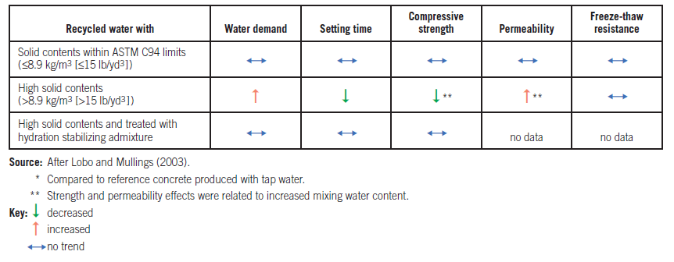
Recycled Water
Notes:
Solid contents exceeding 9 kilograms per cubic meter, or 15 pounds per cubic yard, may adversely impact the properties of concrete through:
increased water demand, accelerated setting time, lower compressive strength, and higher permeability due to increased water demand and associated higher w/cm.

Slide 13
Seawater
Useable in plain, unreinforced concrete
Use sulfate-resistant cement for marine applications
May aggravate ASR
May cause efflorescence and dampness
Notes:
Seawater containing up to 35,000 parts per million of dissolved salts is generally suitable as mixing water for concrete not containing reinforcing steel. Seawater is not suitable for use in production of concrete with steel reinforcement and likewise, it should not be used in prestressed concrete due to the risk of corrosion of the reinforcement. If seawater is used in plain concrete for marine applications moderate sulfate
resistant cements, Types II or MS, should be used along with a low water-cement ratio. Seawater should not be used as mix water for concrete with potentially alkali-silica reactive aggregates. Seawater used for mixing water also tends to cause efflorescence and dampness on concrete surfaces exposed to air and water.

Slide 14
Effects of Impurities
Alkali carbonate and bicarbonate
Chloride
Sulfate
Miscellaneous inorganic salts
Acid and alkaline waters
Industrial wastewater
Silt or suspended particles
Organic impurities
Notes:
Excessive impurities in mixing water not only may affect setting time and concrete strength, but also may cause efflorescence, staining, corrosion of reinforcement, volume instability, and reduced durability. Some impurities may have little effect on strength and setting time, yet adversely
affect durability and other properties. The following slides contain a synopsis of the effects of certain impurities in mixing water on the quality of normal concrete.

Slide 15
Alkali Carbonate and Bicarbonate
Sodium carbonate – rapid setting
Bicarbonates – accelerate or retard setting
Threshold for testing – 1000 ppm
May aggravate AAR
Notes:
Carbonates and bicarbonates of sodium and potassium have varying effects on the setting times of different cements. Sodium carbonate can cause very rapid setting, bicarbonates can either accelerate or retard the set depending on the chemistry of the cement used in the concrete. In large concentrations, these salts can materially reduce concrete strength. When the sum of the dissolved salts exceeds 1000 ppm, tests for their effect on setting time and 28-day strength should be made. The possibility of aggravated alkali-aggregate reactions should also be considered.

Slide 16
Chloride
ACI 318 Limits:
  Prestressed concrete---0.06%
  Reinforced concrete exposed to chloride in service---0.15%
  Reinforced concrete that will be dry or protected from moisture in service---1.00%
  Other reinforced concrete construction---0.30%
Notes:
Concern over a high chloride content in mixing water is chiefly due to the possible adverse effect of chloride ions on the corrosion of reinforcing steel or prestressing strands. The acid-soluble chloride ion level at which steel reinforcement corrosion begins in concrete is about 0.2% to 0.4% by mass of cement. Placing an acceptable limit on chloride content for any one ingredient, such as mixing water, is problematic considering the variety of sources of chloride ions in concrete. An acceptable limit in the concrete depends primarily upon the type of structure and the environment to which it is exposed during its service life. Concentrations of 20,000 ppm of sodium chloride are generally tolerable in concrete that will be dry in service and has low potential for corrosive reactions. The ACI 318 building code and CSA Standard A23.1 limit water soluble chloride ion content in reinforced concrete to the following percentages by mass of cement: prestressed concrete---0.06%, reinforced concrete exposed to chloride in service---0.15%, reinforced concrete that will be dry or protected from moisture in service---1.00%, other reinforced concrete construction---0.30%.

Slide 17
Sulfate
May aggravate sulfate attack
ASTM C1602 limits sulfate to 3000 ppm
Notes:
Concern over a high sulfate content in mix water is due to possible expansive reactions and deterioration by sulfate attack. Although mixing waters containing 10,000 ppm of sodium sulfate have been used satisfactorily, the limit in ASTM C1602, 3000 ppm, should be considered
unless special precautions in the composition of the concrete mixture are taken.

Slide 18
Miscellaneous Inorganic Salts
Manganese, tin, zinc, copper, lead – strength reduction, setting time fluctuation
Sodium iodate, phosphate, arsenate, borate – retard setting
Tolerated up to 500 ppm
Sodium sulfide – 100 ppm can be detrimental
Notes:
Salts of manganese, tin, zinc, copper, and lead in mixing water can cause a significant reduction in strength and large variations in setting time. Of these, salts of zinc, copper, and lead are the most active. Salts that are especially active as retarders include sodium iodate, sodium phosphate, sodium arsenate, and sodium borate. Generally, concentrations of these salts up to 500 ppm can be tolerated in mixing water. Another salt that may be detrimental to concrete is sodium sulfide; even the presence of 100 ppm warrants testing.

Slide 19
Acid and Alkaline Waters
Acceptance based on concentration
Acids may cause handling problems
High concentrations of alkaline waters may reduce strength
Alkaline waters may aggravate AAR
Notes:
Acceptance of acid mixing water should be based on the concentration (in parts per million) of acids in the water. Generally, mixing waters containing hydrochloric, sulfuric, and other common inorganic acids in concentrations as high as 10,000 ppm have no adverse effect on
strength. Acid waters with pH values less than 3.0 may create handling problems and should be avoided if possible. Waters with sodium hydroxide concentrations of 0.5% by mass of cement do not greatly affect concrete strength provided quick set is not induced. Higher concentrations,
however, may reduce concrete strength. Potassium hydroxide in concentrations up to 1.2% by mass of cement has little effect on the concrete strength developed by some cements, but the same concentration when used with other cements may substantially reduce the 28-day strength.
The possibility for increased alkali-aggregate reactivity should be considered.

Slide 20
Industrial Wastewater
Most sources < 4000 ppm
Strength reduction usually 10%-15%
Certain industries produce undesirable impurities
Best to test if solids > 100 ppm
Notes:
Most waters carrying industrial wastes have less than 4000 ppm of total solids. When such water is used as mixing water in concrete, the reduction in compressive strength is generally not greater than 10%-15%.Wastewaters such as those from tanneries, paint factories, coke plants, and chemical and galvanizing plants may contain harmful impurities. It is best to test any wastewater that contains even a few hundred parts per million of unusual solids.

Slide 21
Silt or Suspended Particles
Suspended clay or fine rock < 2000 ppm
Cement fines < 50,000 ppm
Notes:
About 2000 ppm of suspended clay or fine rock particles can be tolerated in mixing water. Higher amounts might not affect strength but may influence other properties of some concrete mixtures. When cement fines are returned to the concrete in reused wash water, 50,000 ppm can be tolerated.

Slide 22
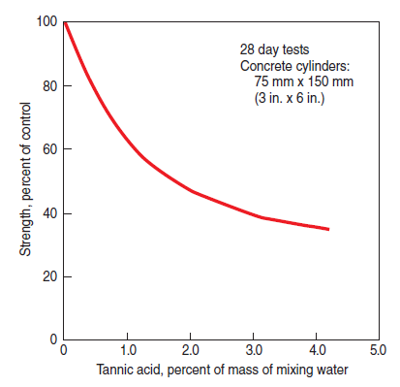
Organic Impurities
Notes:
The effect of organic substances on the setting time of portland cement or the ultimate strength of concrete is a problem of considerable complexity. Such substances, like surface loams, can be found in natural waters. Organic impurities are often of a humus nature containing
tannates or tannic acid. The effect of tannic acid on concrete strength is shown in this graph.

Slide 23
Organic Impurities
Sanitary sewage
  Little effect with diluted sewage
Sugar
  Retarder in small doses, accelerator in large doses
Oils
  Decreased strength, affects air
Algae
  Decreased strength
Notes:
A typical sewage may contain about 400 ppm of organic matter. After the sewage is diluted in a good disposal system, the concentration is reduced to about 20 ppm or less. This amount is too low to have any significant effect on concrete strength. Small amounts of sucrose usually retard the setting of cement. The upper limit of this range varies with different cements. The 7-day strength may be reduced while the 28-day
strength may be improved. Sugar in quantities of 0.25% or more by mass of cement may cause rapid setting and a substantial reduction in 28-day strength. Mineral oil not mixed with animal or vegetable oils may have less effect on strength development than other oils. However, mineral oil in concentrations greater than 2.5% by mass of cement may reduce strength by more than 20%. Oils may interfere with the action of air-entraining admixtures. Water containing algae is unsuitable for concrete because the algae can cause an excessive reduction in strength.
Algae in water leads to lower strengths either by influencing cement hydration or by causing a large amount of air to be entrained in the concrete. Algae may also be present on aggregates, in which case the bond between the aggregate and cement paste is reduced. A maximum algae content of 1000 ppm is recommended.

Slide 24
Interaction with Admixtures
Impurities affect admixture chemistry
Hard water may cause increased need for air-entraining admixture
Trial mixtures should include chemical admixtures
Notes:
When evaluating a water source for its effect on concrete properties, it is important to also test the water with chemical admixtures that will be used in the concrete mixture. Certain compounds in water can influence the performance and efficiency of certain admixtures. For example,
the dosage of air-entraining admixture may need to be increased when used with hard waters containing high concentrations of certain compounds or minerals.

Slide 25
Summary
Standards
Sources
Effects of Impurities
Interactions with Admixtures
Notes:
In summary, we discussed the standards for mixing water for concrete and the sources from which we obtain mixing water. We then went through a summary of the most common impurities and their effects on concrete. We ended the discussion with a brief mention of the interactions between mixing water with impurities and chemical admixtures.

Slide 26
Questions
?

