Slide 1
Chemical Admixtures for Concrete
Design and Control of Concrete Mixtures – Chapter 7

Slide 2
Overview
Air-entraining admixtures
Water-reducing admixtures
Set retarding admixtures
Set accelerating admixtures
Hydration-control admixtures
Workability-retaining admixtures
Corrosion inhibitors
Shrinkage-reducing admixtures
Permeability reducing admixtures
Alkali-aggregate reactivity inhibitors
Coloring admixtures
Pumping Aids
Bonding admixtures and agents
Grouting admixtures
Gas-forming admixtures
Air-detrainers
Fungicidal, germicidal, and insecticidal admixtures
Viscosity modifying admixtures
Admixture compatibility
Storing and dispensing chemical admixtures
Notes:
In this presentation, we will cover a variety of chemical admixtures, including air-entraining, water-reducing, set-controlling, and other admixtures. We will end the discussion with admixture compatibility and an overview of storing and dispensing of chemical admixtures.

Slide 3
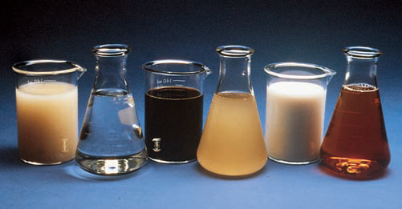
Chemical Admixtures
Notes:
Chemical admixtures are those ingredients in concrete other than hydraulic cement, supplementary cementitious materials, water, aggregates, and fiber reinforcement that are added to the mixture immediately before or during mixing. There are a variety of chemical admixtures available for use in concrete mixtures to modify fresh and hardened concrete properties. The major reasons for using chemical admixtures in concrete mixtures are to achieve certain properties in concrete more effectively than by other means; to maintain the quality of concrete during the stages
of mixing, transporting, placing, finishing, and curing; to overcome certain emergencies during concreting operations; and economy. Despite these considerations, no admixture of any type or amount is a substitute for good concreting practice.

Slide 4
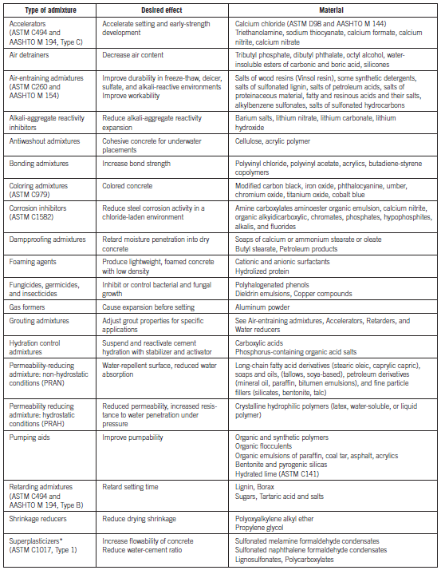
Chemical Admixtures
Notes:
Chemical admixtures considered for use in concrete should meet applicable specifications as presented in this table and on the next slide. Chemical admixtures can be classified by function as follows air-entraining; normal, mid-range, and high-range water-reducing; set accelerating; set retarding; hydration-control; rheology modifying; corrosion inhibitors; shrinkage reducers; permeability reducing admixtures; alkali-silica reactivity inhibitors; coloring admixtures; and miscellaneous admixtures such as workability, bonding, grouting, gas-forming, anti-washout, foaming, and pumping admixtures.

Slide 5
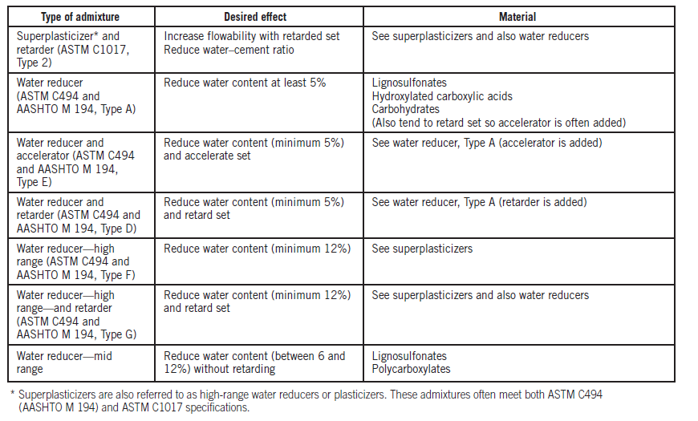
Chemical Admixtures
Notes:
Trial mixtures should be made with the admixture and the other concrete ingredients at the temperature and relative humidity anticipated during placement. Then, observations can be made on the compatibility of the admixture with other ingredients, as well as its effects on the properties of the fresh and hardened concrete. The amount of admixture recommended by the manufacturer should be used, or the optimum dosage should be verified by laboratory testing.

Slide 6
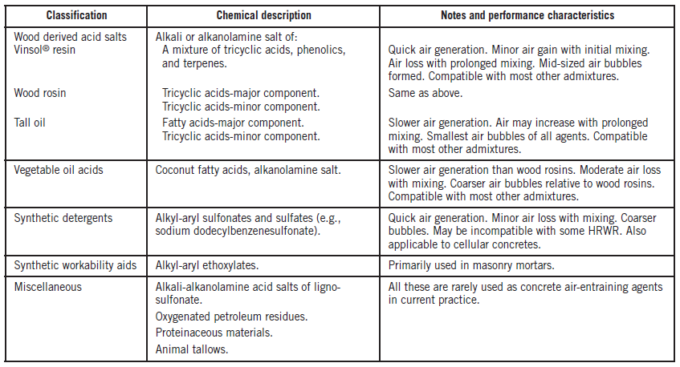
Air-Entraining Admixtures
Notes:
One of the greatest advances in concrete technology was the development of air-entrained concrete in the mid-1930s. Air-entrainment dramatically improves the durability of concrete exposed to cycles of freezing and thawing and deicer chemicals. Air-entraining concrete is produced by using either an air-entraining cement, by adding an air-entraining admixture during batching, or a combination of these approaches. The primary ingredients used in air-entraining admixtures are listed here, including chemical descriptions and performance characteristics. Numerous commercial air-entraining admixtures, manufactured from a variety of materials, are available.

Slide 7
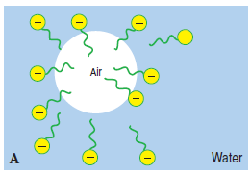
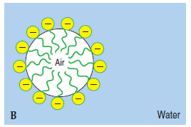
Mechanism of Air Entrainment
Notes:
Air-entraining admixtures are surfactants that concentrate at the air-water interface and reduce the surface tension encouraging the formation of
microscopic bubbles during the mixing process. Air-entraining admixtures typically have a negatively charged head which is hydrophilic and attracts water, and a hydrophobic tail which repels water. The hydrophobic end is attracted to the air within bubbles generated during the mixing process. The polar end, which is hydrophilic, orients itself towards water. The air-entraining admixture forms a tough, water-repelling film, similar to a soap film, with sufficient strength and elasticity to contain and stabilize the air bubbles. The hydrophobic film also keeps water out of the bubbles.

Slide 8
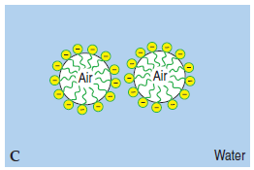
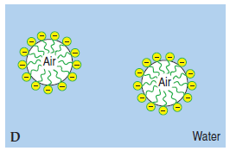
Mechanism of Air Entrainment
Notes:
The stirring and kneading action of mechanical mixing disperses the air bubbles. The charge around each bubble leads to repulsive forces, that prevent the coalescence of bubbles.

Slide 9
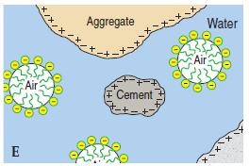
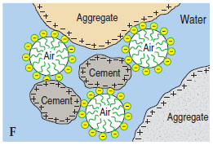
Mechanism of Air Entrainment
Notes:
The surface charge causes the air bubble to be adhered to the charged surfaces of cement and aggregate particles. The fine aggregate particles
also act as a three-dimensional grid to help hold the bubbles in the mixture. This improves the cohesion of the mixture and further stabilizes the air bubbles.

Slide 10
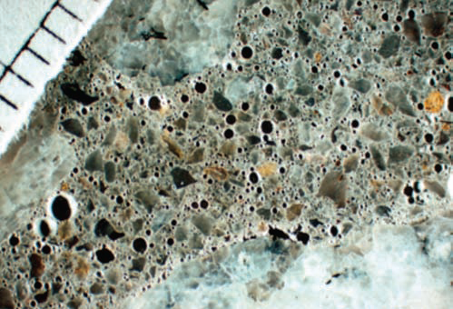
Entrained Air
Notes:
Entrained air bubbles are not like entrapped air voids, which occur in all concretes as a result of mixing, handling, and placing. Intentionally entrained air bubbles are extremely small in size, between 10 to 1000 μm in diameter, while entrapped voids are usually 1000 μm (1mm) or larger. As shown here, the bubbles are not interconnected. They are well dispersed and randomly distributed.

Slide 11
Control of Air Content
Dosage depends on:
  Materials
  Proportions
  Batching order and transport
  Placing and finishing
  Curing
Defoaming agents are available if air is excessive
Notes:
The amount of air entrained in concrete for a given dose of admixture depends on materials, mixture proportions, methods of transport, placing and finishing methods, and curing. Variations in air content can be expected with variations in aggregate proportions and gradation, mixing time
and intensity, temperature, and slump. The order of batching and mixing concrete ingredients when using an air-entraining admixture can also have a significant influence on the amount of air entrained. When entrained air is excessive, it can be reduced by using one of the following defoaming agents: tributyl phosphate, dibutyl phthalate, octyl alcohol, water insoluble esters of carbonic acid and boric acid, and silicones.

Slide 12
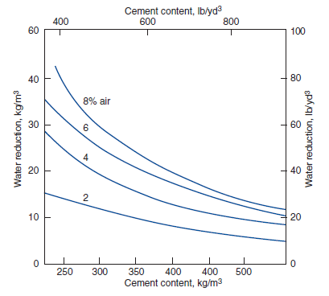
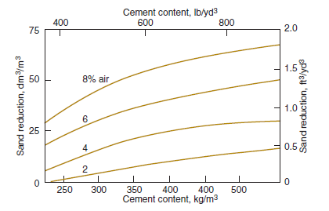
Impact of Air on Concrete Properties
Notes:
The presence of a finely distributed network of bubbles has a significant impact on the properties of plastic concrete. Entrained air improves the workability of concrete. Because of improved workability with entrained air, water and sand content can be reduced significantly as shown in these graphs. A volume of air-entrained concrete requires less water than an equal volume of non-air-entrained concrete of the same consistency and maximum size aggregate. Freshly mixed concrete containing entrained air is cohesive, looks and feels “fatty” or workable, and can usually be handled with ease. On the other hand, high air contents can make a mixture sticky and more difficult to finish. Furthermore, the air bubbles reduce the tendency for segregation and bleeding. Improvements in the performance of hardened concrete obviously include improved resistance to freezing and thawing, and deicer-salt scaling. Furthermore, the incorporation of air also results in a reduced permeability and possibly improved resistance to sulfate attack and alkali-silica reactivity.

Slide 13
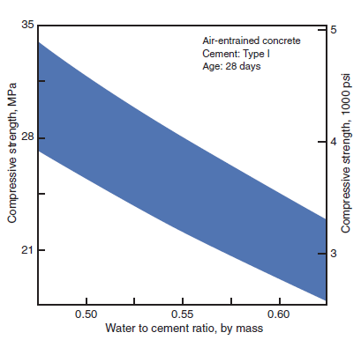
Impact of Air on Concrete Properties
Notes:
The single detrimental effect is that an increase in air content results in a decrease in the strength of the concrete. When the air content is maintained constant, strength varies inversely with the water-cement ratio. A good rule of thumb is that each 1% increase in air content is accompanied by 5% to 6% reduction in strength.

Slide 14
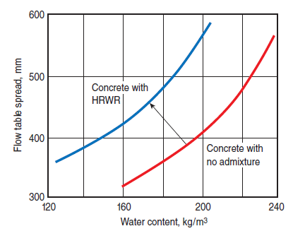
Water-Reducing Admixtures
Notes:
A water-reducing admixture is an admixture that increases workability without increasing the water content of concrete, or that permits a decrease in water content without decreasing the slump. When used as a water-reducer, the water content is reduced while maintaining the slump; this reduces the water-cement ratio of the concrete and increases its strength and durability. When the same chemical is used as a plasticizer, the workability is increased while the water content is kept constant. This can improve the placing characteristics of the concrete without adversely affecting the strength and durability.

Slide 15
Water-Reducing Admixtures
Normal – 5%-10% water reduction
Mid-range – 6%-12% water reduction
High-range – 12%-40% water reduction
  Superplasticizers
Notes:
When used as a water reducer, normal range, or conventional water reducers can reduce the water content by approximately 5% to 10%. Mid-range water reducers were first introduced in 1984 to bridge the gap between normal range water reducers and high-range water reducers. These admixtures provide significant water reduction, between 6% and 12%, for concretes with slumps of 125 mm to 200 mm (5 in. to 8 in.) without the retardation associated with high dosages of normal water reducers. High-range water reducers can be used to impart properties induced by regular water reducers, only much more efficiently. A water reduction of 12% to 40% can be obtained using these admixtures.

Slide 16
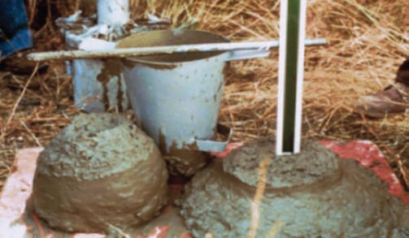
High-Range Water Reducers
Notes:
The reduced water content and water-cement ratio obtained with high-range water reducers can produce concretes with: (1) ultimate compressive strengths in excess of 70 MPa (10,000 psi), (2) increased early strength gain, (3) reduced chloride-ion penetration, and (4) other beneficial properties associated with low water-cement ratio concrete. When the same chemicals used for high-range water reducers are used to make flowing concrete, they are often called superplasticizers. Flowing concrete is a highly fluid but workable concrete that can be placed with little or no vibration or compaction while still remaining essentially free of excessive bleeding or segregation.

Slide 17
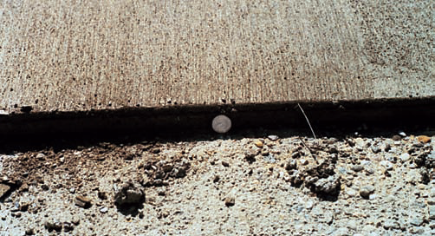
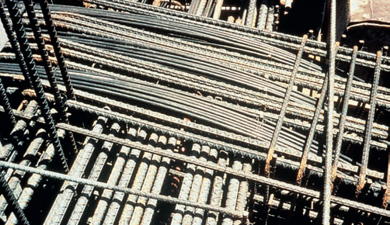
Flowing Concrete
Notes:
Applications where flowing concrete is used include (1) thin-section placements, (2) areas of closely spaced and congested reinforcing steel, (3) tremie pipe (underwater) placements, (4) pumped concrete to reduce pump pressure, thereby increasing lift and distance capacity, (5) areas where conventional consolidation methods are impractical or can not be used, and (6) for reducing handling costs.

Slide 18
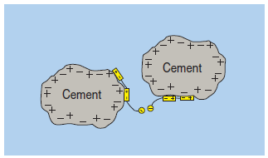
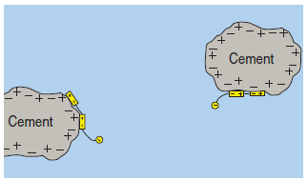
Mechanisms of Water Reducers
Notes:
Water reducers function as cement dispersants primarily through electrostatic and steric repulsive forces. Acidic groups within the polymer neutralize the surface charges on the cement particles. These groups bind to positive ions on the cement particle surfaces. These ions attach the polymer and give the cement a slight negative charge as well as create a layer on the surface. This negative charge and layer of adsorbed compounds create a combination of electrostatic and steric repulsion forces between individual cement particles, dispersing them, thus releasing the water tied up in agglomerations and reducing the viscosity of the paste and concrete.

Slide 19
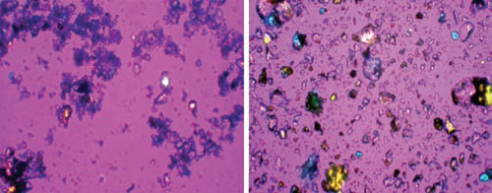
Mechanisms of Water Reducers
Notes:
The effect of the water reducer depends on the dosage level, sequence of addition, and molecular weight. The water reducer will also contribute
to dispersion by repelling negatively charged aggregate particles and air-entrained bubbles. The electrostatic repulsion for these materials is affected by dissolved ions and rapidly diminishes as the hydrating cement releases more ions into the mixture.

Slide 20
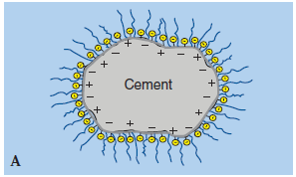
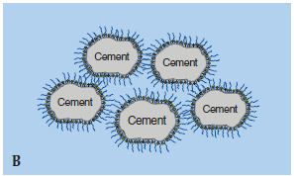
Polycarboxylate Technology
Notes:
Polycarboxylate derivatives are the newest generation of high-range water reducers and superplasticizers. These polymers are comprised of a
main carbon chain with carboxylate groups and polyethylene oxide (PEO) side chains. The PEO side chains extend out from the cement particles and add the mechanism of steric hindrance to the typical electrostatic repulsion. As with typical superplasticizers, the water reducer is dissolved in water, and the polar chain is absorbed at the solid-water interface. The long side chains physically help hold the cement grains apart allowing water to totally surround the cement grains.

Slide 21
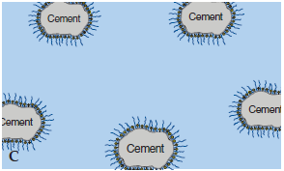
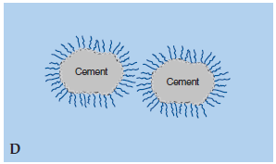
Polycarboxylate Technology
Notes:
The polar chain imparts a slight negative charge causing the cement grains to repel one another. As the electrostatic repulsion dispersing effect wears off due to cement hydration, the long side chains still physically keep the cement dispersed. The PEO chains prevent particles from agglomerating through physical separation great enough to allow fluid to flow between the particles. Because steric hindrance is a physical mechanism, it is not as sensitive to dissolved ions as an electrostatic repulsion mechanism. Concrete mixtures with polycarboxylate additions tend to retain fluidity for longer periods and they tend to require less water than concrete mixtures using other water reducers.

Slide 22
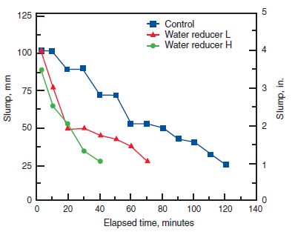
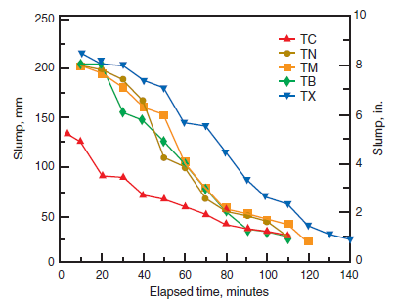
Impact of Water Reducers on Properties of Concrete
Notes:
Adding a water-reducing admixture to concrete without also reducing the water content can produce a mixture with a higher slump. The rate of slump loss, however, is not reduced and in most cases is increased, with the exception of polycarboxylate technology. Rapid slump loss results in reduced workability and less time to place concrete. An increase in strength is generally obtained with water-reducing admixtures as the water-cement ratio is reduced. For concretes of equal cement content, air content, and slump, the 28-day strength of a water-reduced concrete containing a water reducer can be 10% to 25% greater than concrete without the admixture.

Slide 23
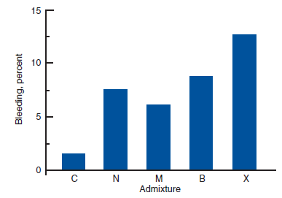
Impact of Water Reducers on Properties of Concrete
Notes:
Water reducers decrease, increase, or have no effect on bleeding, depending on the chemical composition of the admixture. A significant reduction of bleeding can result with large reductions of water content. Tests have shown that some plasticized concretes bleed more than control
concretes of equal water-cement ratio; but plasticized concretes bleed significantly less than control concretes of equally high slump and higher water content. Despite reduction in water content, water-reducing admixtures may cause increases in drying shrinkage. Usually the effect of the water reducer on drying shrinkage is small when compared to other more significant factors that affect shrinkage cracking in concrete.

Slide 24
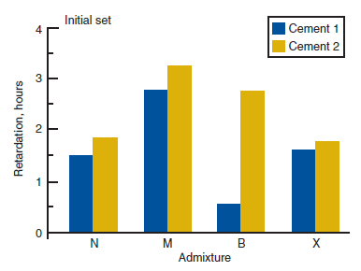
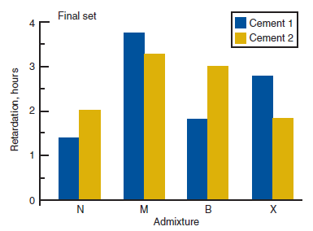
Impact of Water Reducers on Properties of Concrete
Notes:
Water reducers can be modified to give varying degrees of retardation while others do not significantly affect the setting time. Type A water
reducers can have little effect on setting time at their typical dosages, while Type D admixtures provide water reduction with retardation, and Type E admixtures provide water reduction with accelerated setting. Type D water-reducing admixtures usually retard the setting time of concrete from one to four hours. Setting time may be accelerated or retarded based on each admixture’s chemistry, dosage rate, and interaction with other admixtures and cementing materials in the concrete mixture.

Slide 25
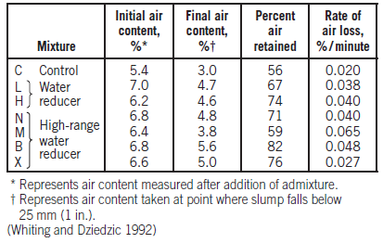
Impact of Water Reducers on Properties of Concrete
Notes:
Some water-reducing admixtures may also entrain some air in concrete. Lignin-based admixtures can increase air contents by 1% to 2%. Concretes with water reducers generally have good air retention. Concretes with high-range water reducers or plasticized flowing concrete can
have larger entrained air voids and higher void-spacing factors than normal air-entrained concrete. Air loss can also be significant when compared to concretes without high range water reducers held at constant water-cement ratios. The effectiveness of water reducers on concrete is a function of their chemical composition, concrete temperature, cement composition and fineness, cement content, and the presence of other admixtures.

Slide 26
Set Retarding Admixtures
Used to delay the rate of setting – initial and final
  Offset accelerating effects
  Enable special placing/finishing techniques
Lower early-age strength, but higher long-term strength
Effects on other properties may be unpredictable
Notes:
Set retarding admixtures are used to delay the rate of setting of concrete. Retarders are sometimes used to: (1) offset the accelerating effect of hot weather on the setting of concrete; (2) delay the initial set of concrete or grout when difficult or unusual conditions of placement occur, such as placing concrete in large piers and foundations, cementing oil wells, or pumping grout or concrete over considerable distances; (3) delay the set for special finishing techniques, such as an exposed aggregate surface, or anticipating long transport time or delays between batching and placement. Set retarders function by slowing the normal cement hydration through complex processes such as inhibiting the growth of certain crystalline hydration products. The use of a set retarding admixture delays both the initial and final set of concrete. The extent of the delay is dependent on admixture composition, dosage, time of addition, and the temperature of the concrete. Retarders do not decrease the initial temperature of concrete. In general, some reduction in strength at early ages accompanies the use of retarders. However, increased long-term strength may result from retarding the initial rate of hydration. The effects of these materials on the other properties of concrete, such as shrinkage, may be unpredictable. The incorporation of retarders can affect some of the other properties of concrete including slump, bleeding, and early-age strength development.

Slide 27
Set Accelerating Admixtures
Accelerates hydration and strength development
Calcium chloride – most common
  Up to 2% by mass of cementing material
Triethanolamine (TEA), inorganic salts – alternatives
Mechanism depends on admixture chemistry
Notes:
A set accelerating admixture is used to accelerate the rate of hydration and strength development of concrete at an early age. Calcium chloride (CaCl₂) is the most common material used in set accelerating admixtures, especially for non-reinforced concrete. The amount of calcium chloride added to concrete should be no more than is necessary to produce the desired results and in no case should be permitted to exceed 2% by mass of cementing material. A more appropriate accelerator for reinforced concrete is a non-chloride containing accelerator. These include organic compounds such as triethanolamine and inorganic salts such as sodium and calcium salts of formate, nitrate, and nitrite. Calcium chloride and calcium or alkali salts catalyze the hydration of the calcium silicates by weakening the barrier of initial hydration products that may form on the cement surface. TEA acts on the C₃A component of the cement accelerating its reaction with gypsum and the production of ettringite and also
promoting the subsequent conversion to monosulfate. Calcium formate works by accelerating the hydration of C₃S.

Slide 28
Set Accelerating Admixtures
Calcium chloride effects on concrete
  Increase corrosion
  Discoloration
  Increased shrinkage
  Long-term strength reduction
  Reduced durability
Notes:
Besides accelerating strength gain, calcium chloride causes an increase in potential reinforcement corrosion and may lead to discoloration. The incorporation of calcium chloride can also affect other properties of concrete including shrinkage, long-term strength and resistance to freezing and thawing, sulfates, and ASR. An overdose of calcium chloride can result in rapid stiffening, a large increase in drying shrinkage, corrosion of reinforcement, and loss of strength at later ages.

Slide 29
Hydration-Control Admixtures
Two-part system:
  Stabilizer/retarder that stops hydration
  Activator that restarts hydration
Allows for suspending overnight or for long hauls
Notes:
Hydration controlling admixtures became available in the late 1980s. They consist of a two-part chemical system: (1) a stabilizer or retarder that essentially stops the hydration of cementing materials, and (2) an activator that reestablishes normal hydration and setting once added to the stabilized concrete. These admixtures make it possible to reuse concrete returned in a ready-mix truck by suspending setting overnight. The admixture is also useful in maintaining concrete in a stabilized non-hardened state during long hauls.

Slide 30
Workability-Retaining Admixtures
Provide workability retention without affecting set times or early-age strength
Can be used with water-reducing admixtures
Reduces the need for slump adjustments
Notes:
Workability retaining admixtures provide varying degrees of workability retention without affecting the initial set of concrete or early-age strength development, as is the case with retarding admixtures. These admixtures can be used with mid-range or high-range water reducers to provide desired levels of workability retention in moderate to high slump concrete mixtures. Their main benefit is reducing the need for slump adjustments prior to concrete placement, thus helping to maintain consistency in concrete performance throughout a project.

Slide 31
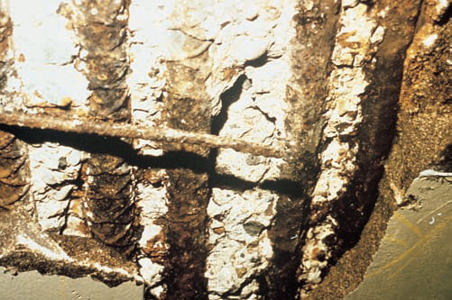
Corrosion Inhibitors
Notes:
Corrosion inhibitors are chemical admixtures that are added to concrete to limit the corrosion of steel reinforcement. Commercially available corrosion inhibitors include calcium nitrite, sodium nitrite, dimethyl ethanolamine, amines, phosphates, and ester amines. Corrosion-inhibiting admixtures chemically arrest the corrosion reaction and reinstate the passive layer, which provides protection to the steel. Increased chloride levels require increased levels of nitrite to stop corrosion. Organic inhibitors, based on a combination of amines and esters in a water medium, act in two ways that result in an increase in the time to corrosion initiation and a decrease in the rate of corrosion once it has started. Cathodic inhibitors react with the steel surface to interfere with the reduction of oxygen.

Slide 32

Shrinkage-Reducing Admixtures
Notes:
Shrinkage-reducing admixtures (SRAs), introduced in the 1980s, have potential uses in bridge decks, critical floor slabs, and buildings where cracks, curling, and warping must be minimized for durability or aesthetic reasons. Propylene glycol and polyoxyalkylene alkyl ether have
been used as shrinkage reducers. Drying shrinkage reductions between 25% and 50% have been demonstrated in laboratory tests. These admixtures have negligible effects on slump, but can impact air content and may possibly require an increase in the dose of air-entraining admixture to achieve a target air content. A delay in time of set and slower bleed rate may also result from the use of SRAs. Because of their effectiveness in reducing drying shrinkage, SRAs are also generally effective in reducing curling and cracking in slabs.

Slide 33
Permeability Reducing Admixtures
Two water penetration mechanisms:
  Capillary absorption (wicking)
  Direct ingress under pressure
Two types of PRA:
  Non-hydrostatic (PRAN)
  Hydrostatic (PRAH)
Not a replacement for quality concrete
Notes:
Water can enter concrete through two primary mechanisms: capillary absorption under non-hydrostatic conditions, often referred to as wicking, and the direct ingress of water under pressure. Considering these two mechanisms of water ingress, permeability reducing admixtures (PRAs) can be divided into two categories; Permeability Reducing Admixture – Non-Hydrostatic (PRAN) and Permeability Reducing Admixtures – Hydrostatic (PRAH). Permeability reducing admixtures that are non-hydrostatic have traditionally been referred to as damp-proofers. PRANs give concrete a water repellent property and they provide reduced absorption. Common materials include soaps such as stearates and other long chain fatty acids, or their derivatives, as well as petroleum products. Hydrostatic permeability reducing admixtures have often been referred to as waterproofers, although permeability reducing admixture for hydrostatic conditions is a more technically correct term. PRAHs contain materials that act to block the pores and capillaries in concrete. Products usually consist of hydrophilic crystalline materials that react in concrete to produce pore blocking deposits, or polymeric materials that coalesce in the concrete’s pores. Permeability reducing admixtures will not correct for a
poorly designed concrete mixture.

Slide 34
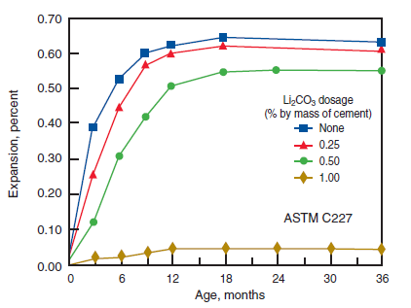
Alkali-Aggregate Reactivity Inhibitors
Notes:
Lithium based compounds when used in sufficient quantity are capable of inhibiting damage due to alkali-silica reactivity (ASR). ASR gel has a great capacity to absorb moisture from within the concrete pores. If lithium nitrate is used as an admixture, the pore solution will contain lithium and nitrate ions in addition to sodium, potassium, and hydroxyl ions. The resulting lithium-bearing reaction product does not have the same
propensity to absorb water and expand.

Slide 35

Coloring Admixtures (Pigments)
Notes:
Natural and synthetic materials are used to color concrete for aesthetic and safety reasons. Pigments used in amounts less than 6% generally do not affect concrete properties. Generally, the amount of pigments used in concrete should not exceed 10% by weight of the cement. Before a coloring admixture is used on a project, it should be tested for color fastness in direct sunlight and autoclaving, chemical stability in cement, and effects on concrete properties. To avoid color distortions, calcium chloride should not be used with pigments.

Slide 36
Miscellaneous Admixtures
Pumping aids
Bonding admixtures and agents
Grouting admixtures
Gas-forming admixtures
Air detrainers
Fungicidal, germicidal, and insecticidal admixtures
Viscosity modifying admixtures
Notes:
There are a variety of admixtures on the market, each with a particular niche purpose. Pumping aids are added to concrete mixtures to improve pumpability. Pumping aids are not a cure-all; they are best used to make marginally pumpable concrete more pumpable. Bonding admixtures are added to portland cement mixtures to increase the bond strength between old and new concrete. Bonding agents should not be confused with bonding admixtures. Bonding agents are applied to existing concrete surfaces immediately before the new concrete is placed. Grouting admixtures alter the properties of grout for specific applications. Aluminum powder and other gas-forming materials are sometimes added to concrete and grout to cause an expansion of the mixture prior to hardening. Air-detraining admixtures reduce the air content in concrete. Bacteria and fungal growth on concrete surfaces or in hardened concrete may be partially controlled through the use of fungicidal, germicidal, and insecticidal admixtures. Viscosity modifying admixtures increase the viscosity of the mixture resulting in increased thixotropy and resistance to
segregation.

Slide 37
Admixture Compatibility
Cement-admixture or admixture-admixture incompatibilities are encountered
Slump loss, air loss, early stiffening, and other fresh and hardened concrete properties may be affected
Solved by:
  Dosage rate or sequence
  Altering cement or admixture composition
Notes:
Fresh concrete problems of varying degrees of severity are encountered as a result of cement-admixture incompatibility and incompatibility between admixtures. Incompatibility between supplementary cementing materials and admixtures or cements can also occur. Slump loss, air loss,
early stiffening, and other factors affecting fresh concrete properties can result from incompatibilities. While these problems primarily affect the plastic-state performance of concrete, long-term hardened concrete performance may also be adversely affected. When incompatibility is encountered, it can often be solved by changing the admixture dosage rate or the sequence of addition to the mixture. Some incompatibility issues may be solved by modifying the composition of the cement or modifying the composition of the admixture.

Slide 38
Less Than Expected Water Reduction
Composition of cementitious materials
Presence of other set-control admixtures
Temperature
Clay minerals
Admixture dosage
Slump loss
  Can be attributed to temperature, reactivity of cement, dispersion and availability of admixture, expansive clays
  Typically avoided by delaying addition of water-reducer
Notes:
If the water reduction achieved using an admixture is less than expected based on previous experience with the same admixture, this may be caused by: the composition of the cementitious materials, the presence of other set-control admixtures, the temperature of the concrete, clay minerals in the aggregates, and the dose of the admixture itself. Slump loss can often be offset by delaying the time of addition of the admixture. Incompatibility between some high-range water-reducers and cementing materials can result in very rapid losses in workability, shortly after mixing. While this can often be attributed to the temperature of the concrete, the reactivity of the cement and the continuous availability of admixture to disperse the hydrating cement grains is a key factor. Certain minerals found in various aggregate sources such as expansive clays, have been found to rapidly adsorb polycarboxylate-type superplasticizers, thus significantly reducing their effectiveness.

Slide 39
Less Than Expected Retardation
May be caused by increase in C₃A
Too much retardation caused by:
  Low C₃A
  Low cement reactivity
  Excessive admixture
  High levels of SCMs
  Low temperatures
Notes:
If the length of retardation is less than expected, this may be due to an increase in the C₃A content of the cement. Abnormally retarded set may be caused by: a low C₃A content or low cement reactivity, excessive admixture with retarding properties, high levels of SCMs, or low temperature. The performance of concrete produced with cements of abnormally low C₃A and SO₃ content should be carefully observed when water-reducing or set retarding admixtures are used. Any changes in the alkali content of the cement should alert the concrete producer to potential changes in admixture performance.

Slide 40
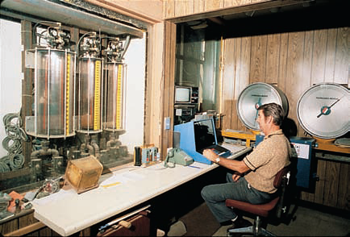
Storing and Dispensing Chemical Admixtures
Notes:
Liquid admixtures can be stored in barrels or bulk tankers. Powdered admixtures can be placed in special storage bins and some are available in premeasured plastic bags. Admixtures added to a truck mixer at the jobsite are often in plastic jugs or bags. Powdered admixtures, such as
certain plasticizers, or an admixture drum or barrel may be stored at the project site. Most liquid chemical admixtures should not be allowed to freeze; therefore, they should be stored in heated environments. Powdered admixtures are usually less sensitive to temperature restrictions, but may be sensitive to moisture. Liquid chemical admixtures are usually dispensed individually in the batch water by volumetric means. Liquid and powdered admixtures can be measured by mass, but powdered admixtures should not be measured by volume.

Slide 41
Summary
Air-entraining admixtures
Water-reducing admixtures
Set retarding admixtures
Set accelerating admixtures
Hydration-control admixtures
Workability-retaining admixtures
Corrosion inhibitors
Shrinkage-reducing admixtures
Permeability reducing admixtures
Alkali-aggregate reactivity inhibitors
Coloring admixtures
Pumping Aids
Bonding admixtures and agents
Grouting admixtures
Gas-forming admixtures
Air-detrainers
Fungicidal, germicidal, and insecticidal admixtures
Viscosity modifying admixtures
Admixture compatibility
Storing and dispensing chemical admixtures
Notes:
In summary, we covered a variety of chemical admixtures, including air-entraining, water-reducing, set-controlling, and other admixtures. We ended the discussion with admixture compatibility and an overview of storing and dispensing of chemical admixtures.

Slide 42
Questions
?

