Slide 1
Properties of Concrete
Design and Control of Concrete Mixtures
CHAPTER 12
Notes:
Design and Control of Concrete Mixtures, 16th edition, Chapter 12 – Properties of Concrete

Slide 2
Overview
Freshly Mixed Concrete
Hardened Concrete
Notes:
This module discusses properties of concrete including fresh concrete topics, such as workability, air content; and hardened concrete properties, such as strength and volume stability.

Slide 3
Properties of Concrete
Quality Concrete
  Consistency
  Stability
  Uniformity
  Workability
  Finishability
Notes:
Quality concrete possesses well defined and accepted principal requirements. For freshly mixed concrete, those requirements include: consistency-–the ability to flow; stability-–the resistance to segregation; uniformity-–homogeneous mixture, with evenly dispersed constituents; workability-–ease of placing, consolidating, and finishing; finishability-–ease of performing finishing operations to achieve specified surface characteristics.

Slide 4
Freshly Mixed Concrete
General requirements:
  Be easily mixed and transported
  Be uniform
  Have good flow properties
  Be compactable
  Be segregation resistant
  Be finishable
Notes:
In general, fresh concrete must be capable of satisfying the following requirements: it must be easily mixed and transported; it must be uniform throughout a given batch; it should have flow properties such that it is capable of completely filling the forms for which it was designed; it must have the ability to be compacted without requiring an excessive amount of energy; it must not segregate during transportation, placing and, consolidation; and it must be capable of being finished properly.

Slide 5
Workability
Notes:
The ease of placing, consolidating, and finishing freshly mixed concrete and the degree to which it resists segregation is called workability. Concrete should be workable, but the ingredients should not separate during transport and handling. Concrete properties related to workability include the consistency (flow) and stability (segregation resistance).

Slide 6
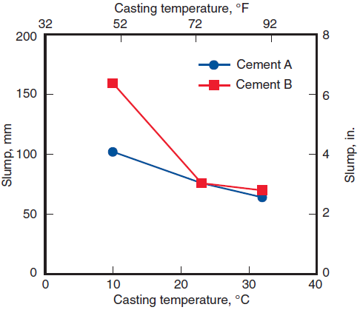
Workability
Burg 1996
Notes:
The degree of workability required for proper placement of concrete is controlled by the placement method, type of consolidation, and type of concrete. This graph illustrates the effect of casting temperature on the consistency, or slump, and potential workability of two concretes made with different cements.

Slide 7
Workability
Factors that influence the workability of concrete are:
the method and duration of transportation
quantity and characteristics of cementitious materials
concrete consistency (slump)
grading, shape, and surface texture of fine and coarse aggregates
entrained air
water content
concrete and ambient air temperatures
admixtures
Notes:
Factors that influence the workability of concrete are listed.

Slide 8
Consistency
Notes:
The slump test, ASTM C143, Standard Test Method for Slump of Hydraulic-Cement Concrete (AASHTO T 119), is the most generally accepted method used to measure the consistency of concrete. The primary benefit of the slump test is that it measures the consistency from one batch of concrete to the next. However, it does not characterize the rheology or workability of a concrete mixture quantitatively.

Slide 9
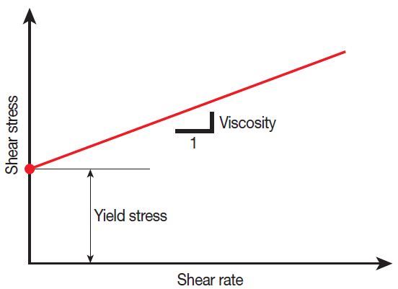
Rheology
Bingham Model
Notes:
The Bingham model describes two properties of the material, the yield stress and the viscosity. In fresh concrete, yield stress defines the threshold between static and fluid behavior. The viscosity of the concrete determines how fast it moves.

Slide 10
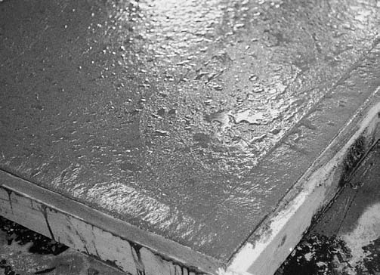
Bleeding and Settlement
Notes:
Bleeding is the development of a layer of water at the top or surface of freshly placed concrete. It is caused by settlement of solid particles and the simultaneous upward migration of water, shown in this image. Some bleeding is normal and it should not diminish the quality of properly placed, finished, and cured concrete.

Slide 11
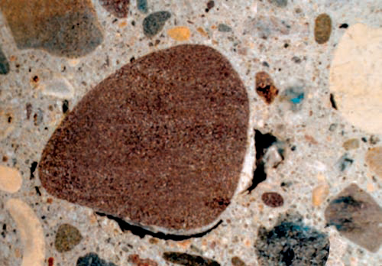
Bleeding and Settlement
Notes:
Excessive bleeding increases the water-cement ratio near the top surface which creates a weak top layer with poor durability, particularly if finishing operations take place while bleed water is present. A water pocket or void can develop under a prematurely finished surface (which can cause a future surface delamination). Bleed water can accumulate under and alongside coarse aggregate particles as shown.

Slide 12
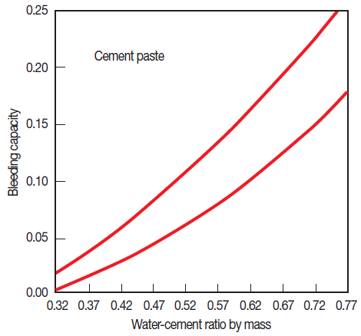
Bleeding
ASTM C232, Standard Test Methods for Bleeding of Concrete (AASHTO T 158)
Steinour 1945
Notes:
The bleeding properties of fresh concrete can be determined by two methods described in The bleeding rate and bleeding capacity increases with initial water content, concrete height, and pressure.

Slide 13
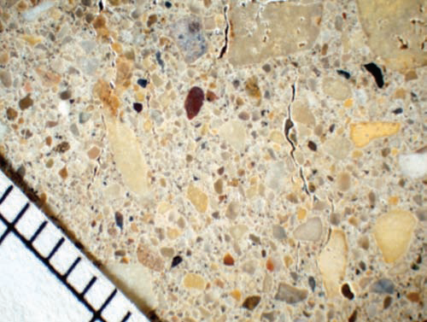
Bleeding and Settlement
Notes:
Large bleed channels may form from concrete mixtures with very low cement contents, high water contents, or other mixtures with high bleeding properties.

Slide 14
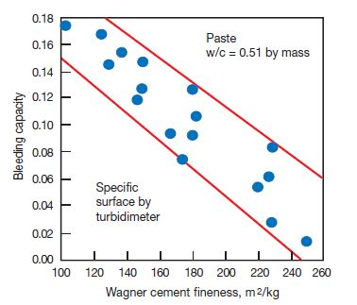
Bleeding
Steinour 1945
Notes:
Effect of cement fineness by Wagner turbidimeter on bleeding capacity of paste. Note that Wagner values are slightly more than half of Blaine values (Steinour 1945).

Slide 15
Bleeding
To reduce bleeding in concrete:
Reduce the water content
Reduce w/cm
Reduce slump
Increase the cementitious materials content
Increase fineness of cementitious materials
Increase the amount of fines in the sand
Use chemical admixtures
Air-entrained concrete
Notes:
The most effective means of reducing bleeding in concrete include:
reduce the water content, water-cementitious material ratio, and slump
increase the amount of cement resulting in a reduced water-cement ratio
use finer cementitious materials
use blended hydraulic elements
increase the amount of supplementary cementing materials such as fly ash, slag cement, or silica fume
increase the amount of fines in the sand
use chemical admixtures that permit reduced water-to-cementitious materials ratios or provide other means capable of reducing the bleeding of concrete
use air-entrained concrete.

Slide 16
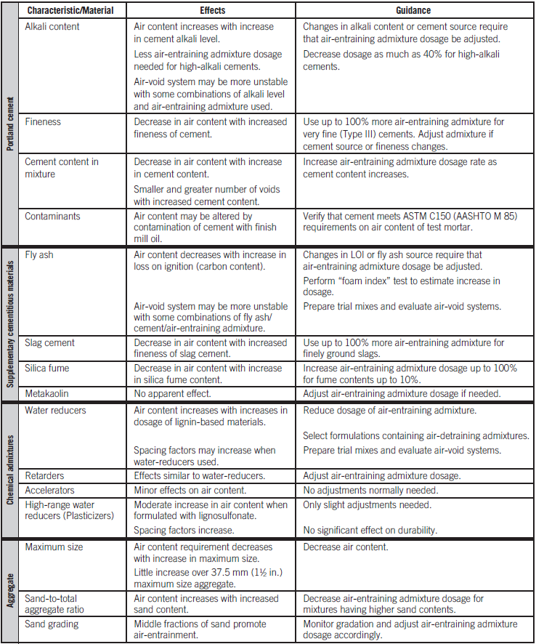
Air Content
Effect of Concrete Constituents on Control of Air Content in Concrete
Notes:
As summarized in this table, the constituent materials may have a significant effect on air content generated in the concrete.

Slide 17
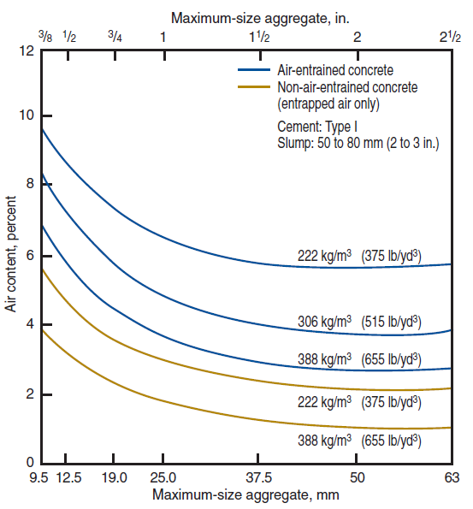
Air Content
PCA Major Series 336
Notes:
This figure shows the relationship between aggregate size, cement content, and air content of concrete. The air-entraining admixture dosage per unit of cement was constant for air-entrained concrete.

Slide 18
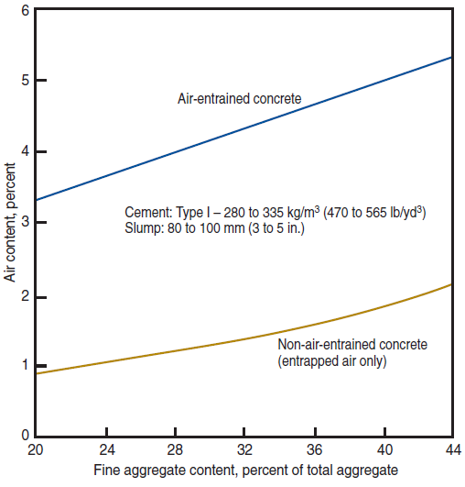
Air Content
PCA Major Series 336
Notes:
The relationship between percentage of fine aggregate and air content of concrete is shown in the figure. As shown in this graph, increasing the amount of fine aggregate causes more air to be entrained for a given amount of air-entraining cement or admixture. Fine-aggregate particles passing the 600 μm to 150 μm (No. 30 to No. 100) sieves entrap more air than either very fine or coarser particles. Appreciable amounts of material passing the 150 μm (No. 100) sieve will result in a significant reduction of entrained air.

Slide 19
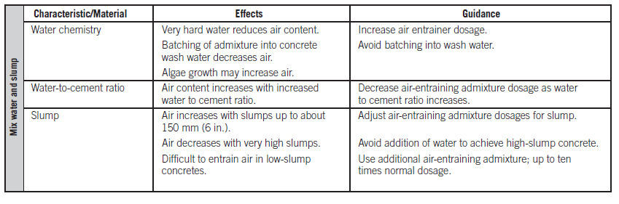
Air Content
Effect of Concrete Mixture Design on Control of Air Content in Concrete
Notes:
The mixing water used may also affect air content. Algae contaminated water increases air content. Highly alkaline wash water from truck mixers can affect air contents. The effect of water hardness in most municipal water supplies is generally insignificant. Very hard water from wells used in many communities, may decrease the air content in concrete. An increase in the mixing water makes more water available for the generation of air bubbles, thereby increasing the air content as slumps increase up to about 150 mm or 175 mm (6 in. or 7 in.). A very fluid concrete mixture with a 200-mm to 250-mm (8-in. to 10-in.) slump may lose air with the addition of water.

Slide 20
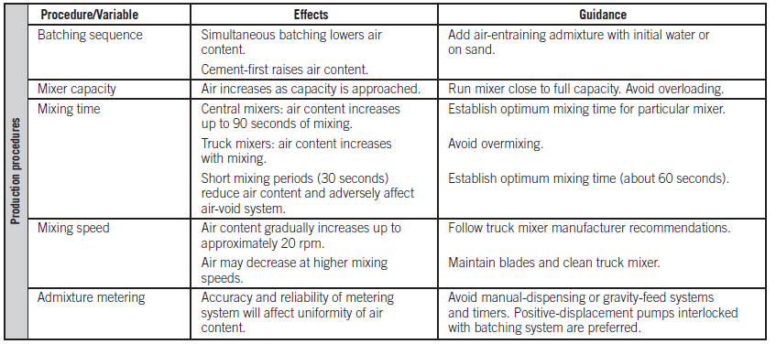
Air Content
Effect of Production Procedures on Control of Air Content in Concrete
Notes:
This table summarizes the effect of the production procedures on the air content. Mixing action is one of the most important factors in the production of entrained air in concrete. Uniform distribution of entrained air voids is essential to produce scale resistant concrete. The amount of entrained air varies with the type and condition of the mixer, the amount of concrete being mixed, and the rate and duration of mixing. The amount of air entrained in a given mixture will decrease appreciably as the mixer blades become worn, or if hardened concrete is allowed to accumulate in the drum or on the blades.

Slide 21
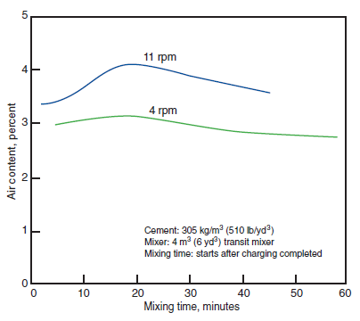
Air Content
PCA Major Series 336
Notes:
This graph shows the effect of mixing speed and duration of mixing on the air content of freshly mixed concretes made in a transit mixer. Generally, more air is entrained as the speed of mixing is increased up to about 20 rpm, beyond which air entrainment decreases. Mixing time and speed will have different effects on the air content of different mixtures.

Slide 22
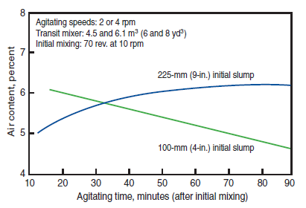
Air Content
PCA Major Series 336
Notes:
This graph shows the effect of continued mixer agitation on air content. The changes in air content with prolonged agitation can be explained by the relationship between slump and air content. Prolonged agitation will decrease slump and air content. When concrete is retempered (the addition of water and remixing to restore original slump), the air content is increased. However, after 4 hours, retempering is ineffective in increasing air content and may cause clustering of air bubbles. Prolonged mixing or agitation of concrete is accompanied by a progressive reduction in slump.

Slide 23
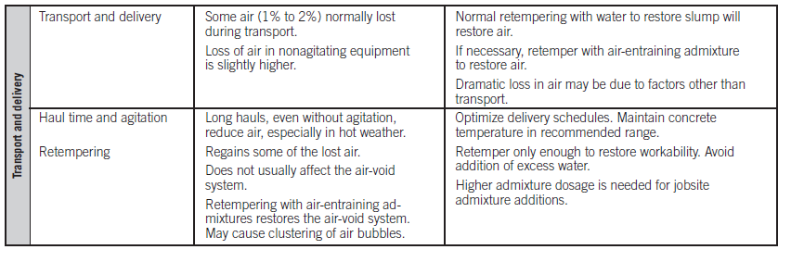
Air Content
Effect of Transportation and Delivery on Control of Air Content in Concrete
Notes:
The effects of transportation and delivery of concrete on the air content are summarized here. Generally, some air, approximately 1% to 2%, is lost during transportation of concrete from the mixer to the jobsite. The stability of the air content during transport is influenced by several variables including concrete ingredients, haul time, amount of agitation or vibration during transport, temperature, slump, and amount of retempering.

Slide 24
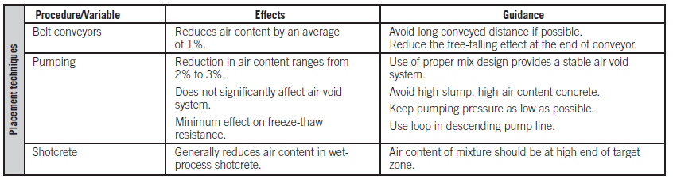
Air Content
Effect of Placement Techniques on Control of Air Content in Concrete
Notes:
The effect of placing techniques on air content is summarized in this table. Once at the jobsite, the concrete air content remains essentially constant during handling by chute discharge, wheelbarrow, power buggy, and shovel. However, concrete pumping, crane and bucket, and conveyor-belt handling can cause some loss of air, especially with high-air-content mixtures. Pumping concrete can cause a loss of up to 3% of air.

Slide 25
Air Content
Brewster 1949
Notes:
The greater the slump, air content, and vibration time, the larger the percentage of reduction in air content during vibration. Prolonged vibration of concrete should be avoided. Internal vibrators reduce air content more than external vibrators. The air loss due to vibration increases as the volume of concrete is reduced or as the vibration frequency is significantly increased.

Slide 26
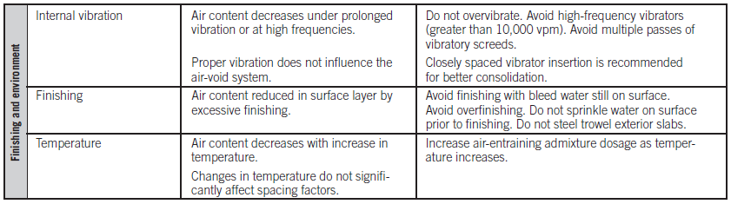
Air Content
Effect of Finishing and Environment on Control of Air Content in Concrete
Notes:
The effect of finishing, internal vibration, and environment on control of air content in concrete is shown here. Proper screeding, floating, and general finishing practices should not affect the air content. Overfinishing (excessive finishing) may reduce the amount of entrained air in the surface region of slabs—thus making the concrete surface vulnerable to scaling.

Slide 27
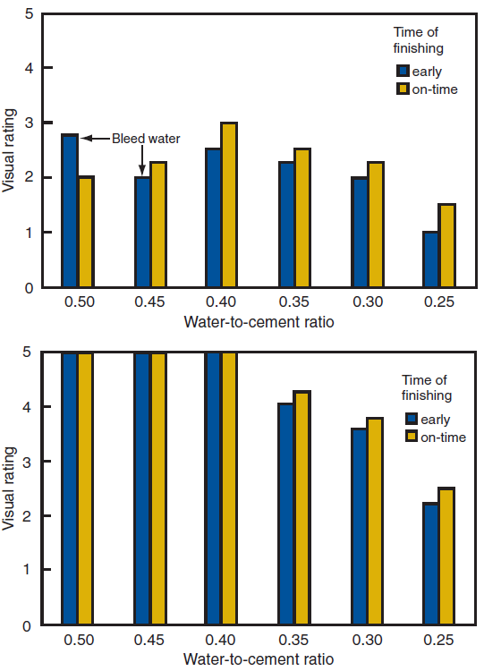
Air Content
Notes:
As shown in these graphs, early finishing does not necessarily affect scale resistance unless bleed water is present. The graph on the left is 6% air-entrained concrete and the graph on the right is non-air-entrained concrete. Concrete to be exposed to deicers should never be steel troweled.

Slide 28
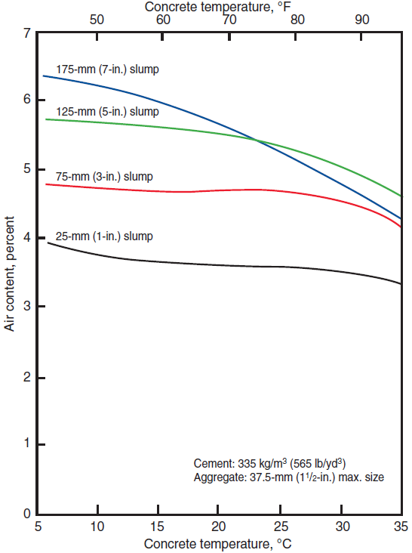
Air Content
PCA Major Series 336 and Lerch 1960
Notes:
The relationship between temperature, slump, and air content is shown here. Less air is entrained as the temperature of the concrete increases, particularly as slump is increased. During cold-weather concreting, the air-entraining admixture may lose some of its effectiveness if hot mix water is used during batching. To offset this loss, these admixtures should be added to the batch after the temperature of the concrete ingredients have equalized. Although increased concrete temperature during mixing generally reduces air volume, the spacing factor and specific surface are only slightly affected.

Slide 29
Uniformity
Notes:
Uniformity is a measure of the homogeneity of the concrete. This measurement includes within-batch uniformity and between batching of concrete mixtures. If the within-batch uniformity is low, this is indicative of inadequate or inefficient mixing. Uniformity of concrete is typically achieved by consolidation.

Slide 30
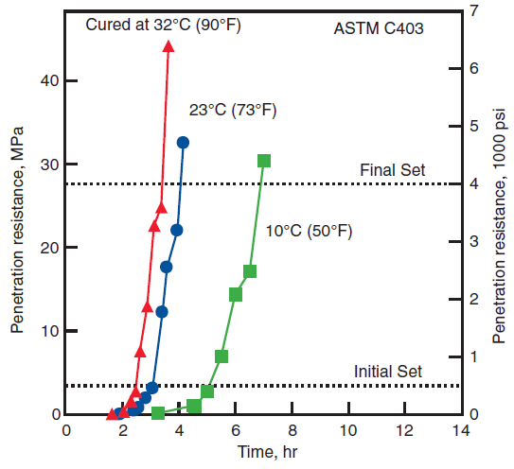
Hydration, Setting, and Hardening
Burg 1996
Notes:
This graph illustrates the setting properties of a concrete mixture at different temperatures. The binding quality of portland cement paste is due to the chemical reaction between the cement and water, called hydration. Knowledge of the amount of heat released as cement hydrates can be useful in planning construction. Knowledge of the rate of reaction between cement and water is important because it determines the rate of hardening.

Slide 31
Setting and Hardening
Adapted from Young and others 1998
Notes:
The setting and hardening of portland cement can be explained using a simple model showing unhydrated cement grains dispersed in water. Time starts when the water is first added to the cement. Upon the addition of water, a chemical reaction occurs between the water and cement-–the reaction is called hydration. The solid products resulting from hydration occupy a greater volume than the original cementitious materials and consequently some of the space between the cement grains is filled in. Eventually the hydration products will connect adjacent grains and a continuous solid network is formed. This is referred to as initial set. Between the addition of water and just before initial set occurs the paste has little rigidity. This is referred to as the dormant period. During the dormant period the paste is still plastic and the concrete can still be handled and placed. As the cement continues to hydrate, more hydration products are formed and the solid matrix becomes more dense and rigid. This period is called the setting or transition period as it represents the period during which the paste transforms from a fluid to a solid. Eventually the paste can be considered a rigid and solid material with mechanical properties such as strength and stiffness.

Slide 32
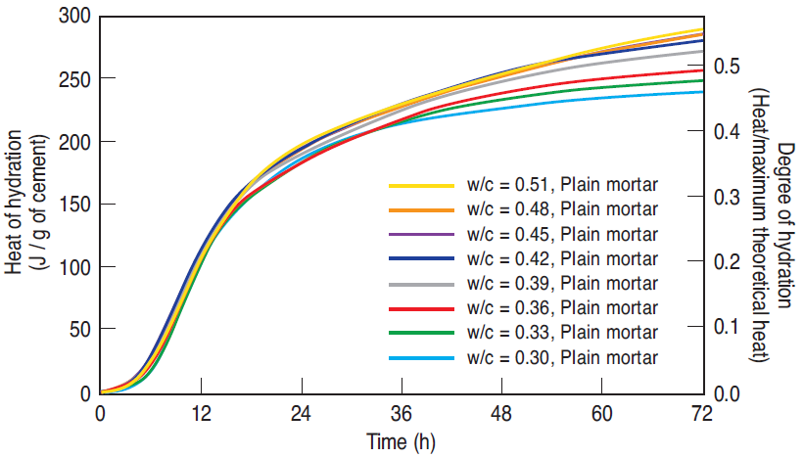
Degree of Hydration
Lura and others 2007
Notes:
The graph shows the degree of hydration for varying water cement ratios. Initially, all of the mixtures demonstrate a similar rate of heat release irrespective of the w/c. Mixtures with a higher water to cement ratio show a greater heat release. This suggests that lower w/c mixtures have a reduction in their hydration due to either a lack of water to participate in the hydration (or relative humidity) or a lack of space for the particles to hydrate.

Slide 33
Hardened Concrete Properties
Curing
Drying rate
Strength
Density
Permeability and watertightness
Volume stability and crack control
Durability
Aesthetics
Notes:
The following will discuss the properties of hardened concrete including: curing, drying rate, strength, density, permeability and watertightness, volume stability and crack control, durability, and aesthetics in more detail.

Slide 34
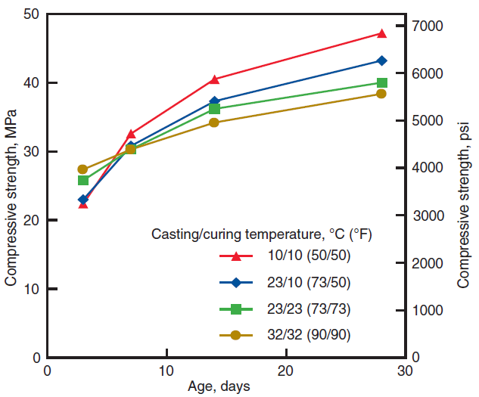
Curing
Burg 1996
Notes:
When the relative humidity within the concrete drops to about 80% or the temperature of the concrete drops below 10°C (14°F), hydration and strength gain virtually stop.

Slide 35
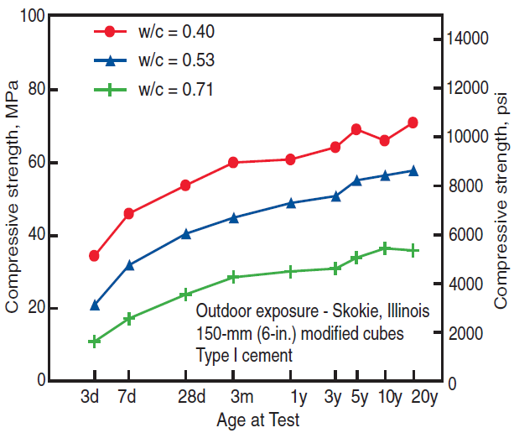
Curing
Wood 1992
Notes:
This graph illustrates the long-term strength gain of concrete in an outdoor exposure. If concrete is resaturated after a drying period, hydration is resumed and strength will again increase. However, it is best to moist-cure concrete continuously from the time it is placed until it has attained the desired quality. Once concrete has dried it is difficult to resaturate.

Slide 36
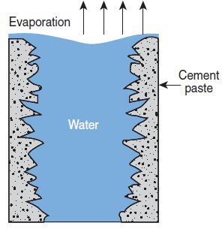
Drying Rate
Adapted from Scherer 1990
Notes:
Knowledge of the rate of drying is helpful in understanding the properties or physical condition of concrete. During the first stage of drying, liquid water is present at the surface and evaporates into the air over the concrete. As liquid water moves from within the body of the concrete to replace water that has evaporated at the surface, the concrete must shrink to make up the volume of water that has left. If the rate of evaporation is very high, the concrete may shrink excessively before the cement paste has developed much strength. This is the cause of plastic shrinkage cracking that may occur within the first few hours after the concrete is placed.

Slide 37
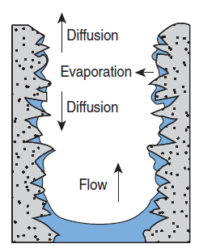
Drying Rate
Adapted from Scherer 1990
Notes:
When the concrete can no longer shrink to accommodate the volume lost due to water evaporation, the second stage of drying begins. Liquid water recedes from the exposed surface of the concrete into the pores. Within each pore, water clings to the sidewalls and forms a curved surface called the meniscus. At the surface of the concrete, water evaporates from the meniscus in each pore into the air over the concrete. At this point, water still fills the pore structure of the concrete. The surface may appear to be dry, but the concrete is just beginning to dry in a very thin layer. The rate of drying during this period steadily decreases.

Slide 38
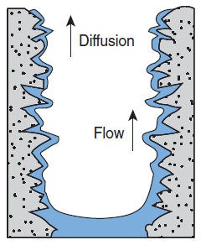
Drying Rate
Adapted from Scherer 1990
Notes:
The third stage of drying begins when enough water has evaporated from just below the surface that the pores are no longer continuously filled with liquid. Pockets of liquid water exist but moisture must now move by vapor diffusion within the body of the concrete before arriving at the surface where it can evaporate.

Slide 39
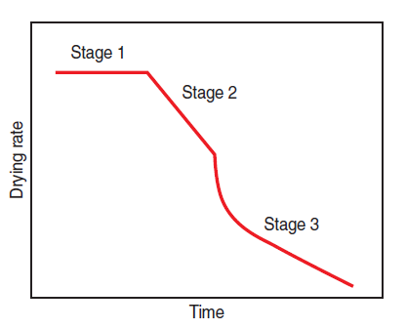
Drying Rate
Adapted from Hughes 1966
Notes:
This figure illustrates the three stages of drying. Stage 1 has a constant rate and depends on air movement and relative humidity over the slab while Stages 2 and 3 depend more on the properties of the cement paste.

Slide 40
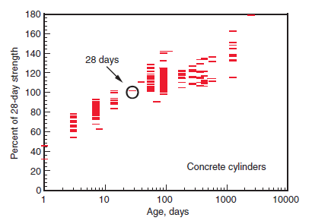
Strength
Lange 1994
Notes:
Seven-day strengths are often estimated to be about 75% of the 28-day strength while 56-day and 90-day strengths are about 10% to 15% greater than 28-day strengths, as shown here.

Slide 41
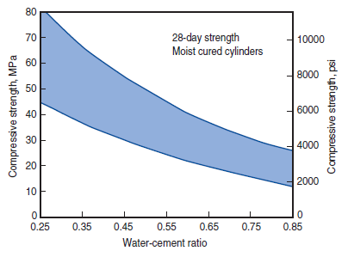
Strength
Notes:
This graph shows compressive strengths for a wide range of concrete mixtures and water-cement ratios at an age of 28 days. Note that strengths increase as the water-cement ratios decrease. The water-cement ratio compressive strength relationships shown are for typical non-air-entrained concretes. When more precise values for concrete are required, graphs should be developed for the specific materials and mix proportions to be used on the job.

Slide 42
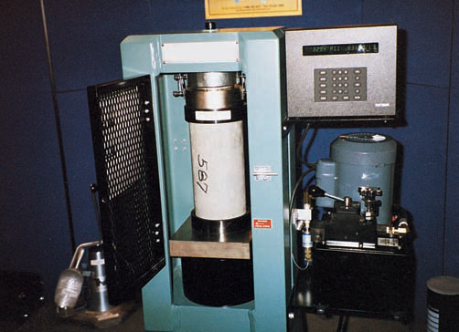
Strength
Notes:
To determine compressive strength, tests are made on specimens of mortar or concrete. Unless otherwise specified, compression tests of concrete are made on cylinders 150 mm (6 in.) in diameter and 300 mm (12 in.) high or smaller cylinders sized at 100 mm x 200 mm (4 in. x 8 in.). Most general-use concrete has a compressive strength between 20 MPa and 40 MPa (3000 psi and 6000 psi).

Slide 43

Strength
Flexural strength – 0.7-0.8 times sq. root of compressive strength in MPa (7.5-10 for psi)
Direct tensile strength – 8%-12% of compressive strength
Torsional strength – related to flexural strength and dimensions
Shear strength – related to compressive strength (ACI 318)
Modulus of elasticity – typically 1-4 GPa (2-6 million psi)=
Notes:
The flexural strength of normal-weight concrete is often approximated as 0.7 to 0.8 times the square root of the compressive strength in megapascals (7.5 to 10 times the square root of the compressive strength in pounds per square inch). The direct tensile strength of concrete is about 8% to 12% of the compressive strength and is often estimated as 0.4 to 0.7 times the square root of the compressive strength in megapascals (5 to 7.5 times the square root of the compressive strength in pounds per square inch). The torsional strength for concrete is related to the modulus of rupture and the dimensions of the concrete element. Shear strength to compressive strength relationships are discussed in the ACI 318 building code. The correlation between compressive strength and flexural, tensile, torsional, and shear strength varies with concrete ingredients and environment. For normal-weight concrete, the modulus of elasticity ranges from 1 GPa to 4 GPa (2 million psi to 6 million psi) and can be approximated as 5,000 times the square root of the compressive strength in megapascals (57,000 times the square root of the compressive strength in pounds per square inch).

Slide 44
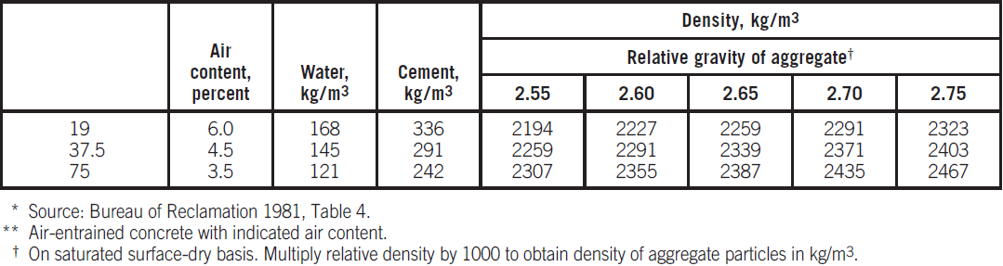
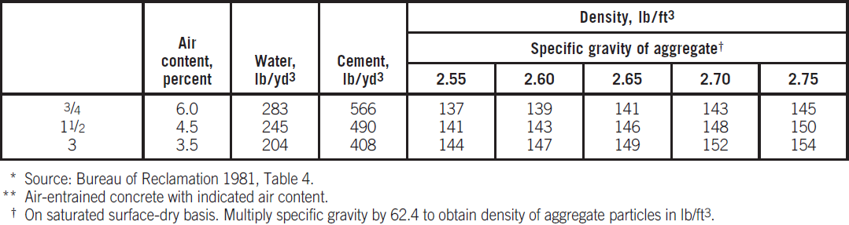
Density
Observed Average Density of Fresh Concrete (SI Units)*
Maximum
size of aggregate, mm
Observed Average Density of Fresh Concrete (Inch-Pound Units)*
Maximum
size of aggregate, in.
Notes:
The density of concrete varies depending on the amount and density of the aggregate, the amount of air that is entrapped or purposely entrained, and the water and cement contents. Conventional concrete, normally used in pavements, buildings, and other structures, has a density (unit weight) in the range of 2200 kg/m³ to 2400 kg/m³ (137 lb/ft³ to 150 lb/ft³). Values of the density of fresh concrete are given in these tables.

Slide 45
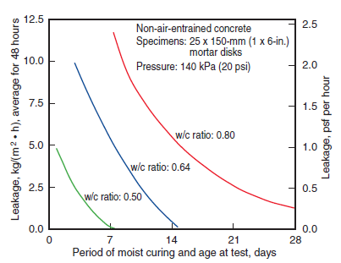
Permeability and Watertightness
McMillan and Lyse 1929 and PCA Major Series 227
Notes:
Watertightness is the ability of concrete to hold back or retain water without visible leakage. Permeability refers to the amount of water migration through concrete when the water is under pressure or to the ability of concrete to resist penetration by water or other substances (liquid, gas, or ions). Generally, the same properties of concrete that make it less permeable also make it more watertight.
Test results obtained by subjecting 25-mm (1-in.) thick non-air-entrained mortar disks to 140-kPa (20-psi) water pressure are shown here. Mortar disks that had a water-cement ratio of 0.50 by weight or less and were moist-cured for seven days showed no water leakage. Where leakage occurred, it was greater in mortar disks made with high water-cement ratios.

Slide 46
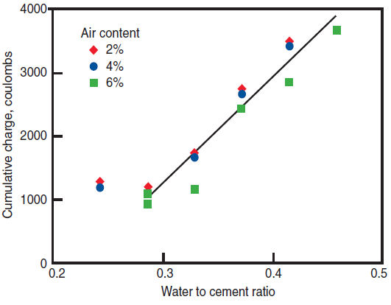
Permeability and Watertightness
Pinto and Hover 2001
Notes:
This graph illustrates the effect of different water-cement ratios on concrete’s resistance to chloride ion penetration as indicated by electrical conductance. The total charge in coulombs was significantly reduced with a low water-cement ratio. Also, the results showed that a lower charge passed when the concrete contained a higher air content. A low water-cement ratio also reduces segregation and bleeding, further contributing to watertightness. Of course watertight concrete must also be free from cracks, honeycomb, or other large visible voids.

Slide 47
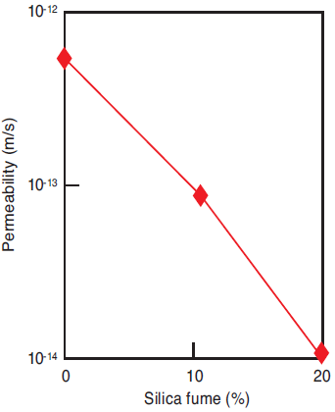
Permeability
Hooton 1986
Notes:
Silica fume and metakaolin are especially effective in reducing permeability. Tests show that the permeability of concrete decreases as the quantity of hydrated cementitious materials increases and is age dependent.

Slide 48
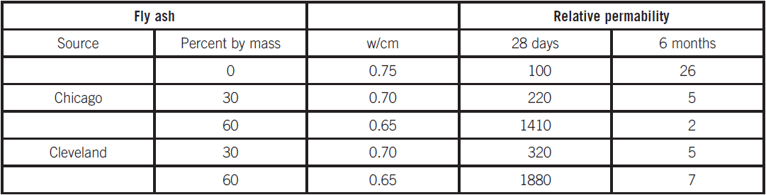
Permeability With Fly Ash
Effect of Fly Ash on the Permeability of Concrete (Davies 1954)
Notes:
The impact of supplementary cementing materials on the permeability of concrete is shown here and in the following slide. With appropriate dosages, fly ash, slag cement, and natural pozzolans can greatly reduce the permeability and absorption of concrete.

Slide 49
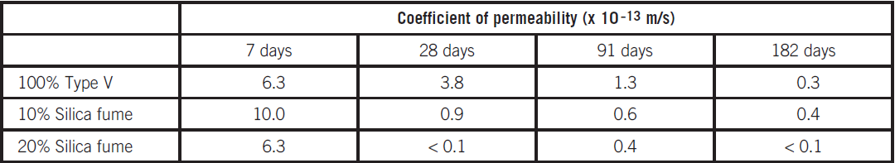
Permeability With Silica Fume
Effect of Silica Fume on Water Permeability (Hooton 1993)
Notes:
Tests show that the permeability of concrete decreases as the quantity of hydrated cementitious materials increases and is age dependent.

Slide 50
Shrinkage
Concrete shrinkage depends upon:
The water content of freshly mixed concrete
The amount of aggregate
The properties of the aggregate
Size and shape of the element
Relative humidity and temperature of the ambient air
Method of curing
Degree of hydration
Time
Notes:
Concrete kept continually moist will expand slightly. When permitted to dry, concrete will shrink. The primary factor influencing the amount of drying shrinkage is the water content of the freshly mixed concrete Drying shrinkage increases with increases in this water content.

Slide 51
Volume Stability and Crack Control
Volume changes due to temperature, moisture, stress – 0.01%-0.08%
Thermal behavior similar to steel
Elastic deformation and creep
Cracking due to load or volume changes
Reinforcing steel used to reduce crack widths
Notes:
Hardened concrete changes volume due to changes in temperature, moisture, and stress. These volume or length changes may range from about 0.01% to 0.08%. Thermal volume changes of hardened concrete are about the same as those for steel. Concrete under stress deforms elastically. Sustained stress results in an additional deformation called creep. The rate of creep (deformation per unit of time) decreases with time. Concrete kept continually moist will expand slightly. When permitted to dry, concrete will shrink.

Slide 52
Crack Control
Two basic causes of cracks in concrete
Stress due to applied loads
Stress due to drying shrinkage, temperature changes, durability related distress, and restraint
Notes:
Drying shrinkage is an inherent, unavoidable property of concrete. However, properly positioned reinforcing steel is used to reduce crack widths, or joints are used to predetermine and control the location of cracks. Thermal stress due to fluctuations in ambient temperature also can cause cracking, particularly at an early age.

Slide 53
Joints
Contraction joints
  Grooved, formed, or sawed into sidewalks, driveways, pavements, floors and walls
Isolation joints
  Separate a concrete placement from other parts of a structure
Construction joints
  Separate areas of concrete placed at different times
Notes:
Joints permit movement in the plane of a slab or wall. They should extend to a depth of approximately one-quarter of the concrete thickness. Isolation joints permit horizontal and vertical movements. They should be used at the junction of floors with walls, columns, footings, and other points where restraint can occur. They extend the full depth of slabs and include a premolded joint filler. Construction joints occur where concrete work is concluded for the day. In slabs-on-ground, construction joints usually align with, and function as, control or isolation joints. They may also require dowels for load transfer.

Slide 54
Durability
Ability to resist weathering, chemicals, and abrasion
More exposure variety than other materials
Notes:
The durability of concrete may be defined as the ability of concrete to resist weathering action, chemical attack, and abrasion while maintaining its desired engineering properties.

Slide 55
Durability
Concrete deterioration
  Freeze-thaw and deicer salts
  Corrosion
  Carbonation
  ASR
  Abrasion
  Sulfate Attack
  Others
Notes:
Most durability concerns involved water in the concrete. There are other forms of concrete deterioration less common or which occur only in special conditions.

Slide 56

Aesthetics
Notes:
Pleasing decorative finishes can be built into concrete during construction. Pattern-stamped finish and colored surfaces are popular for decorative concretes.

Slide 57
Summary
Freshly mixed concrete
Hardened concrete

Slide 58
?

