Slide 1
Cold Weather Concreting
Design and Control of Concrete Mixtures
CHAPTER 20

Slide 2
Overview
Effect of Cold Weather
Adjusting Concrete Mixtures
Concreting Process
Curing
Maturity Concept

Slide 3
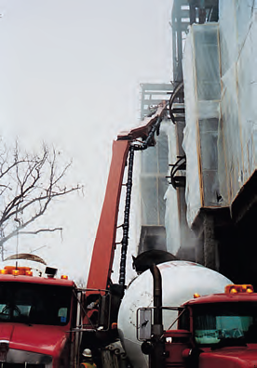
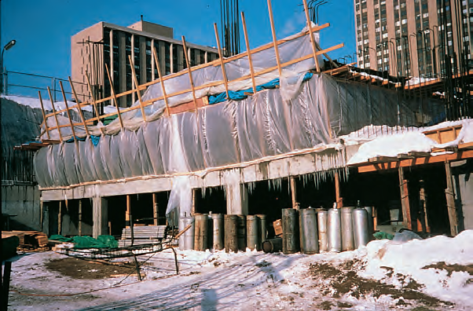
Cold Weather Concreting
Notes:
Concrete can be placed safely without damage from freezing in cold climates if certain precautions are taken. Preparations should be made to protect the concrete from excessively low temperatures. Concrete must be delivered at the proper temperature. Concrete should not be cast on frozen concrete or on frozen ground.

Slide 4
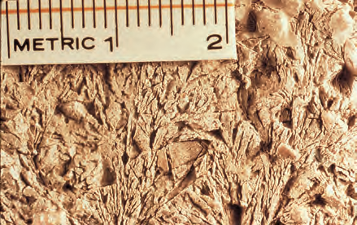
Effect of Freezing on Fresh Concrete
Notes:
Concrete gains very little strength at low temperatures. Ice crystal formations occur as unhardened concrete freezes. They do not occur in adequately hardened concrete. The disruption of the paste matrix by freezing can cause reduced strength gain and increased porosity.

Slide 5
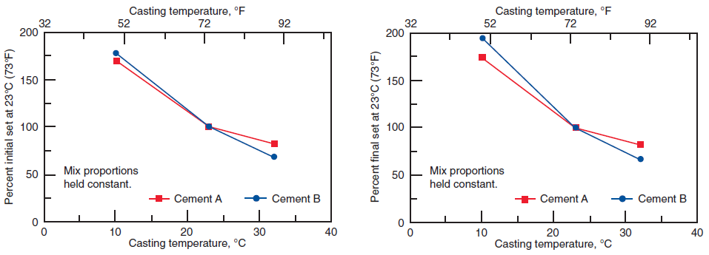
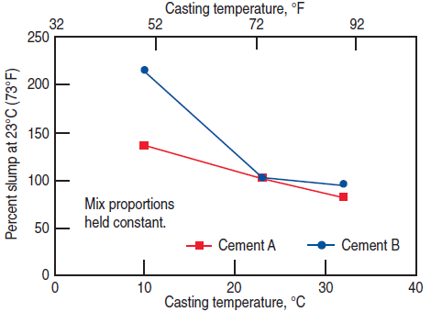
Strength Gain of Concrete
Notes:
Temperature affects the rate at which hydration of cement occurs-–low temperatures retard hydration and consequently retard the hardening and strength gain of concrete. If hardened concrete is frozen and kept frozen above about minus 10°C (14°F), it will still be able to gain strength slowly. However, below that temperature, cement hydration and concrete strength gain cease. The graphs on the top illustrate the effect of cool temperatures on setting time of concrete. The graph on the bottom illustrates the effects of casting temperature on slump.

Slide 6
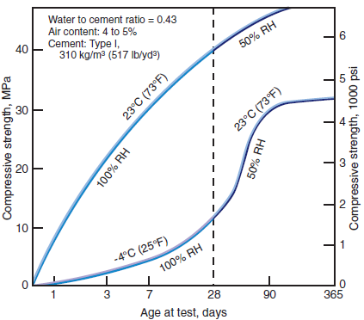
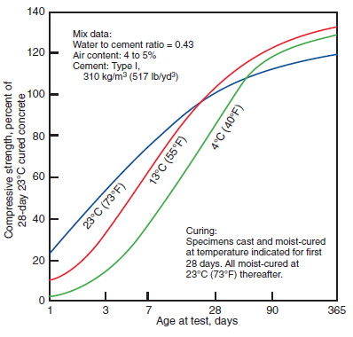
Strength Gain of Concrete
Notes:
These graphs show the age-compressive strength relationship for concrete that has been cast and cured at various temperatures. Note in the graph on the right that concrete cast and cured at 4°C (40°F) and 13°C (55°F) had relatively low strengths for the first week; but after 28 days—when all specimens were moist-cured at 23°C (73°F)—strengths for the 4°C (40°F) and 13°C (55°F) concretes grew faster than the 23°C (73°F) concrete and at one year they were slightly higher.

Slide 7
Heat of Hydration
Concrete generates heat during hardening as a result of the chemical reaction by which cement reacts with water to form a hard, stable paste
Dimensions of the concrete placement, ambient air temperature, initial concrete temperature, water-cement ratio, the composition, fineness, and amount of cementitious material all effect heat generation.

Slide 8
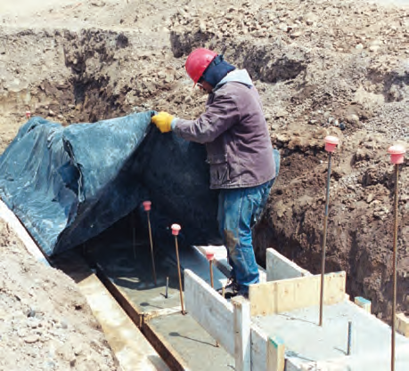
Heat of Hydration
Notes:
This image shows a concrete pedestal being covered with a tarpaulin just after the concrete was placed. The heat liberated during hydration will offset to a considerable degree the loss of heat during placing, finishing, and early curing operations. As the heat of hydration subsides, the need to cover the concrete becomes even more important.

Slide 9
Special Concrete Mixtures
High-early-strength concrete can be obtained by using one of a combination of the following:
Type III or HE high-early-strength cement
Additional portland cement
Set accelerating admixtures

Slide 10
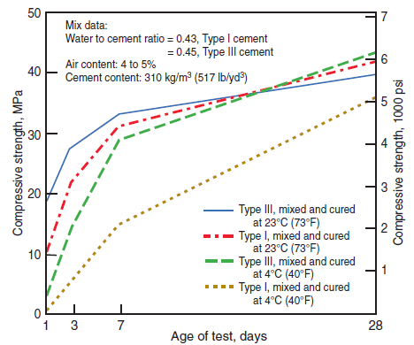
Special Concrete Mixtures
Klieger 1958
Notes:
High strength at an early age is desirable in cold weather construction to reduce the length of time temporary protection is required. The additional cost of high-early-strength concrete is often offset by earlier reuse of forms and shores, savings in the shorter duration of temporary heating, earlier setting times that allows the finishing of flatwork to begin sooner, and earlier use of the structure. Principal advantages occur during the first 7 days. At a 4°C (40°F) curing temperature, the advantages of Type III cement are more pronounced and persist longer than at the higher temperature.

Slide 11
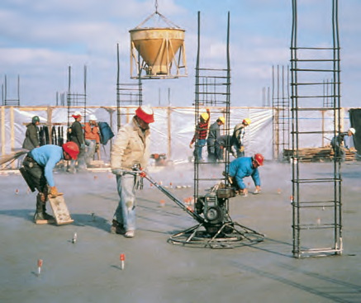
Special Concrete Mixtures
Notes:
Since the goal of using special concrete mixtures during cold weather concreting is to reduce the time of setting, a low water-cement ratio, low-slump concrete is particularly desirable, especially for cold-weather flatwork. In addition, bleed water is minimized so that finishing can be accomplished more quickly. Concrete mixtures with higher slumps provided by water or retarding water-reducing admixtures usually take longer to set.

Slide 12
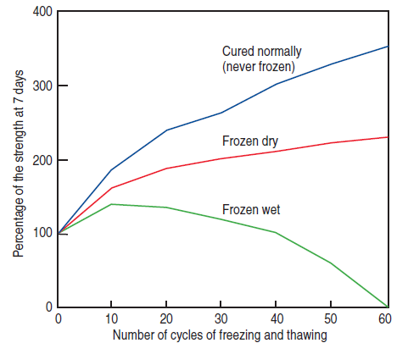
Air-Entrained Concrete
Powers 1956
Notes:
Entrained air is particularly desirable in any concrete that will be exposed to freezing weather while in service. Concrete that is not air entrained can suffer strength loss and internal as well as surface damage as a result of freezing and thawing, as shown in this graph. Air entrainment provides the capacity to absorb stresses due to ice formation within the concrete. Air entrainment should always be used for construction during the freezing months. The exception is concrete work done under roof where there is no chance that rain, snow, or water from other sources can saturate the concrete and where there is no chance of freezing.

Slide 13
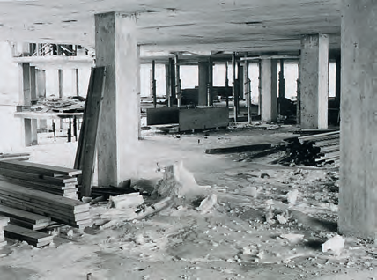
Air-Entrained Concrete
Notes:
There is a likelihood of water saturating a concrete floor during construction. Snow accumulated on the top deck and when heaters were used underneath to warm the deck below, the snow melted. Water ran through floor openings down to an unheated level. The water-saturated concrete froze, which caused a strength loss, particularly at the floor surface (pictured here).

Slide 14
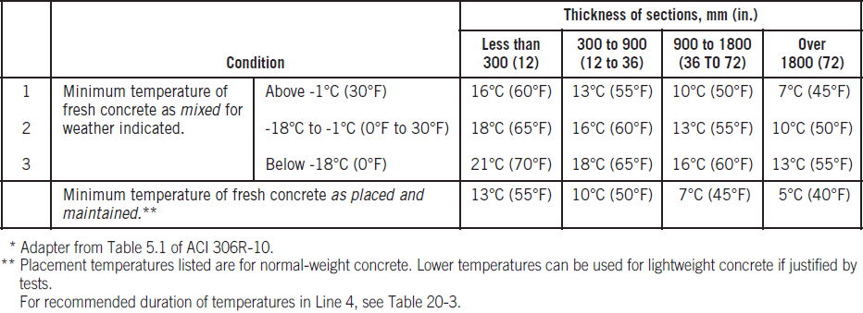
Temperature of Concrete
Notes:
The temperature of fresh concrete as mixed should not be less than shown in Lines 1,2, or 3 of this table for the respective thickness of section. Note that lower concrete temperatures are recommended for more massive concrete sections because heat generated during hydration is dissipated less rapidly in heavier sections. The recommended concrete temperatures as mixed are higher for colder weather.

Slide 15
Aggregate Temperature
Frozen aggregates must be thawed to avoid aggregate pockets in the concrete after batching, mixing, and placing
Aggregates usually contain frozen lumps and ice when the temperature is below freezing

Slide 16
Mixing-Water-Temperature
This equation shows the effect of temperature of materials on temperature of fresh concrete:
T= [0.22(T_{a}M_{a}+T_{s}M_{s}+T_{c}M_{c})+T_{w}M_{w}+T_{ws}M_{ws}+T_{wa}M_{wa}]
[0.22(M_{a}+M_{s}+M_{c})+M_{w}+M_{ws}+M_{wa}]
Notes:
Where:
T = temperature in degrees Celsius (Fahrenheit) of the fresh concrete
T_{a,} T_{s,} T_{c,} T_{w,} and T_{ws} and T_{wa} = temperature in degrees Celsius (Fahrenheit) of the coarse aggregate, sand, cement, added mixing water, and free moisture on sand and free moisture on coarse aggregate; generally T_{s} = T_{ws} and T_{a} = T_{wa}
M_{a}, M_{s}, M_{c}, M_{w}, M_{ws} and M_{wa} = mass in kilograms (pounds) of the coarse aggregate, sand, cement, mixing water, free moisture on sand, and free moisture on coarse aggregate

Slide 17
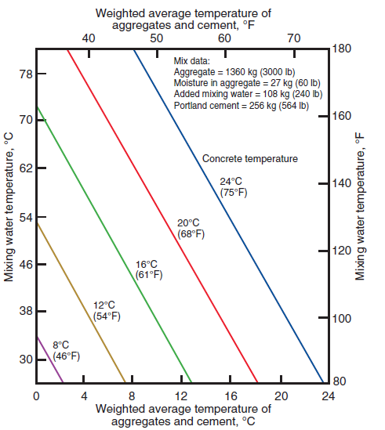
Temperature of Concrete
Notes:
Of the ingredients used to make concrete, mixing water is the easiest and most practical to heat. The mass of aggregates and cement in concrete is much greater than the mass of water. The graph shows the temperature of mixing water needed to produce heated concrete of required temperature. Temperatures are based on the mixture shown but are reasonably accurate for other typical mixtures.

Slide 18
Mixing-Water Temperature
When the temperature of one or more aggregates is below 0°C (32°F) the free moisture on the aggregates will freeze. The previous equation can be modified to account for additional heat required to return the frozen free moisture to a thawed moist state.
SI units – substitute M_{ws}(0.5T_{s} – 80) for T_{s}M_{ws}
subsitute M_{wa}(0.5T_{a} – 80) for T_{a}M_{wa}
Inch pounds – substitute M_{ws}(0.5T_{s} – 128) for T_{s}M_{ws}
subsitute M_{wa}(0.5T_{a} – 80) for T_{a}M_{wa}

Slide 19
Temperature Loss During Delivery
Temperature loss during haul time may be an issue when delivery times approaching or greater than 1 hour are anticipated. The following equations may be used to estimate temperature loss:
For revolving drum mixers T = 0.25 (t_{r} – t_{a})
For covered-dump body T = 0.10 (t_{r} – t_{a})
For open-dump T = 0.15 (t_{r} – t_{a})
Where:
t_{r} – Is required delivery temperature in degrees Celsius or Fahrenheit
t_{a} – Is required air temperature in degrees Celsius or Fahrenheit
Notes:
The concrete should be placed in the forms before its temperature drops below that given on Line 4 in the table discussed in a previous slide.

Slide 20
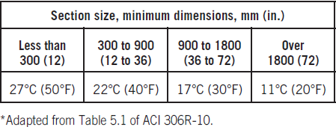
Cooling After Protection
Notes:
To avoid cracking of the concrete due to sudden temperature change at the end of the curing period, ACI Committee 306 requires that the source of heat and cover protection be slowly removed. The maximum allowable temperature drop during the first 24 hours after the end of the protection is shown in this table. The temperature drops apply to surface temperatures. Notice that the cooling rates for surfaces of mass concrete (thick sections) are lower than they are for thinner members.

Slide 21
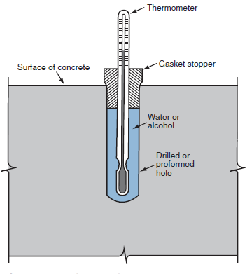
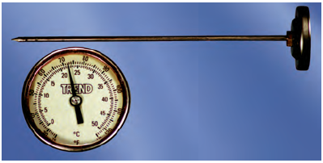
Monitoring Concrete Temperature
Notes:
Calibrated thermometers are needed to check the concrete temperatures as delivered, as placed, and as maintained. An inexpensive pocket thermometer is shown on the left. After the concrete has hardened, temperatures can be checked with special surface thermometers or with an ordinary thermometer that is kept covered with insulating blankets. A simple way to check temperature below the concrete surface is shown on the right. Instead of filling the hole with a fluid, it can be fitted with insulation. In that application the bulb would remain exposed.

Slide 22
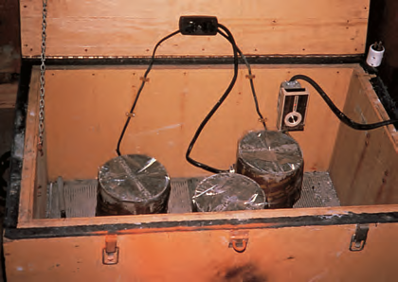
Monitoring Concrete Temperature
Notes:
Concrete test cylinders must be maintained at a temperature between 16°C (60°F) and 27°C (80°F) at the jobsite for up to 48 hours until they are taken to a laboratory for. For concrete mixtures with a specified strength of 40 MPa (6,000 psi) or greater, the initial curing temperature shall be between 20°C and 26°C (68°F and 78°F). During this period, cylinders should be kept in a curing box and covered with a nonabsorptive, nonreactive plate or impervious plastic bag. The temperature in the box should be accurately controlled by a thermostat.

Slide 23
Concreting on Ground
Placing concrete on the ground involves different procedures than those used at an upper level:
The ground must be thawed before placing concrete
Cement hydration will furnish some of the curing heat
Construction of enclosures is much simpler instead and use of insulating blankets may be sufficient
In the case of a floor slab, a vented heater is required if the area is enclosed
Hydronic heaters can be used to thaw subgrades using insulated blankets or to heat enclosures without concern for carbonation

Slide 24
Concreting on Ground
When the subgrade is frozen to a depth of approximately 80 mm (3 inches), the surface region can be thawed by:
Steaming
Spreading a layer of hot sand, gravel, or other granular material where the grade elevations allow it
Removing and replacing with unfrozen fill
Covering the subgrade with insulation for a few days
Using hydronic heaters under insulated blankets
Notes:
Placing concrete for floor slabs and exposed footings should be delayed until the ground thaws and warms sufficiently to ensure that it will not freeze again during the protection and curing period.

Slide 25
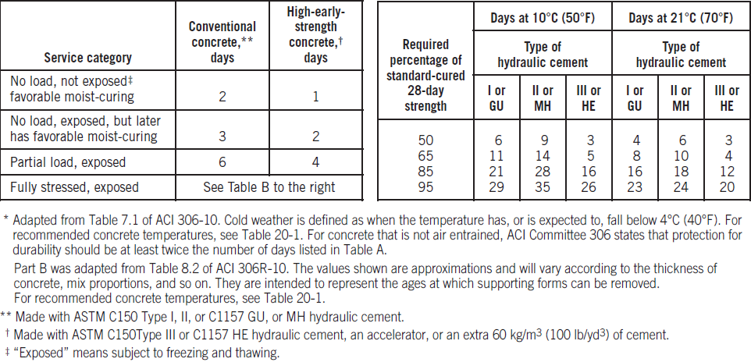
Concreting Above Ground
Notes:
The left table shows recommended duration of concrete protection in cold weather – air-entrained concrete. The right table shows recommended duration of concrete protection for Fully Stressed, Exposed, Air-Entrained Concrete

Slide 26
Concreting Above Ground
Working above ground in cold weather usually involves several different approaches in comparison to work at ground level:
The concrete mixture may not need to be changed to generate more heat because portable heaters can be used to heat the undersides of floor and roof slabs.
Enclosures must be constructed to retain the heat under floor and roof slabs.
Portable heaters used to warm the underside of formed concrete can be direct fired heating units (without venting)
Notes:
1. However, there are advantages to having a mix that will produce a high strength at an early age; for example, artificial heat can be cut off sooner, and forms can be recycled faster.

Slide 27
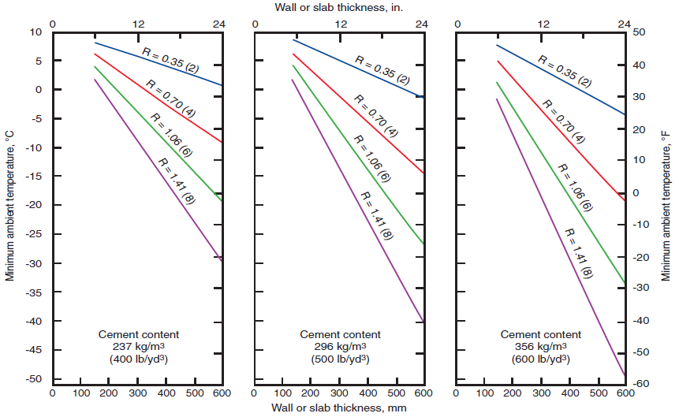
Notes:
When slab finishing is completed, insulating blankets or other insulation must be placed on top of the slab to ensure that proper curing temperatures are maintained. The insulation value (R) necessary to maintain the concrete surface temperature of walls and slabs above ground at 10°C (50°F) or above for 7 days may be estimated from these graphs. To maintain a temperature for longer periods, more insulation is required. ACI 306 has additional graphs and tables for slabs placed on ground at a temperature of 2°C (35°F).

Slide 28
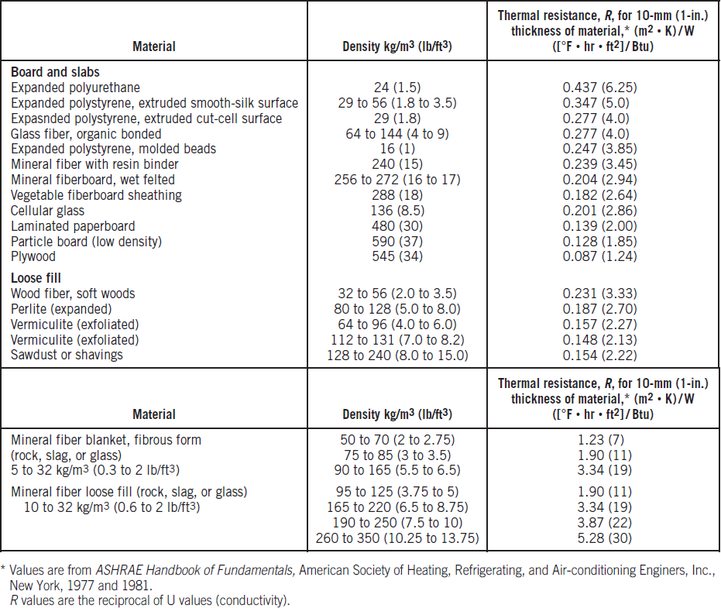
Notes:
Insulation can be selected based on R values provided by insulation manufacturers or by using the information in this table. When concrete strength development is not determined, a conservative estimate can be made if adequate protection at the recommended temperature is provided for the duration of time found in the previously shown table, concreting above ground.

Slide 29
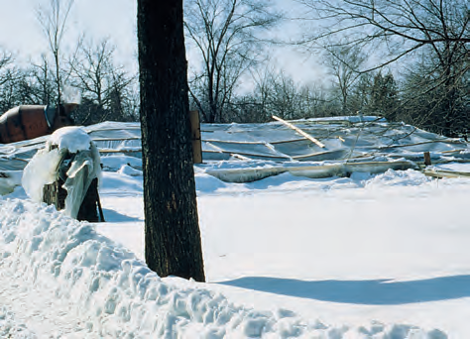
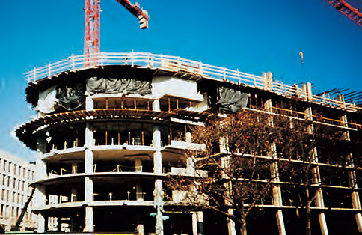
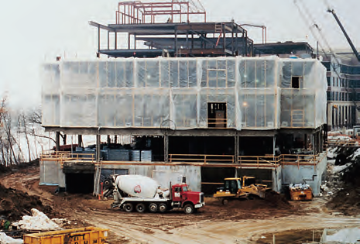
Enclosures
Notes:
Heated enclosures are very effective for protecting concrete in cold weather, but are expensive. Enclosures can be of wood, canvas tarpaulins, or polyethylene film. Prefabricated, rigid plastic enclosures are also available. When enclosures are being constructed below a deck, the framework can be extended above the deck to serve as a windbreak. Typically, a height of 2 m (6 ft) will protect concrete and construction personnel against biting winds that cause temperature drops and excessive evaporation. Wind breaks may be taller or shorter depending on anticipated wind velocities, ambient temperatures, relative humidity, and concrete placement temperatures.

Slide 30
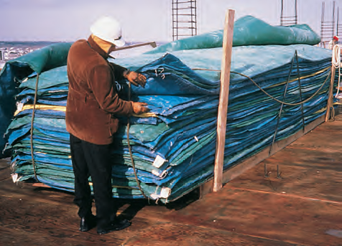
Insulating Material
Notes:
Heat and moisture can be retained in the concrete by covering it with commercial insulating blankets or batt insulation. The effectiveness of insulation can be determined by placing a thermometer under it and in contact with the concrete. Concrete pavements can be protected from cold weather by spreading 300 mm (1 ft) or more of dry straw or hay on the surface for insulation. Tarpaulins, polyethylene film, or waterproof paper should be used as a protective cover over the straw or hay to make the insulation more effective and prevent it from blowing away. The higher the R value, the better the thermal resistance of a given material

Slide 31
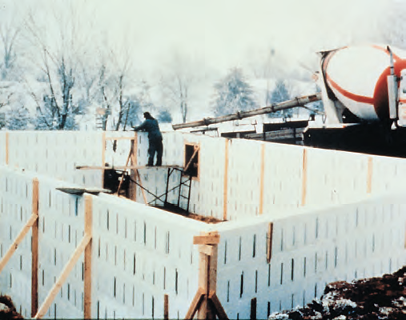
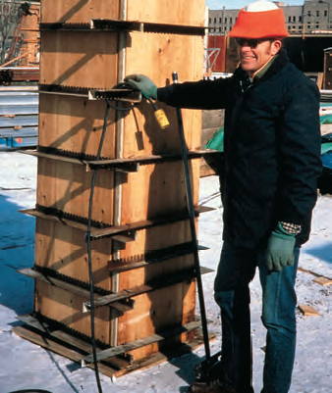
Insulating Concrete Forms
Notes:
Stay-in-place insulating concrete forms (ICF) became popular for cold-weather construction in the 1990s. ICFs (shown on the left) can be used to successfully place concrete in ambient temperatures as low as -29°C (-20°F). Forms built for repeated use often can be economically insulated with commercial blanket or batt insulation. The insulation should have a tough moisture proof covering to withstand handling abuse and exposure to the weather. Rigid insulation can also be used (shown on the right).

Slide 32
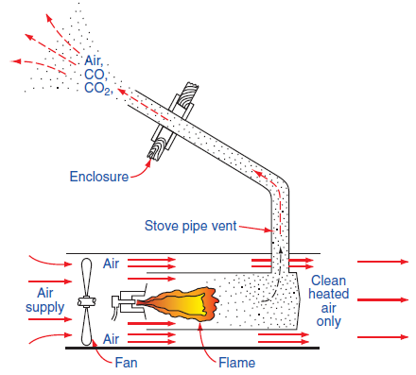
Heaters
Notes:
Three types of heaters are used in cold weather concrete construction: direct fired (pictured left), indirect fired (pictured (right), and hydronic systems (upcoming). In direct fired heaters are vented to remove the products of combustion. Direct fired units can be used to heat the enclosed space beneath concrete placed for a floor or a roof deck.

Slide 33
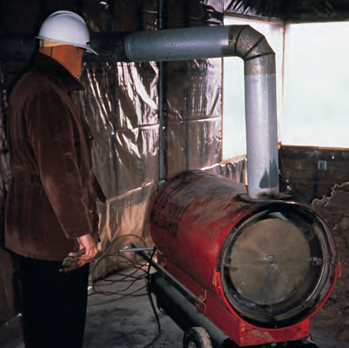
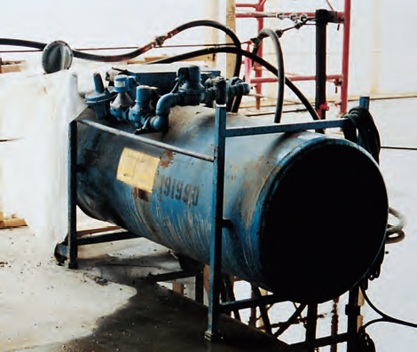
Heaters
Notes:
Left is an indirect-fired heater. Notice the vent pipe that carries combustion gases outside the enclosure. Right is a direct-fired heater installed through the enclosure, using a fresh air supply.

Slide 34
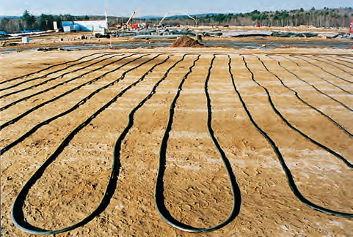
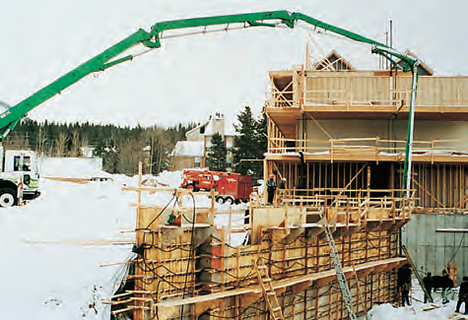
Hydronic Systems
Notes:
Hydronic systems transfer heat by circulating a glycol/water solution in a closed system of pipes or hoses. These systems transfer heat more efficiently than forced air systems without the negative effects of exhaust gases and drying of the concrete from air movement. Typical applications for hydronic systems include thawing and preheating subgrades. They are also used to cure elevated and on-grade slabs, walls, foundations, and columns. Hydronic systems can be used over areas much larger than would be practical to enclose. If a heated enclosure is necessary for other work, hydronic hoses can be sacrificed (left under a slab on grade) to make the slab a radiant heater for the structure built above.

Slide 35
Duration of Heating
Curing temperatures should be maintained until sufficient strength is gained to withstand exposure to low temperatures, anticipated environment, and construction and service loads.
The length of protection required to accomplish this will depend on the cement type and amount, whether accelerating admixtures were used, and the loads that must be carried.

Slide 36
Form Removal and Reshoring
It is good practice in cold weather to leave forms in place as long as possible. Even within heated enclosures, forms serve to distribute heat more evenly and help prevent drying and local overheating.
In-place strengths can be monitored using one of the following:
field-cured cylinders
probe penetration tests
cast-in-place cylinders
pullout testing
maturity testing

Slide 37
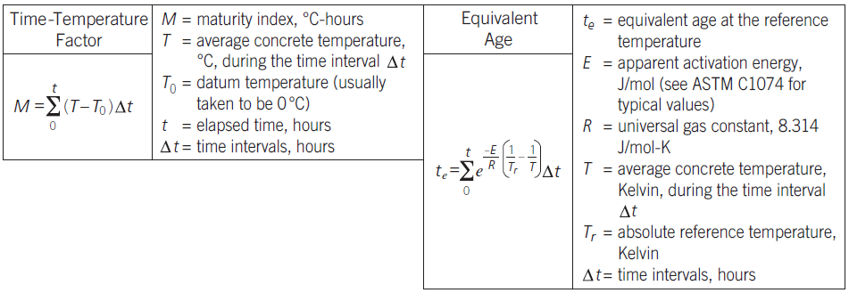
Maturity Concept
Notes:
The maturity concept is based on the principle that strength gain in concrete is a function of curing time and temperature. The maturity concept, as described in ACI 306R and ASTM C1074 can be used to evaluate strength development. Two maturity methods to estimate the in-place concrete strength are shown here. The Time-Temperature factor underestimates the strength development at elevated temperatures. The “Equivalent Age” maturity function is based on the Arrhenius equation; this function presents maturity in terms of equivalent age curing at a specified temperature.

Slide 38
Maturity Method
Notes:
To monitor the strength development of concrete in place using the maturity concept, the following information must be available:
The strength-maturity relationship of the concrete used in the structure. The results of compressive strength tests at various ages on a series of cylinders made of a concrete similar to that used in the structure; this must be done to develop a strength-maturity curve. These cylinders are cured in a laboratory at 23°C ± 2°C (73°F ± 3°F).
A time-temperature record of the concrete in place. Temperature readings are obtained by placing expendable thermistors or thermocouples at varying depths in the concrete. The location giving the lowest values provides the series of temperature readings to be used in the computation.

Slide 39
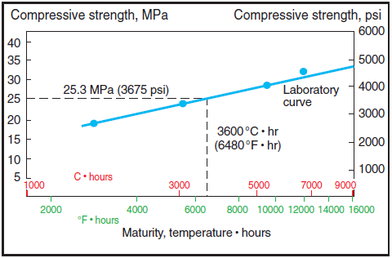
Maturity Method
Notes:
This graph shows an example using the maturity concept. Before construction begins, a calibration curve is drawn plotting the relationship between compressive strength and the maturity factor for a series of test cylinders (of the particular concrete mixture proportions) cured in a laboratory and tested for strength at successive ages.

Slide 40
Questions
?

