Slide 1
Test Methods
Design and Control of Concrete Mixtures
CHAPTER 21

Slide 2
Overview
Classes of Tests
Frequency of Testing
Precision and Bias
Testing Aggregates
Testing Freshly Mixed Concrete
Testing Hardened Concrete
Notes:
As quality control and acceptance testing are indispensible parts of the construction process, this module will cover the techniques of testing in the different physical states and compositions of concrete. Testing results provide important feedback on compliance with project specifications and may also be used to base decisions regarding any necessary adjustments to the concrete mixture.

Slide 3
Classes of Tests
Cementitious Materials
Aggregate
Fresh Concrete
Notes:
Cementitious materials are tested for their compliance with ASTM or AASHTO standard specifications to avoid abnormal performance such as early stiffening, delayed setting, or low strength in concrete. Aggregate is tested to determine its suitability for use in concrete and to assure uniformity. Fresh concrete is tested to evaluate the performance of available materials, establish mixture proportions, and control concrete quality during construction.

Slide 4
Frequency of Testing
The frequency of testing aggregates and concrete for typical batch-plant procedures depends largely upon the uniformity of materials, including the moisture content of aggregates, and the production process.
The number of strength tests will depend on the job specifications and the occurrence of variations in the concrete mixture.
In-place concrete strengths are typically estimated by testing specimens that have been field-cured in the same manner as concrete in the structure.

Slide 5
Precision and Bias
A precision and bias statement should include:
A statement of the test interlaboratory test program-materials, number of laboratories, number of test results per lab material, and the analysis of the data
A description of any deviation from the test method for each test result
The number of test determinations to form a result
Report on the repeatability and reproducibility standard deviations
Precision under any additional conditions – operator to operator, day to day
Notes:
The ASTM definition of precision is “the closeness of agreement between independent test results obtained under stipulated conditions”, and bias is “the difference between the expectation of the test results and an accepted reference value.”

Slide 6
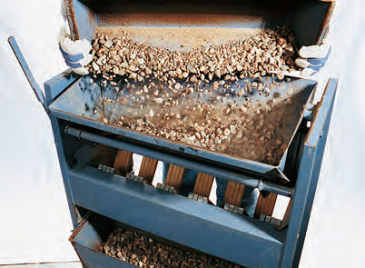
Testing Aggregates - Sampling
Notes:
Accurate sampling is important. The location in the production process where samples will be obtained must be carefully planned. Sampling from a conveyor belt, stockpile, or aggregate bin may require special sampling equipment; caution must be exercised to obtain a sample free from segregation of different particle sizes.

Slide 7
Testing Aggregates - Moisture Content
Using the mass measured before and after drying, the total moisture content can be calculated as follows:
P= 100(M-D)/D
Where:
P = moisture content of sample, percent
M = mass of original sample
D = mass of dried sample
Notes:
In this method, a measured sample of damp aggregate is dried either in a ventilated conventional oven, microwave oven, or over an electric or gas hotplate.

Slide 8
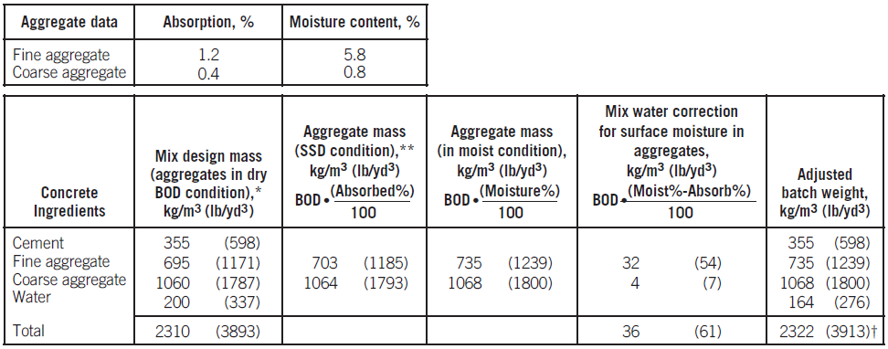
Moisture Content
Notes:
Only the surface moisture, not the absorbed moisture, becomes part of the mixing water in concrete. Surface moisture percentages are used to calculate the amount of water in the aggregates to reduce the amount of mix water added to the batch. This table illustrates a method of adjusting batch weights for moisture in aggregates.

Slide 9
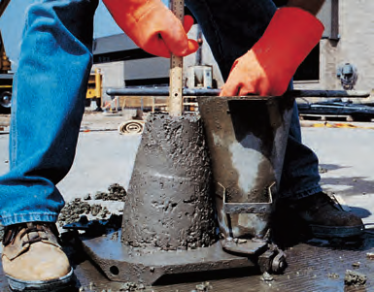
Consistency
Notes:
The slump test described by ASTM C143 (AASHTO T 119), is the most generally accepted method used to measure the consistency of concrete. In this context, the term consistency refers to the relative fluidity of fresh concrete. The dampened slump cone, placed upright on a flat, nonabsorbent rigid surface, should be filled in three layers of approximately equal volume. Therefore, the cone should be filled to a depth of about 70 mm (2.5 in.) for the first layer, a depth of about 160 mm (6 in.) for the second layer, and overfilled for the third layer. Each layer is rodded 25 times. The picture here illustrates a concrete sample with a lower slump.

Slide 10
Consistency
Notes:
Following rodding, the last layer is struck off and the cone is slowly raised vertically 300 mm (12 in.) in 5 ± 2 seconds. After the concrete settles to a new height, the empty slump cone is inverted and gently placed next to the settled concrete. The tamping rod is placed on the inverted cone to provide a reference for the original height. The slump is the vertical distance the concrete settles, measured to the nearest 5 mm (1⁄4 in.); a ruler is used to measure from the top of the slump cone to the displaced original center of the subsided concrete. Pictured here is a higher slump concrete test sample.

Slide 11
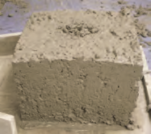
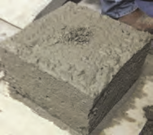
Consistency
A.
A.
B.
C.
Notes:
The Box Test investigates the concrete’s response to vibration. Unconsolidated concrete is placed in a 1 ft³ collapsible wood form and
vibrated in a consistent manner. Next, the wood forms are removed and the sides of the concrete are inspected for excessive voids. If the
sides have excessive voids, the mixture did not consolidate under the vibration and is not satisfactory. The edges can be inspected also.
Mixture that showed good consolidation and no edge slumping
Mixture that showed good consolidation and poor edge slumping
Mixture with poor consolidation

Slide 12
Temperature
Notes:
Because of the important influence concrete temperature has on the properties of freshly mixed and hardened concrete, many specifications place limits on the temperature of fresh concrete. The thermometer should be accurate to plus or minus 0.5°C (±1°F) and should remain in a representative sample of concrete for a minimum of 2 minutes or until the reading stabilizes. At least 75 mm (3 in.) of concrete should surround the sensing portion of the thermometer. The temperature test should be completed within 5 minutes after obtaining the sample.

Slide 13
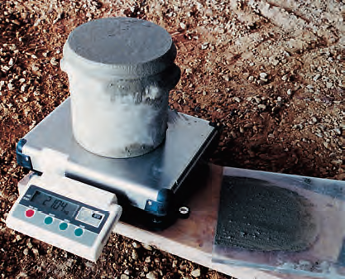
Density and Yield
Notes:
The density (unit weight) and yield of freshly mixed concrete (pictured above) are determined in accordance with ASTM C138, Standard Test Method for Density (Unit Weight), Yield, and Air Content (Gravimetric) of Concrete (AASHTO T 121). The results may be used to determine the volumetric quantity (yield) of concrete produced per batch. The test also can give indications of air content provided the relative densities of the ingredients are known.

Slide 14
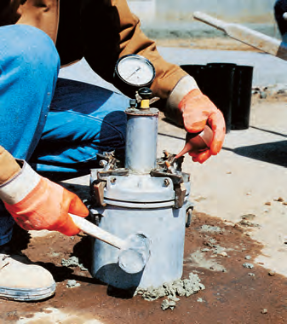
Air Content
Notes:
A number of methods for measuring air content of freshly mixed concrete can be used. Although they measure only total air volume and not air-void characteristics, laboratory tests have demonstrated that total air content is indicative of the adequacy of the air-void system. The applied pressure compresses the air within the concrete sample, including the air in the pores of aggregates. For this reason, the pressure method is not suitable for determining the air content of concretes made with some lightweight aggregates or other very porous materials. Aggregate correction factors that compensate for air trapped in normal-weight aggregates are relatively constant and, though small, should be subtracted from the pressure meter gauge reading to obtain the correct air content.

Slide 15
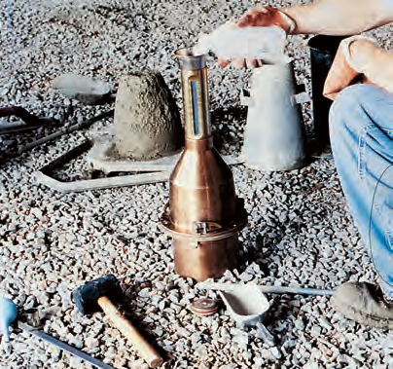
Air Content
Notes:
The volumetric method (shown) described in ASTM C173 (AASHTO T 196) is based on the removal of air from a known volume of concrete by agitating the concrete in a fixed volume of water-isopropyl alcohol mixture. This method can be used for concrete containing any type of aggregate, including lightweight or porous materials. An aggregate correction factor is not necessary with this test. The volumetric test is not affected by atmospheric pressure, and the specific gravity of the concrete ingredients need not be known. Care must be taken to agitate the sample sufficiently to remove all air.

Slide 16
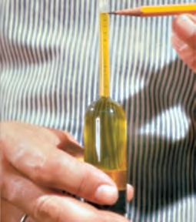
Air Content
Notes:
The gravimetric method, ASTM C138 (AASHTO T 121), uses the same test equipment used that is for determining the density of fresh concrete (shown). The measured density of concrete is subtracted from the theoretical density as determined from the absolute volumes of the ingredients, assuming no air is present. This difference, expressed as a percentage of the theoretical density, is the air content. This method is suitable only where laboratory-type control is exercised. Significant changes in density can be a convenient way to detect variability in air content.

Slide 17
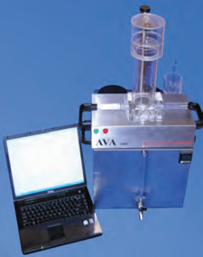
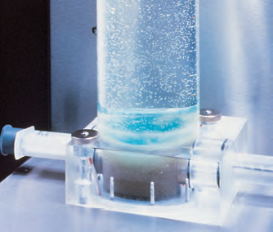
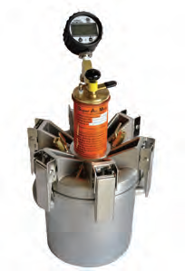
Air Void Analysis
Notes:
A test method has been developed to determine the key air-void parameters in samples of fresh air-entrained concrete. The method uses an apparatus known as an air-void analyzer (AVA). The test apparatus (left) determines the volume and size distributions of entrained air bubbles. The measured data are used to estimate the spacing factor, specific surface, and total volume of entrained air. The viscous liquid retains the original bubble sizes. Large bubbles rise faster than small ones through the liquids. As air bubbles accumulate under the pan, the buoyancy of the pan increases (middle). The balance measures this change in buoyancy, which is recorded as a function of time and can be related to the number of bubbles of different size. Testing concrete before and after placement into forms can verify how the applied methods of transporting, placing, and consolidation affect the air-void system. The Super Air Meter (SAM) is a mater that uses sequential pressures to determine the air void volume and distribution.

Slide 18
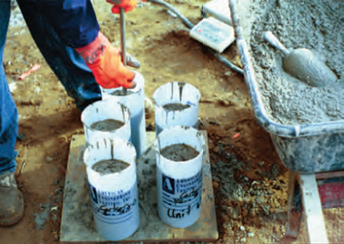
Strength Specimens
Notes:
Specimens molded for strength tests should be made and cured in accordance with ASTM C31 (AASHTO T 23), and laboratory-molded specimens according to ASTM C192 (or AASHTO R39). Molding of strength specimens should be started within 15 minutes after the composite sample is obtained. Traditionally, the standard test specimen for compressive strength of concrete with a nominal maximum aggregate size of 50 mm (2 in.) or smaller was a cylinder 150 mm (6 in.) in diameter by 300 mm (12 in.) high.

Slide 19
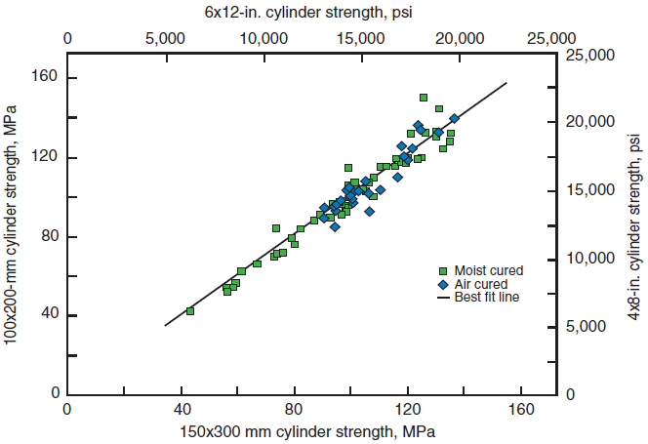
Strength Specimens
Notes:
The 100-mm x 200-mm (4-in. x 8-in.) cylinders are easier to cast, requires less material, weigh considerably less than 150-mm x 300-mm (6-in. x 12-in.) cylinders and requires less storage space for curing. In addition, the smaller cross-sectional area allows the use of smaller capacity testing machines to test high-strength concrete cylinders. The difference in indicated strength between the two cylinder sizes is insignificant as illustrated here. The standard deviation and coefficient of variation of 100-mm (4-in.) cylinders is slightly higher or similar to that for 150-mm (6-in.) cylinders.

Slide 20
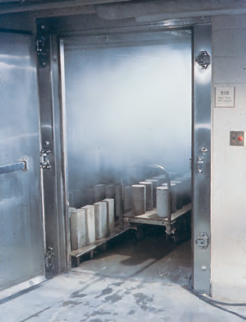
Strength Specimens
Notes:
The strength of a test specimen can be greatly affected by jostling, changes in temperature, and exposure to drying, particularly within the first 24 hours after casting. Thus, test specimens should be cast in locations where subsequent movement is unnecessary and where protection is available. Cylinders and test beams should be protected from rough handling at all ages/ Standard testing procedures require that specimens be cured under controlled conditions, either in the laboratory or in the field. Standard curing gives an accurate indication of the quality of the concrete as delivered.

Slide 21
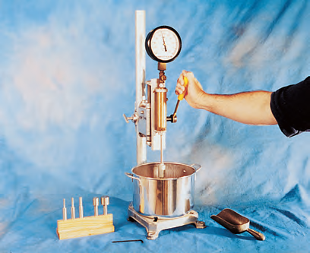
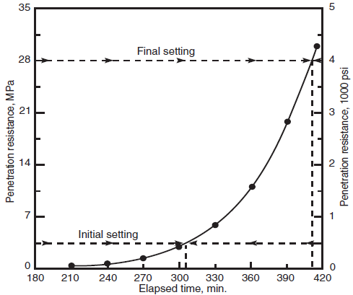
Time of Setting
Notes:
ASTMC403 (AASHTO T 197), is used to determine the time of setting of concrete by means of penetration resistance measurements made at regular time intervals on mortar sieved from the concrete mixture (left). The initial and final time of setting are determined as the times when the penetration resistance equals 3.4 MPa (500 psi) and 27.6 MPa (4000 psi). Typically, initial setting occurs between 2 and 6 hours after batching and final setting occurs between 4 and 12 hours. Temperature, water cementitious materials ratio, and admixtures all affect setting time.

Slide 22
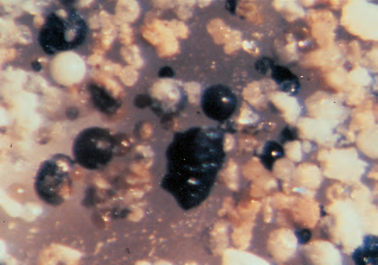
SCM Content
Notes:
Standard test methods are not available for determining the supplementary cementitious materials content of freshly mixed concrete. However, the presence of certain supplementary cementitious materials, such as fly ash, can be determined by washing a sample of the concrete’s mortar over a 45 μm (No. 325) sieve and using a stereo microscope (150 to 250 X) to view the residue retained. Fly ash particles appear as spheres of various colors. Sieving the mortar through a 150- or 75-μm (No. 100 or 200) sieve is helpful in removing sand grains.

Slide 23
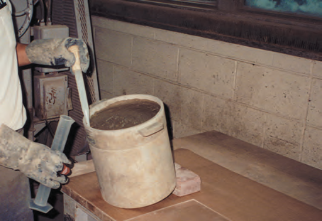
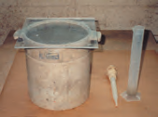
Bleeding
Notes:
The bleeding tendency of fresh concrete can be determined by two methods described in ASTM C232(AASHTO T 158). One method consolidates the specimen by tamping without further disturbance; the other method consolidates the specimen by vibration after which the specimen is vibrated intermittently throughout the test. The bleeding tendency is expressed as the volume of bleed water at the surface per unit area of exposed concrete, or as a percentage of the net mixing water in the test specimen. Typical values range from 0.01 to 0.08 mL/cm2 or 0.1% to 2.5% of mixing water. The bleeding test is rarely used in the field, but it is useful for evaluating alternative mixtures in the laboratory.

Slide 24
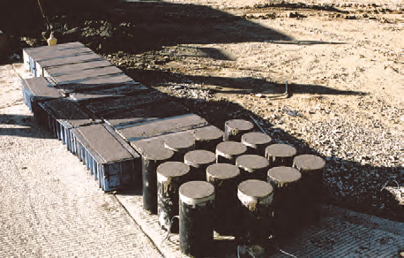
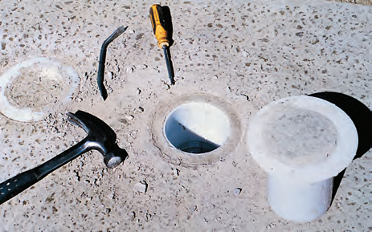
Strength of Hardened Concrete
Notes:
Strength tests of hardened concrete can be performed on the following: (1) specimens molded from samples of freshly mixed concrete and cured in accordance with ASTM C31 or ASTM C192 (AASHTO T 23 and R 39) (left image); (2) in-situ specimens cored or sawed from hardened concrete in accordance with ASTM C42 (AASHTO T 24); or (3) cast-in-place specimens made using special cylinder molds and cured in the structure in accordance with ASTM C873 (right image).

Slide 25
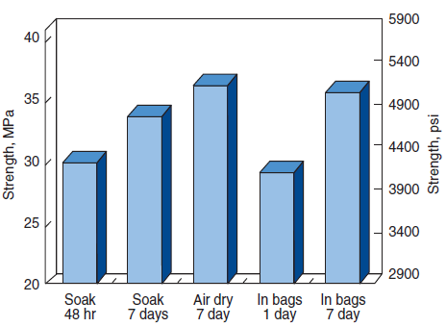
Strength of Hardened Concrete
Fiorato, Burg, and Gaynor 2000
Notes:
This graph shows the effects of core conditioning on the strength of drilled cores. Forty-eight hour water immersion of the specimens prior to testing yields significantly lower test results than air-drying specimens for seven days prior to testing. Measured strengths varied by up to 25%, depending upon the time and type of conditioning prior to testing. Before testing, ASTM C42 requires that cores be kept in sealed plastic bags for at least 5 days after last being wetted. Flexure test specimens that are saw-cut from in-place concrete are always immersed in lime-saturated water at 23.0°C ± 2.0°C (73.5°F ± 3.5°F) for at least 40 hours immediately prior to testing.

Slide 26
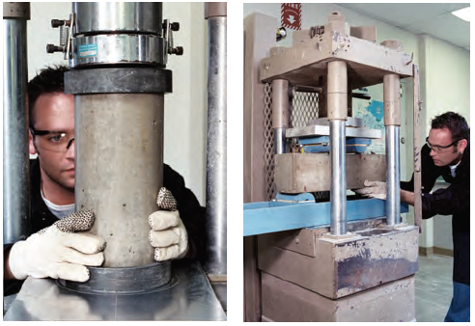
Strength of Hardened Concrete
Notes:
For both pavement thickness design and pavement mixture proportioning, the modulus of rupture (flexural strength) should be determined by ASTM C78 (AASHTO T 97). However, ASTM C293 (AASHTO T 177) can be used for job control if empirical relationships to third-point loading test results are determined before construction starts. The moisture content of the specimen has considerable effect on the resulting strength. Beams for flexural tests are especially vulnerable to moisture gradient effects. A saturated specimen will show lower compressive strength and higher flexural strength than those for companion specimens tested dry.

Slide 27
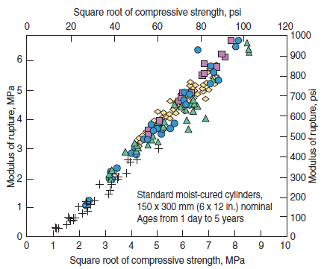
Strength of Hardened Concrete
Wood 1992
Notes:
The amount of variation in compressive-strength testing is far less than for flexural-strength testing. To avoid the extreme care needed in field flexural-strength testing, compressive-strength tests can be used to monitor concrete quality in projects designed on the basis of modulus of rupture. However, a laboratory-determined empirical relationship must be developed between the compressive and flexural strength of the concrete used.

Slide 28
Air Content
Notes:
The air-content and air-void-system parameters of hardened concrete can be determined using ASTM C457 to assure that the air-void system is adequate to resist damage from a freezing and thawing environment. The test is also used to determine the effects of different admixtures and methods of placement and consolidation on the air-void system. The test can be performed on molded specimens or samples removed from the structure. Using a polished section of a concrete sample, the air-void system is characterized with measurements from a microscope. The information obtained from this test method includes the volume of entrained and entrapped air, its specific surface (surface area of the air voids per unit volume of air), the spacing factor, and the number of voids per linear distance.

Slide 29
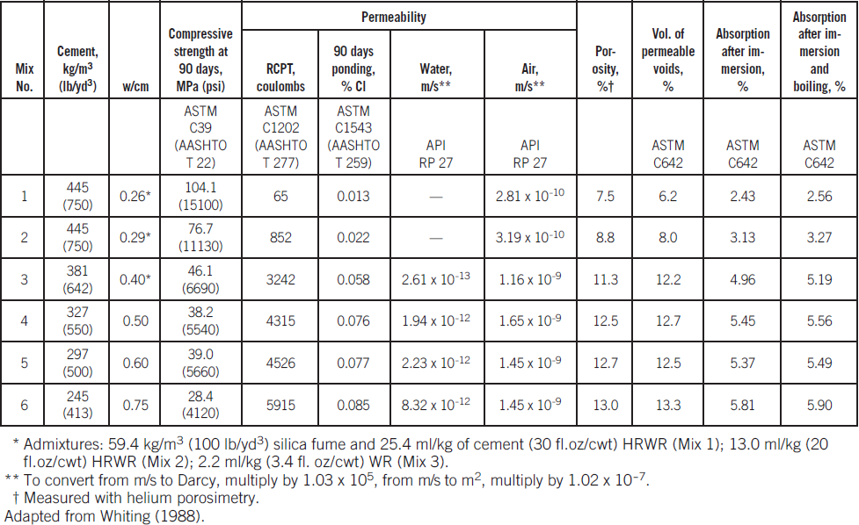
Notes:
The density, absorption, and voids content of hardened concrete can be determined in accordance with ASTM C642. It should be noted that the boiling procedure in ASTM C642 can render the specimens useless for other tests, especially strength tests. The rate of absorption (sorptivity) of water by hardened concrete can be determined using ASTM C1585. In this test, a concrete disk with a diameter of 100 mm (4 in.) and a height of 50 mm (2 in.) is preconditioned to control the internal relative humidity at the start of the test. The side of the disk and one end is sealed. The bare end is placed in water and the uptake of water is measured as a function of time. The water gain is plotted as a function of the square root of time, and the initial rate of water absorption is calculated through regression analysis.

Slide 30
Density, Absorption, and Voids
Saturated, surface-dry density (SSD) is often required for specimens prior to many other tests. In this case, the density can be determined by soaking the specimen in water for 48 hours and then determining its mass in air (in the SSD condition) and immersed in water. The SSD density is calculated as follows:
D_{SSD} = [M₁ρ]
[M₁-M₂]
Where:
D_{SSD} is density in the SSD condition
M₁ is the SSD mass in air, kg (lb)
M₂ is the apparent mass immersed in water, kg (lb)
ρ is the density of water, 1000 kg/m³ (62.4 lb/ft³).
Notes:
The SSD density provides an approximation of the density of freshly mixed concrete. The density of hardened concrete can also be determined using ASTM C1040 (AASHTO T 271). For this test, a relationship is established between gravimetric density measurements of concrete mixtures and nuclear gauge measurements.

Slide 31
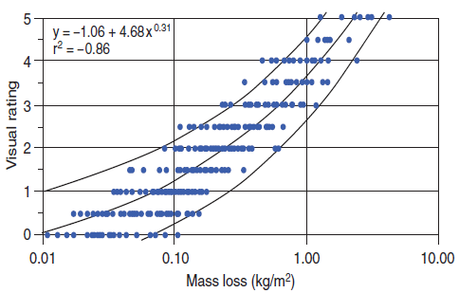
Resistance to Freezing and Thawing
Pinto and Hover 2001
Notes:
The freeze-thaw resistance of concrete is usually determined in accordance with ASTM C666 (AASHTO T 161). Prismatic specimens are monitored for changes in the dynamic modulus of elasticity, mass, and specimen length over a period of 300 or more cycles of freezing and thawing. ASTM C1646 can be used to prepare test specimens to evaluate the performance of coarse aggregates in air-entrained concrete when tested using ASTM C666. Concrete that will be exposed to deicers as well as freezing in a saturated condition should be tested for deicer-scaling resistance using ASTM C672.

Slide 32
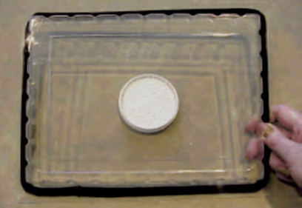
Moisture Testing
Notes:
The in-place moisture content, water vapor emission rate, and relative humidity of hardened concrete are useful indicators in determining if concrete is dry enough for the application of floor-covering materials and coatings. Moisture related test methods fall into two general categories: qualitative or quantitative.

Slide 33
Qualitative v. Quantitative
Qualitative tests provide a gross indication of the presence or absence of moisture while quantitative tests measure the amount of moisture.
Qualitative moisture tests include: plastic sheet, mat bond, electrical resistance, electrical impedance, and nuclear moisture gauge tests.
Quantitative tests are performed to verify that the floor is dry enough for these materials.
Quantitative test methods include: gravimetric moisture content, moisture vapor emission rate, and relative humidity probe tests.
Notes:
The most direct method for determining moisture content is to dry cut a specimen from the concrete element in question, place it in a moisture proof container, and transport it to a laboratory for testing. After obtaining the specimen’s initial mass, dry the specimen in an oven at about 105°C (220°F) for 24 hours or until constant mass is achieved. The difference between the two masses divided by the dry mass, multiplied by 100, provides the moisture content in percent. ASTM F1869 is a commonly used test for measuring the readiness of concrete for application of floor coverings (shown). The emission rate is expressed according to the standard as pounds of moisture emitted from 1000 ft² in 24 hours. Converted to SI units, the rate is expressed as micrograms per square meter per second (μg/m²s).

Slide 34
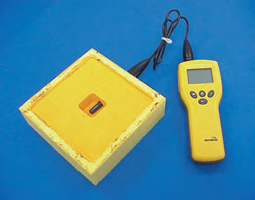
Moisture Testing
Notes:
ASTM F2420 uses a hygrometer or relative humidity probe sealed under an insulated, impermeable box to trap moisture in an air pocket above the floor. The probe is allowed to equilibrate for at least 72 hours or until two consecutive readings at 24-hour intervals are within the accuracy of the instrument (typically ± 3% RH). Acceptable relative humidity limits for the installation of floor coverings range from a maximum of 60% to 90%. It can require several months of air-drying to achieve the desired relative humidity.

Slide 35
Carbonation and pH Testing
Notes:
The depth or degree of carbonation can be determined by petrographic techniques (ASTM C856) through the observation of calcium carbonate-–the primary chemical product of carbonation. In addition, a pH stain (phenolphthalein) can be used to estimate the depth of carbonation by testing the pH of concrete. For example, upon application of a phenolphthalein solution to a freshly fractured or freshly cut surface of concrete, noncarbonated areas turn red or purple while carbonated areas remain colorless. The phenolphthalein indicator when observed against hardened paste changes color at a pH of 9.0 to 9.5. The pH of good quality noncarbonated concrete without admixtures is usually greater than 12.5.

Slide 36
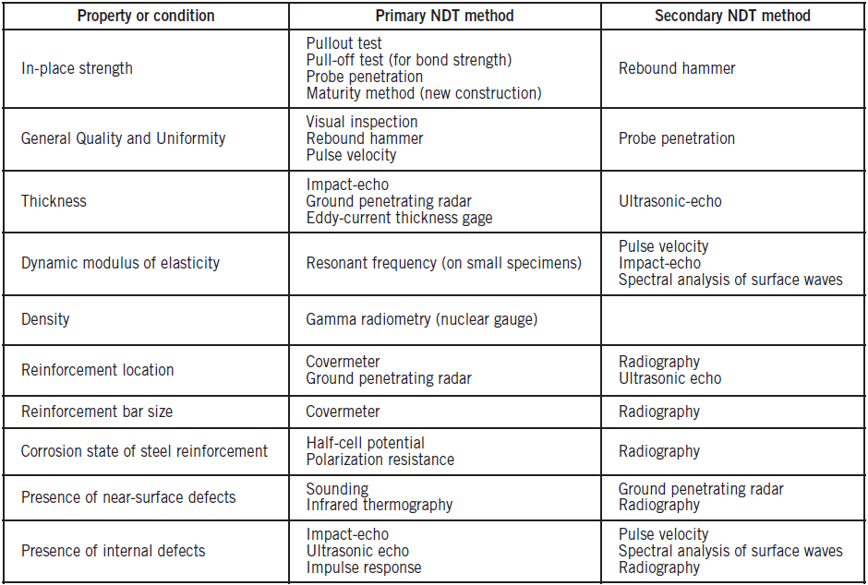
Notes:
Nondestructive tests (NDT) can be used to evaluate the relative strength and other properties of hardened concrete. The most widely used methods are the rebound hammer, probe penetration, pullout test, and a variety of tests based on stress-wave propagation. Other techniques include: X-rays, gamma radiography, neutron moisture gages, magnetic cover meters, eddy current, microwave absorption, and acoustic emissions. When using methods to estimate in-place strength, caution should be exercised against acceptance of nondestructive test results assuming a unique correlation to the compression strength. Empirical correlations must be developed for the specific instrument and concrete mixture prior to use. This table lists several nondestructive test methods along with main applications.

Slide 37
Nondestructive Test Methods
An NDT program may be undertaken for a variety of purposes regarding the strength or condition of hardened concrete, including:
determination of in-place concrete strength
monitoring rate of concrete strength gain
location of defects, such as voids or honeycombing in concrete determination of relative strength of comparable members; evaluation of concrete cracking and delaminations
evaluation of damage from mechanical or chemical actions steel reinforcement location, size, and corrosion activity
member dimensions.
Notes:
Irrespective of the type of NDT test used to estimate in-place strength, adequate and reliable correlation data with compressive strength data is necessary for a reliable estimate of in-place strength. In addition, correlation to in-place compressive strengths using drilled cores from one or two locations can provide guidance in interpreting NDT test results. NDT methods can then be used to survey larger portions of the structure. Care should be taken to consider the influence that varying sizes and locations of structural elements can have on the NDT test performed.

Slide 38
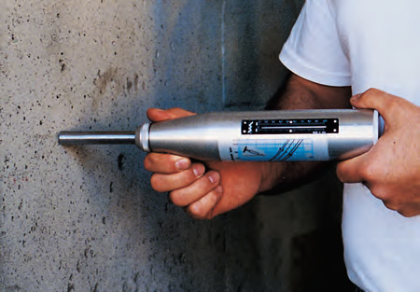
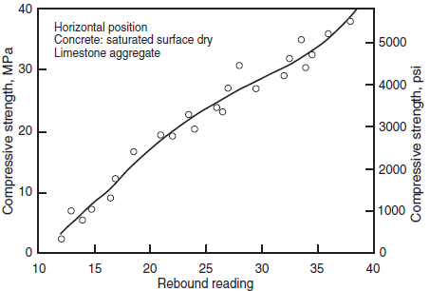
Rebound Hammer
Notes:
ASTM C805, is essentially a surface-hardness tester that provides a quick, simple means of checking concrete uniformity. It measures the rebound of a spring-loaded mass after it has struck a steel rod in contact with a smooth concrete surface. The rebound number reading gives an indication of the relative compressive strength and elastic modulus of the concrete. Two different concrete mixtures having the same strength but different elastic modulus will yield different readings. In view of this, an understanding of the factors influencing the rebound number is required.

Slide 39
Probe Penetration
Notes:
ASTM C803 is also called the Windsor Probe test. The Windsor probe, like the rebound hammer, is basically a hardness tester that provides a quick means of determining the relative strength of the concrete. The equipment consists of a powder-actuated gun that drives a hardened alloy probe into the concrete. The exposed length of the probe is measured and related to the compressive strength of the concrete by using a previously-established correlation curve.

Slide 40
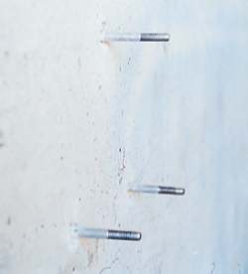
Probe Penetration
Notes:
The results of the Windsor-probe test will be influenced greatly by the type of coarse aggregate used in the concrete. Therefore, to improve accuracy of the estimated in-place strength, a correlation curve for the particular concrete to be tested should be developed. This can be done using a cast slab for probe penetration tests and companion cores or cast cylinders for compressive strength. Both the rebound hammer and the probe damage the concrete surface to some extent. The rebound hammer leaves a small indentation on the surface; the probe leaves a small hole and may cause minor cracking and small craters similar to popouts.

Slide 41
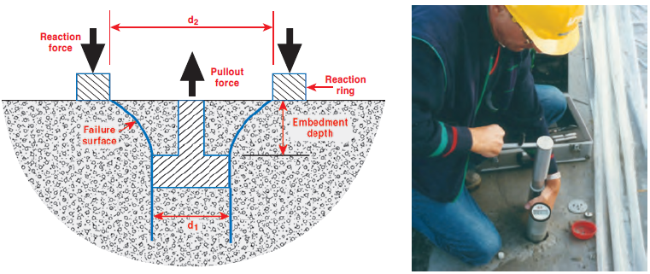
Pullout Tests
Courtesy of N. Carino
Notes:
ASTM C900 involves casting the enlarged end of a steel insert in the concrete to be tested and then measuring the force required to pull it out. The tensile load reacts against a ring bearing on the surface of the concrete, which constrains the failure along a well-defined surface.

Slide 42
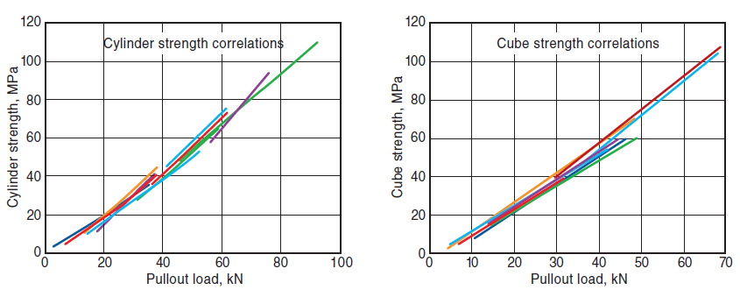
Pullout Tests
Peterson 1997
Notes:
The pullout strength has a strong correlation to compressive strength, and the relationship is affected little by factors such w/cm and type of materials used. ASTM C900 also describes a procedure for performing pullout tests in existing concrete. In this case, special hardware is used to insert a ring into an undercut created in the concrete by diamond studded router.

Slide 43
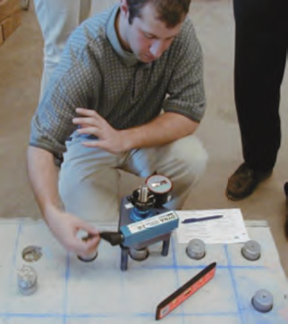
Pull-Off Tests
Courtesy of N. Carino
Notes:
The pull-off test in accordance with ASTM C1583 can be used to evaluate the strength of the concrete surface before applying a repair material and for evaluating the bond strength of an overlay bonded to concrete. A metal disc is bonded to the surface using a fast-setting adhesive, a partial depth core is drilled to a specified depth, and the disc is pulled off by applying direct tensile force. Failure can occur in one of several potential failure planes: in the overlay, at the interface, or in the substrate. The failure load is divided by the cross sectional area of the core and reported as the pull-off strength in MPa (psi).

Slide 44
Other Tests of Hardened Concrete
Portland Cement Content
SCM and Organic Admixture Content
Chloride Content
Petrographic Analysis
Volume and Length Change
Stress Wave and Vibration Tests
Acoustic Emission Tests
Nuclear (Radioactive) Tests
Covermeters
Ground Penetrating Radar
Infrared Thermography

Slide 45
Questions
?

