Slide 1
Portland, Blended and Other Hydraulic Cement
Design and Control of Concrete Mixtures
CHAPTER 5
Notes:
Design and Control of Concrete Mixtures, 16th edition, Chapter 5 – Portland, Blended and Other Hydraulic Cement

Slide 2
Overview
Manufacture of Portland Cement
Types of Portland Cement
Selecting and Specifying Cements
Chemistry of Portland Cement
Physical Properties of Cement
Transportation, Packaging, and Storage
Hot Cement
Notes:
This module consists of an overview of portland cement manufacturing, types of cement, and the chemical and physical properties.

Slide 3
Portland Cement
Notes:
Portland cements are hydraulic cements composed primarily of hydraulic calcium silicates. Portland cement is a fine powder that when mixed with water becomes the glue that holds aggregates together in concrete.

Slide 4
Portland Cement
Notes:
Portland cement was patented in 1824 by Joseph Aspdin. It is named as such, because in its final state, it resembles the color of the premier building stone of England, Portland limestone.

Slide 5
Sources of Raw Materials used in Manufacture of Portland Cement
Notes:
This table lists the predominant sources of raw materials used in the manufacture of portland cement.

Slide 6
Manufacturing Process
Notes:
Portland cement is manufactured by combining precise proportions of raw materials. These materials are then fired in a rotary cement kiln at high temperatures to form new chemical compounds which are hydraulic in nature. This image shows an aerial view of a cement plant. Every plant has significant differences in layout, equipment, or general appearance.

Slide 7
Manufacturing Process
Notes:
Cement manufacturing can be broken into four stages.
1. Selected raw materials are transported from the quarry and crushed to the size of a typical gravel.

Slide 8
Manufacturing Process
Notes:
Limestone, a primary raw material providing calcium in making cement, is quarried near the cement plant (left). Quarry rock is trucked to the primary crusher (right).

Slide 9
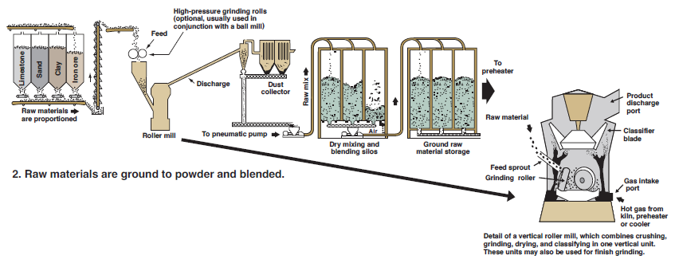
Manufacturing Process
Notes:
2. The stone is then milled and proportioned so that the resulting mixture has the desired chemical composition.

Slide 10
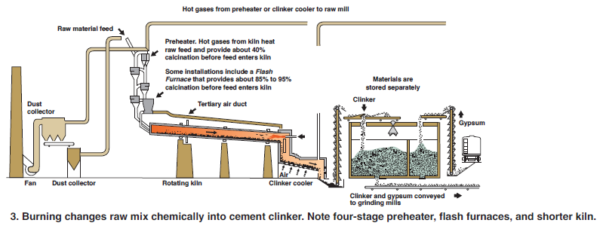
Manufacturing Process
Notes:
3. After blending, the ground raw materials are fed into the upper end of a kiln.

Slide 11
Cement Kiln
Notes:
Fuel is forced into the lower end of the kiln where it ignites and generates material temperatures of 1400 to 1550 degrees Celsius, or 2550 to 2800 degrees Fahrenheit. In the kiln, the raw materials reach approximately 1450°C (2700°F) and a number of chemical reactions occur, changing the raw material into portland cement clinker, grayish black pellets predominately the size of marbles or coarse sand.

Slide 12
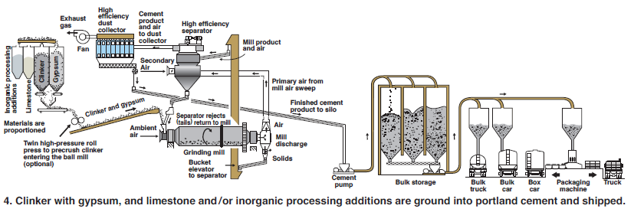
Manufacturing Process
Notes:
4. In the final stage of manufacture, clinker is rapidly cooled and then pulverized into a fine material. During this operation, small amounts of gypsum are added mostly to regulate the setting time of the cement.

Slide 13
Clinker
Notes:
The final product from the kiln is called clinker. Portland cement clinker is formed by burning calcium and siliceous raw materials in a kiln. This particular clinker is about 20 mm (3/4 in.) in diameter.

Slide 14
Gypsum
Notes:
Gypsum, a form of calcium sulfate, is interground with portland clinker to form portland cement. It helps control setting, drying shrinkage properties, and strength development.
Limestone and inorganic processing additions may also be added, each in amounts up to 5% by mass. Organic processing additions may be added in amounts up to 1% by mass.

Slide 15
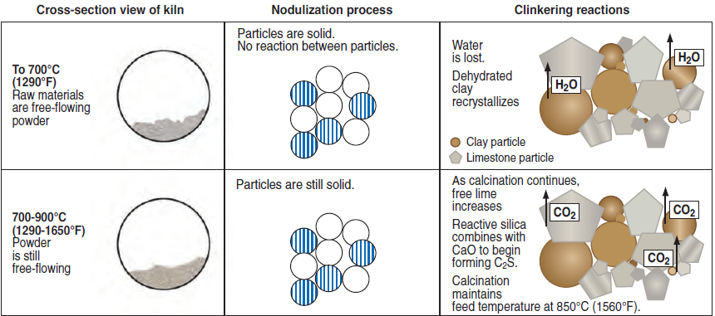
Kiln Reactions
Notes:
In the kiln, a number of chemical reactions occur. Burning changes the raw mix into clinker. In the first stage water is driven from the powder (700 degrees Celsius, or 1290 degrees Fahrenheit). Next, the carbon dioxide in the limestone is driven off in a process called calcination (700 to 900 degrees Celsius, 1290 to 1650 degrees Fahrenheit). At this stage, the first calcium silicates are nucleating to form-C₂S, or belite.

Slide 16
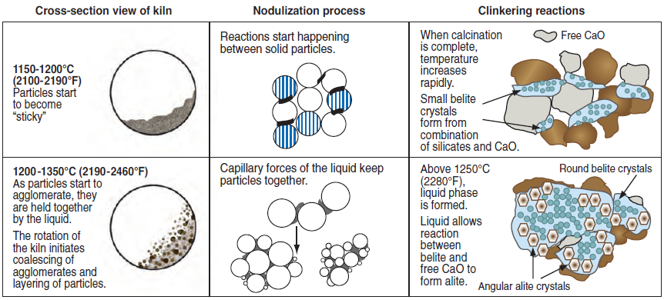
Kiln Reactions
Notes:
Next, the material becomes “sticky” and the temperature increases rapidly (Between 1150 and 1200 degrees Celsius, or 2100 and 2190 degrees Fahrenheit). Once the mixture reaches 1250 degrees Celsius, 2280 degrees Fahrenheit, the liquid phase forms and the free calcium oxide and the expanding crystals of belite form a new phase, C₃S, also called alite.

Slide 17
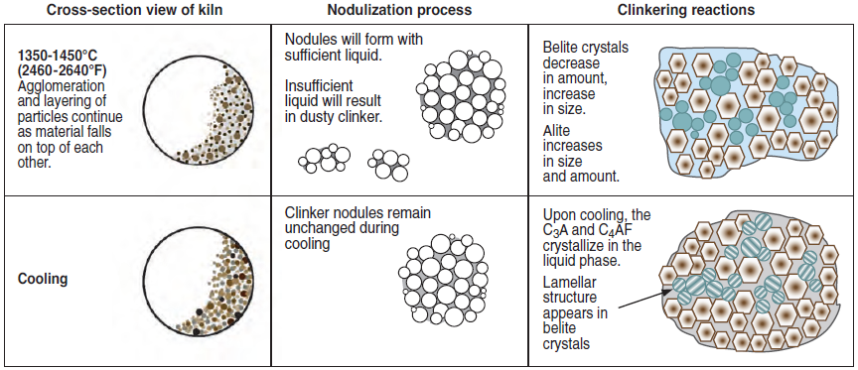
Kiln Reactions
Notes:
At peak temperatures (between 1350 and 1450 degrees Celsius, 2460 and 2640 degrees Fahrenheit), the C₂S continues to react with the free lime to form more alite. Additionally, nodules form as the liquid agglomerates crystals together forming clinker. Upon cooling, tricalcium aluminate, C₃A, and tetracalcium aluminoferrite, C₄AF, form.

Slide 18
Types of Portland Cement
ASTM C150/AASHTO M 85
  Type I
  Type II
  Type II (MH)
  Type III
  Type IV
  Type V
Notes:
Portland cements are manufactured to meet the specifications of ASTM C150 or AASHTO M 85. The requirements of these two standards are equivalent and provide for six basic types of portland cement.

Slide 19
Type I
Notes:
Type I portland cement is a general-purpose cement suitable for all uses where the special properties of other cement types are not required. Typical uses for normal or general use cements include pavements, floors, bridges, and buildings.

Slide 20
Type II
Notes:
Type II portland cement is used where protection against moderate sulfate attack is necessary. It is used in normal structures or elements exposed to soil or ground waters where sulfate concentrations are higher than normal, but not unusually severe.

Slide 21
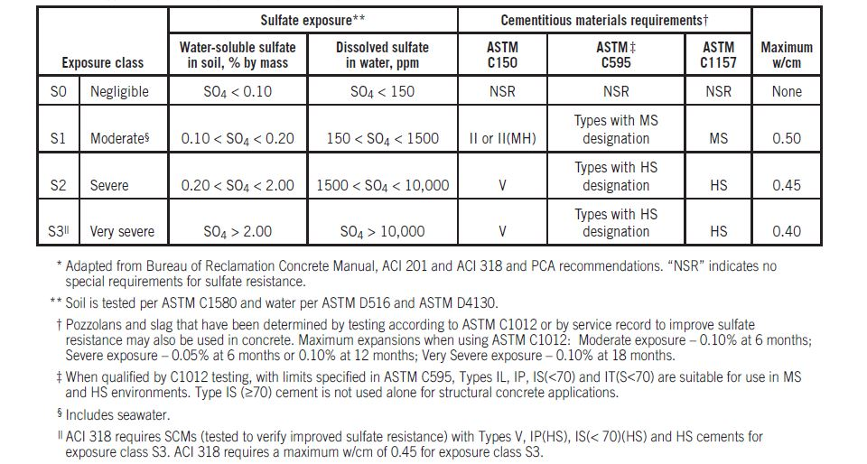
Types of Cement Required for Concrete Exposed to Sulfate in Soil or Water
Notes:
The table shows types of cement required for concrete exposed to sulfates in soil or water. Type II cement has moderate sulfate resistance properties because it contains no more than 8% tricalcium aluminate. Additionally, concrete exposed to seawater is often made with Type II cement. The use of Type II (or Type V) cement in concrete must be accompanied by the use of a low water-to-cementitious materials ratio (to achieve low permeability) to effectively control sulfate attack.

Slide 22
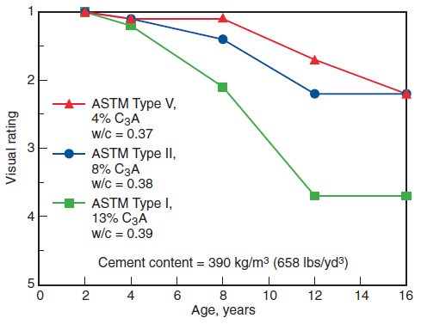
Sulfate Resistance by Type of Cement
Stark 2002
Notes:
This graph shows the performance of concretes made with different cements in sulfate soil. Type II and Type V cements have lower C₃A contents that improve sulfate resistance. The vertical axis is a visual rating in which a higher number means more deterioration.

Slide 23
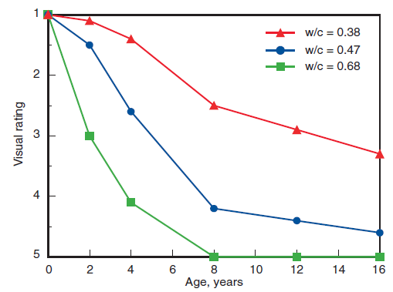
Sulfate Resistance by W/C
Stark 2002
Notes:
Improved sulfate resistance results from low water to cementitious materials ratios as demonstrated over time for concrete beams exposed to sulfate soils in a wetting and drying environment. Shown are average values for concretes containing a wide range of cementitious materials, including cement Types I, II, V, blended cements, pozzolans, and slags.

Slide 24
Type II (MH) and Type IV
Notes:
Type II (MH) and Type IV cements are manufactured to generate heat at a slower rate than most other cements. Moderate heat and low heat cements minimize heat generation in massive elements or structures such as very thick bridge supports, and dams.

Slide 25
Type III
Notes:
Type III portland cement provides strength at an earlier period than normally expected. High early strength cements are used where early concrete strength is needed, such as in cold weather concreting, fast track paving to minimize traffic congestion, and rapid form removal for precast concrete.

Slide 26
Type V
Stark 2002
Notes:
Type V portland cement is used in concrete exposed to severe sulfate environments ̶ principally where soils or groundwaters have high sulfate content. Type V cement concrete cannot withstand a severe sulfate exposure if the concrete has a high water-cementitious ratio. Specimens shown were used in the outdoor sulfate test plot in Sacramento, California. A comparison of ratings is illustrated: (left) a rating of 5 for 12-year old concretes made with Type V cement and a water-to-cement ratio of 0.65; and (right) a rating of 2 for 16-year old concretes made with Type V cement and a water-to-cement ratio of 0.37.

Slide 27
Air-Entraining Portland Cements
Type IA
Type IIA
Type II(MH)A
Type IIIA
Notes:
Specifications for four types of air-entraining portland cement are given in ASTM C150 and AASHTO M 85. They correspond in composition to ASTM Types I, II, II(MH), and II, except that small quantities of air-entraining additions are interground with the clinker during manufacture.

Slide 28
White Portland Cements
Notes:
White portland cement is made to conform to the specifications of ASTM C150, usually Type I or Type III. The manufacture of white cement is accomplished by limiting the amount of iron and manganese oxide in the raw materials.

Slide 29
Blended Hydraulic Cements
Notes:
Blended cements use a combination of portland cement or clinker and gypsum blended or interground with fly ash or other pozzolans, slag, or limestone. Shown is blended cement (center) surrounded by (right and clockwise) clinker, gypsum, portland cement, fly ash, slag, silica fume, and calcined clay.

Slide 30
Blended Hydraulic Cements
ASTM C595/AASHTO M 240
  Type IS (X) Portland blast-furnace slag cement
  Type IP (X) Portland-pozzolan cement
  Type IL (X) Portland-limestone cement
  Type IT (AX)(BY) Ternary blended cement
Notes:
Blended hydraulic cements must conform to the requirements of ASTM C595 or AASHTO M 240. The requirements of AASHTO M 240 are nearly identical to those in ASTM C595. ASTM C595 recognizes four primary classes of blended cements: Type IS, Type IP, Type IL, and Type IT. The letters X and Y in the designations represent the nominal mass percentage of the supplementary material, with the remaining mass being portland cement. For Type IT, which are ternary blends, “A” represents the supplementary material that has the highest percentage, while B is the lower percentage. “A” or “B” may be either S for slag cement, P for pozzolan, or L for limestone.

Slide 31
Type IS
Intergrinding of clinker and granulated slag
Blending of portland and slag cements
Combination
Type IS (<70)
Type IS (≥70)
Notes:
Type IS, or portland blast-furnace slag cement, is manufactured by either intergrinding portland cement clinker and granulated blast-furnace slag, blending portland cement and slag cement, or a combination of intergrinding and blending. Portland blast-furnace slag cement is classified into two categories depending on its slag cement content mass relative to total mass: Type IS (<70) and Type IS (≥70). Type IS (≥70) is not used alone for structural concrete applications.

Slide 32
Type IP
May be used for general construction
Up to 40% by mass pozzolan
Intergrinding, blending, or combination
Notes:
Type IP cements are portland-pozzolan cements and are used for general construction. The pozzolan content of these cements is up to 40% by mass. Like Type IS cements, Type IP cements are manufactured by intergrinding, blending, or a combination of both. Type IP may be designated as air-entraining, moderate sulfate resistant, high sulfate resistant, low heat of hydration, or with moderate heat of hydration by adding the suffixes (A), (MS), (HS), (LH), or (MH).

Slide 33
Type IL
5% < finely ground limestone ≤ 15%: of total mass
Perform similarly to Type I cements
Offer sustainability advantages
Notes:
Type IL cements may contain between 5-15% finely ground cements. Type IL cements may be designated as air-entraining, moderate heat of hydration, low heat of hydration, or resistant to alkali-silica reactivity by adding suffixes (A), (MH), or (LH), respectively.

Slide 34
Type IT
Portland cement + 2 SCMs
Requirements based on dominant SCM
Notes:
Ternary blended cements can sometimes offer advantages over binary blended cements in the form of optimization of overall performance for a specific application. Type IT cements meet the same chemical and physical requirements as for Types IS or IP, depending on which supplementary material is present in the greatest quantity. If there are equal parts pozzolan and slag, then Type IP is used.

Slide 35
Subcatagories
A- air-entraining
MS- moderate sulfate resistant
HS- high sulfate resistant
MH- moderate heat of hydration
LH- low heat of hydration
Notes:
Optional special properties such as air-entrainment, moderate sulfate resistance, high sulfate resistance, or moderate heat of hydration may be specified by adding the suffixes A, MS, HS, or MH, respectively.

Slide 36
Performance Based Hydraulic Cements
ASTM C1157
  Type GU : General use
  Type HE : High early strength
  Type MS : Moderate sulfate resistance
  Type HS : High sulfate resistance
  Type MH : Moderate heat of hydration
  Type LH : Low heat of hydration
Notes:
Cements meeting the requirements of ASTM C1157 meet physical performance test requirements, as opposed to prescriptive restrictions on ingredients or chemistry as found in C150 and C595. Type GU is a general purpose cement. Type HE is high early strength cement. Types MS and HS are moderate and high sulfate resistant cements and Types MH and LH are moderate and low heat of hydration cements.

Slide 37
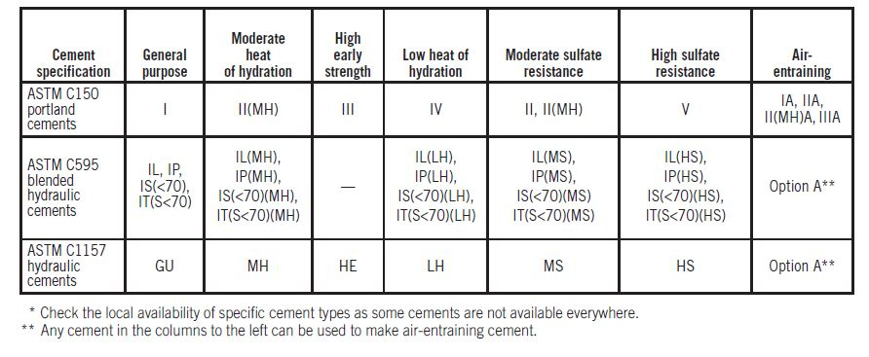
Applications for Hydraulic Cement
Notes:
This table shows hydraulic cements and their typical applications in concrete construction.

Slide 38
Masonry and Mortar Cements
Notes:
Masonry cements and mortar cements are hydraulic cements designed for use in mortar for masonry construction. Masonry cements meet the requirements of ASTM C91 and mortar cements meet the requirements of ASTM C1329. Both are used to make mortar according to ASTM C270. Masonry cements are also used in portland-cement based plaster or stucco.

Slide 39
Plastic Cements
Notes:
Plastic cement is a hydraulic cement that meets the requirements of ASTM C1328. It is used to produce portland cement based plaster or stucco. Plastic cements consist of a mixture of portland or blended hydraulic cement and plasticizing materials (such as limestone, hydrated or hydraulic lime), together with materials introduced to enhance one or more properties such as setting time, workability, water retention, and durability.

Slide 40
Finely-Ground Cements
Notes:
Finely-ground cements, also referred to as ultrafine cements, are hydraulic cements that are ground very fine for use in grouting into fine soil or thin rock fissures. These very fine cements consist of portland cement, slag cement, and other mineral additives.

Slide 41
Expansive Cements
Pfeifer and Perenchio 1973
Notes:
Expansive cement is a hydraulic cement that expands slightly during the early hardening period after initial set. It must meet the requirements of ASTM C845. Currently, three varieties of expansive cement are recognized: K, M, and S. The graph shows the length-change history of shrinkage compensating concrete containing Type E-1(S) cement and Type I portland cement concrete.

Slide 42
Oil-Well Cements
API Specification 10A
  Classes A through H
  Grade O – ordinary
  Grade MSR – moderate sulfate resistance
  Grade HSR – high sulfate resistance
Notes:
Oil-well cements are usually made from portland cement clinker or from blended hydraulic cement. Generally they must be slow-setting and resistant to high temperatures and pressures. The American Petroleum Institute’s Specification 10A includes requirements for eight classes---A through H. Each class is applicable for use at a certain range of well depths, temperatures, pressures, and sulfate environments. There are also three grades: ordinary, moderate sulfate resistance, and high sulfate resistance.

Slide 43
Rapid Hardening Cements
ASTM C1600
  Type URH : ultra rapid hardening
  Type VRH : very rapid hardening
  Type MRH : medium rapid hardening
  Type GRH : general rapid hardening
Notes:
Rapid-hardening, high-early strength, hydraulic cement is used in construction applications, such as fast-track paving, where fast strength development is required. They are classified according to ASTM C1600 as Type URH – ultra rapid hardening, type VRH – very rapid hardening, Type MRH – medium rapid hardening, and Type GRH – general rapid hardening.

Slide 44
Cements with Functional Additions
ASTM C226
  Air-entraining additions
ASTM C688
  Water-reducing
  Set-control
Notes:
Functional additions can be interground with cement clinker to beneficially change the properties of hydraulic cement. ASTM C226 addresses air entraining additions, while ASTM C688 addresses water-reducing additions and set-controlling additions, including accelerators and retarders.

Slide 45
Water-Repellent Cements
Reduce capillary water transmission
Do not affect water vapor transmission
Tile grouts, paint, stucco finish coats, specialty precast units
Notes:
Water-repellent cements, sometimes called waterproofed cements, are usually made by adding a small amount of stearate to cement clinker during final grinding. Water-repellent cements are used in tile grouts, paint, stucco finish coats, and specialty precast units.

Slide 46
Regulated-Set Cements
Portland-based cement with functional additions
  Set control
  Early strength development
Notes:
Regulated-set cement is a calcium flouroaluminate hydraulic cement that can be formulated and controlled to produce concrete with setting times ranging from a few minutes to one hour and with corresponding rapid early strength development.

Slide 47
Geopolymer Cements
Inorganic hydraulic cement
Alkali-activated alumino-silicate cement
Zeolitic or polysilate cement
www.geopolymer.org
Notes:
Geopolymer cements are inorganic hydraulic cements. Specifically, they are alkali-activated alumino-silicate cements that are sometimes called zeolitic or polysilate cements. They often contain industrial by-products, such as fly ash and are used in general construction, high early strength applications, and waste stabilization. These cements do not contain organic polymers or plastics.

Slide 48
Calcium Aluminate Cements
Applications:
  Chemical, heat, and corrosion resistant floors
  Repair
Chemical conversion after placement
Low water-cement ratios (less than 0.40)
Notes:
Calcium aluminate cement is not a portland-based cement, but can be combined with portland cement to make rapid setting concretes and mortars. Typical applications of calcium aluminate cement include floors that need to be chemically resistant, heat resistant, or corrosion resistant and repair applications.

Slide 49
Natural Cements
Used before portland cement became popular
ASTM C10
Used for historical restoration
Notes:
Natural cements are cements that pre-date portland cements. They are coarse grained hydraulic cements with slow strength gain properties. It was used extensively in canal, bridge, and building construction during the 1800s. Natural cements must meet the requirements of ASTM C10.

Slide 50
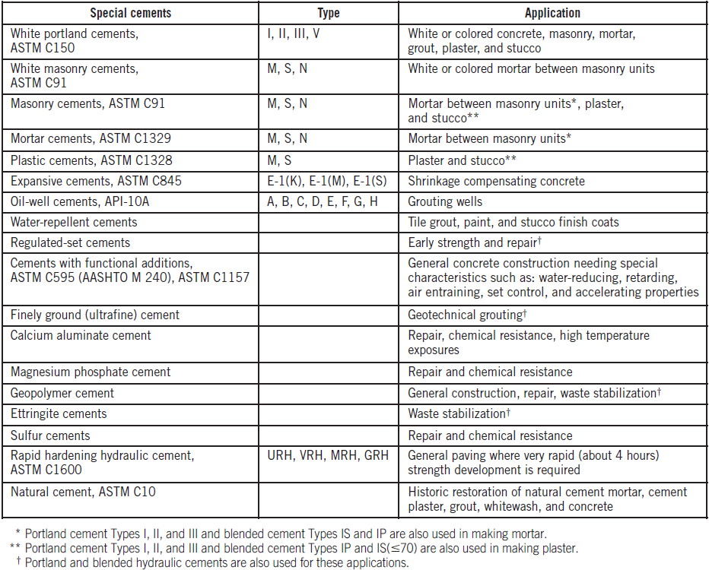
Special Cements
Notes:
Special cements are produced for particular applications.

Slide 51
Canadian and European Cement Specifications
CSA A3001
  Types GU, MS, MH, HE, LH and HS
  Blended option (b)
  Portland limestone cements (L)
EN 197-1
  Types CEM I, II, III, IV, and V
Notes:
CSA A3001 is the Canadian standard for cementitious material. If the cement is a blended cement, a lower-case b is appended to the designation. EN 197-1 is the European cement standard. Only Type CEM I is portland cement; the remainder are blended cements. Outside North America, there is typically no direct equivalency between ASTM and international cement standards because of differences in test methods and limits on required properties.

Slide 52
Shorthand Notation for Oxides
Cement chemist shorthand
  A = Al₂O₃ - alumina
  C = CaO - calcium oxide
  F = Fe₂O₃ - ferric oxide
  H = H₂O - water
  M = MgO - magnesia
  S = SiO₂ - silica
  S = SO₃ - sulfate
Notes:
Cement chemists use these shorthand notations for common cement chemistry oxides, all capital letters: A for alumina, C for calcium oxide, F for ferric oxide, H for water, M for magnesia, S for silica, and S-bar for sulfate.

Slide 53
Chemical Phases of Portland Cement
Clinker phases:
  Tricalcium silicate – C₃S
  Dicalcium silicate – C₂S
  Tricalcium aluminate – C₃A
  Tetracalcium aluminoferrite – C₄AF
Notes:
The four primary phases in clinker are tricalcium silicate, C₃S (which is 3 calcium oxides and one silica, remember that these are shorthand notation); dicalcium silicate, C₂S; tricalcium aluminate, C₃A; and tetracalcium aluminoferrite, C₄AF.
Tricalcium Silicate, C₃S,hydrates and hardens rapidly and is largely responsible for initial set and early strength. Dicalcium silicate, C₂S, hydrates and hardens slowly, contributing largely to strength increase at ages beyond one week. Tricalcium Aluminate, C₃A, liberates a large amount of heat during the first few days of hydration and hardening. Cements with low percentages of C₃A are more resistant to soils and waters containing sulfates. Tetracalcium Aluminoferrite, C₄AF, is the product resulting from the use of iron and aluminum raw materials to reduce the clinkering temperature during cement manufacture.

Slide 54
Chemical Phases of Portland Cement
Sulfate forms:
  Anhydrous calcium sulfate (anhydrite) – CS
  Gypsum – CSH₂
  Calcium sulfate hemihydrate - CSH_{½}
Notes:
The forms of calcium sulfate that are added to clinker to make portland cement are: anhydrous calcium sulfate; gypsum, or calcium sulfate dihydrate; and calcium sulfate hemihydrate.

Slide 55
Primary Phases
Notes:
C₃S and C₂S in clinker are also referred to as alite and belite. Alite generally constitutes 50% to 70% of the clinker, whereas belite accounts for only 10% to 25%. Aluminate phases constitute up to about 10% of the clinker and ferrite compounds generally up to as much as 15%. Alite is shown on the left and belite is shown on the right.

Slide 56
Hydration
Brunauer 1962
Notes:
The calcium silicates, C₂S on the left and C₃S on the right, react chemically with water to form calcium hydroxide and calcium silicate hydrate. The strength and other properties of hydrated cement are due primarily to calcium silicate hydrate.

Slide 57
Hydration of Cement
Copeland and Shulz 1962
Notes:
This image shows the hydration of normal portland cement. Broken fragments of angular calcium hydroxide crystallites are also present.
The aggregation of fibers and adhesion of the hydration particles are responsible for the strength development of portland cement paste.

Slide 58
Cement Paste
Notes:
These images show scanning-electron micrographs of hardened cement paste. The plate-like material is made from crystallized calcium hydroxide. The remainder is primarily calcium-silicate-hydrate (CSH) with some ettringite needles showing in the image on the right. The calcium silicate hydrate that is primarily responsible for the strength properties of the cement paste.

Slide 59
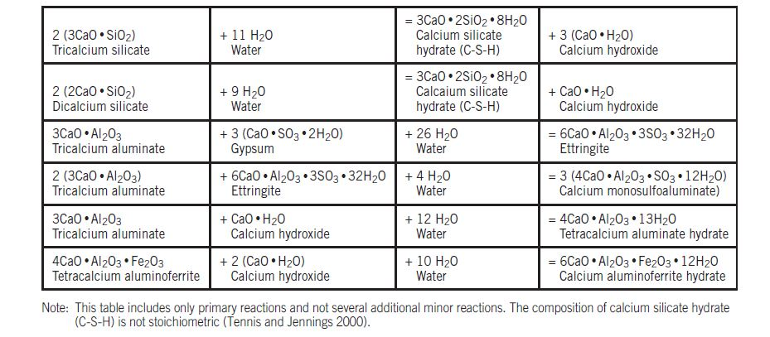
Hydration Reactions
Notes:
This table shows the general equations in traditional chemical notation for the various hydration reactions.

Slide 60
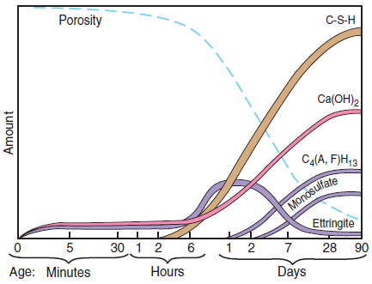
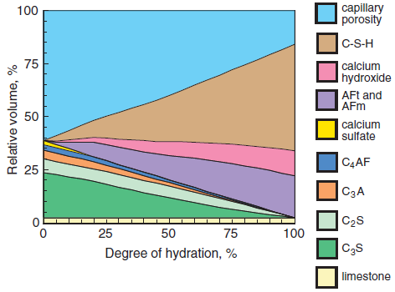
Hydration Products
Adapted from Locher, Richartz, and Sprung 1976
Adapted from Tennis and Jennings 2000
Notes:
Relative volumes of the cement phases and hydration products in the microstructure of hydrating portland cement pastes (left) as a function of time and (right) as a function of the degree of hydration as estimated by a computer model for a water to cement ratio of 0.50 Values are given for an average Type I cement composition (Gebhardt 1995): C₃S=55%, C₂S=18%, C₃A=10% and C₄AF=8%. “AFt and AFm” includes ettringite (AFt) and calcium monosulfoaluminate (AFm) and other hydrated calcium aluminate compounds.

Slide 61
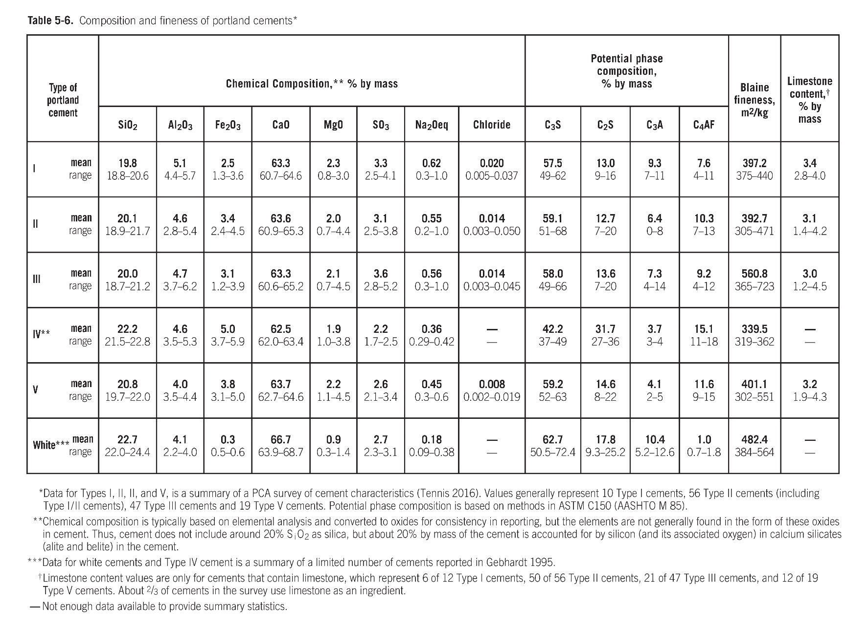
Composition and Fineness
Notes:
This table shows typical oxide and phase composition and fineness for each of the principal types of portland cement. Although phases are reported as simple oxides for consistency, they are not found in that oxide form in the cement. The amount of calcium, silica, and alumina establish the amounts of the primary phases in the cement and effectively the properties of the hydrated cement.

Slide 62
Reactivity
Tennis and Jennings 2000
Notes:
Relative reactivity of cement compounds. The curve labeled “Overall” has a composition of 55% C₃S, 18% C₂S, 10% C₃A,
and 8% C₄AF, an average Type I cement composition.

Slide 63
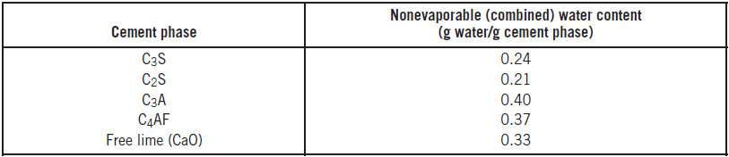
Water (Evaporable and Nonevaporable)
Notes:
Water is a key ingredient of pastes, mortars, and concretes. The space initially occupied by water in a cementitious mixture is either partially or completely replaced over time as the hydration reactions proceed. The image shows cement paste cylinders of equal mass and equal cement content, but mixed with different water to cement ratios, after all water has evaporated from the cylinders. The cylinder on the left has much higher residual porosity.
Nonevaporable water contents calculated for the major phases of portland cement are shown in this table. For a typical Type I cement, these values result in a calculated nonevaporable water to cement ratio of between 0.22 and 0.25.

Slide 64
Physical Properties of Cement
Compressive strength
Setting time
Early stiffening
Particle size and fineness
Soundness
Consistency
Heat of hydration
Loss on ignition
Density and relative density
Bulk density
Notes:
Specifications for cement place limits on both its physical properties and often its chemical composition. An understanding of the significance of some of the physical properties is helpful in interpreting results of cement tests.

Slide 65
Compressive Strength
Notes:
The strength development characteristics of cement are determined by measuring the compressive strength of 50 millimeter, 2 inch, mortar cubes tested in accordance with ASTM C109.

Slide 66
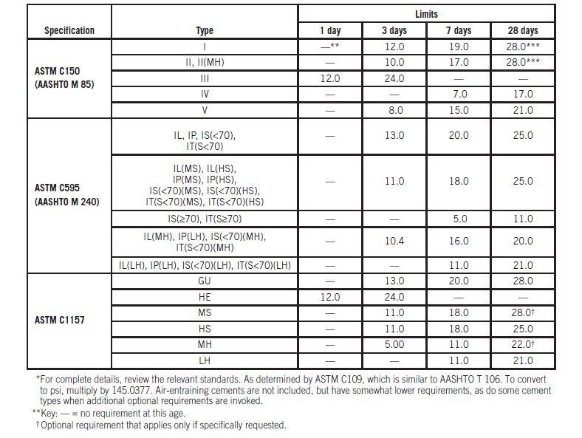
Compressive Strength
13.0
20.0
IL(MH), IP(MH), IS(<70)(MH), IT(S<70)(MH)
10.0
17.0
22.0
Notes:
This table shows the minimum compressive strength requirements as given in the various ASTM and AASHTO standards. These requirements are typically exceeded comfortably. In general, cement strengths cannot be used to predict concrete strengths with any degree of accuracy.

Slide 67
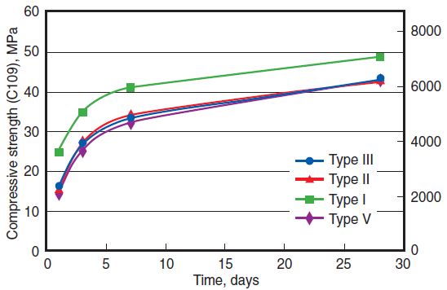
Compressive Strength
Tennis 2016
Notes:
This chart illustrates the strength development for standard mortars with various types of portland cement.

Slide 68
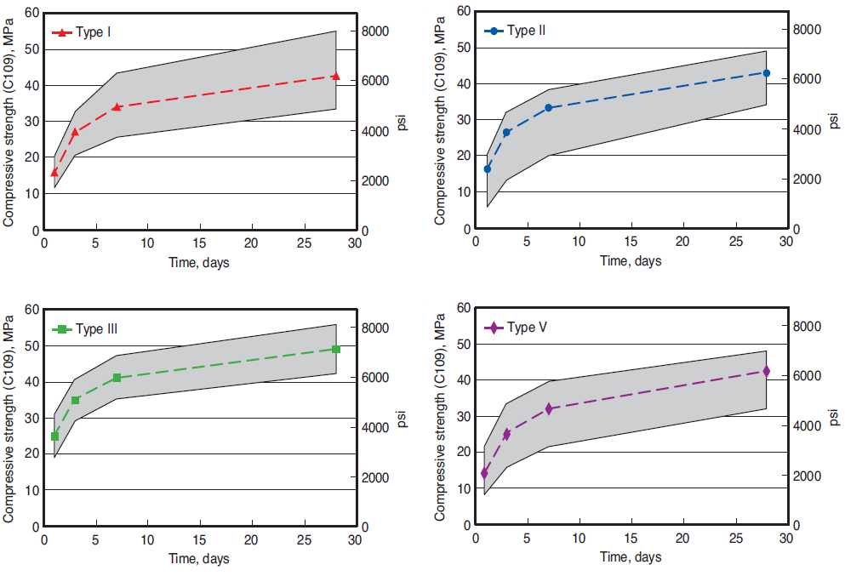
Compressive Strength
Tennis 2016
Notes:
These charts show mean values of ASTM C109 mortar cube strengths from a 2004 survey. Range of reported values indicated by shaded areas, and mean values by the dashed lines.

Slide 69
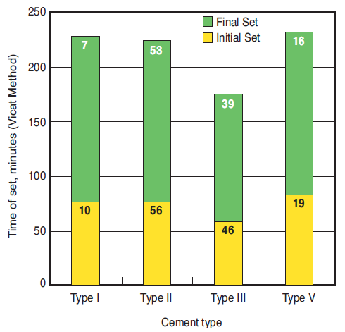
Setting Time
Tennis 2016
Notes:
The setting properties of hydraulic cement are measured to ensure that the cement is hydrating normally. The term initial set refers to the time that elapses from the moment water is added until the paste ceases to be fluid and plastic. The term final set refers to the time required for the paste to acquire a certain degree of hardness. The graph shows the time of set for portland cements. Type IV setting times are based on limited data in Gebhardt (1995).

Slide 70
Early Stiffening
False set
  Loss of plasticity without heat evolution
  Can be reversed by continued mixing
Flash set (Quick set)
  Rapid, early loss of workability
  High heat evolution
  Cannot be reversed without adding water
Notes:
Early stiffening is the early development of stiffness in the working characteristics or plasticity of cement paste, mortar, or concrete. This includes both false set and flash set.
False set is evidenced by a significant loss of plasticity shortly after mixing without the evolution of much heat. This stiffening is caused by the rapid crystallization of interlocking needle-like secondary gypsum. Additional mixing without added water breaks up these crystals to restore workability.
Flash set is evidenced by a rapid, early loss of workability, usually accompanied by the evolution of considerable heat. This is caused by the hydration of tricalcium aluminate without sufficient amounts and proper types of sulfate. Flash set cannot be dispelled and the plasticity cannot be regained without continued mixing with the addition of water.

Slide 71
Particle Size
Notes:
Portland cement consists of individual angular particles with a range of sizes. Approximately 95% of the cement particles are smaller than 45 microns, with the average particle around 15 microns. The graph on the right illustrates a typical particle size distribution for a Type I or Type II cement.

Slide 72
Fineness
Blaine test – ASTM C204
Notes:
Cement fineness is usually measured by the Blaine air-permeability test (ASTM C204), that indirectly measures the surface area of the cement particles per unit mass. Cements with finer particles have more surface area in square meters per kilogram of cement.

Slide 73
Fineness
Notes:
The 45-micrometer sieve (left), and electronic particle size analyzers (right) can also be used to determine values for fineness, although the results are not equivalent among different test methods.

Slide 74
Consistency
Notes:
Consistency refers to the relative mobility of a freshly mixed cement paste or mortar or to its ability to flow. During cement testing, pastes are mixed to normal consistency as defined by a penetration of 10±1 mm of the Vicat plunger(ASTM C187).
Consistency test for mortar using the flow table in accordance with ASTM C230. The mortar is placed in a small brass mold centered on the table (inset). For skin safety the technician wears protective gloves while handling the mortar. After the mold is removed and the table undergoes a succession of drops, the diameter of the pat is measured to determine consistency.

Slide 75
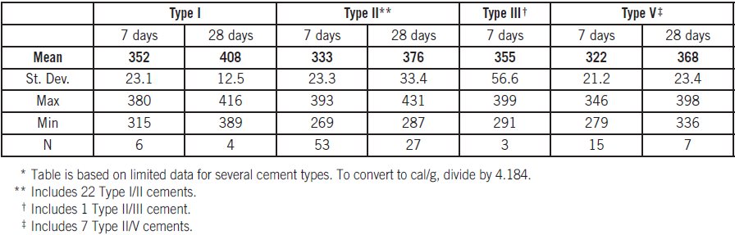
Heat of Hydration
Notes:
This table shows a summary of heat of hydration data obtained during a survey in 2007. The units are kilojoules per kilogram. These limited data show that Type III, high early strength, cement has a higher heat of hydration than other types.

Slide 76
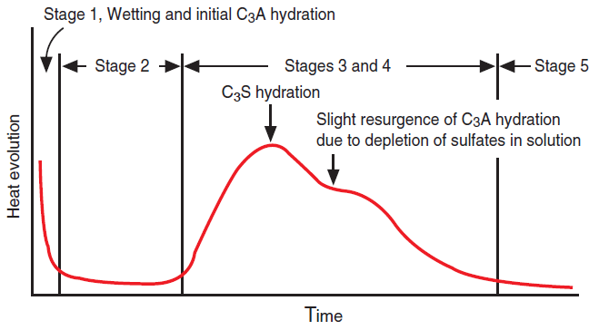
Heat of Hydration
Notes:
This graph shows heat evolution as a function of time for cement paste. Stage 1 is heat of wetting or initial hydrolysis (C3A and C3S hydration).
Stage 2 is a dormant period related to initial set. Stage 3 is an accelerated reaction of the hydration products that determines rate of
hardening and final set. Stage 4 decelerates formation of hydration products and determines the rate of early strength gain. Stage 5 is a
slow, steady formation of hydration products establishing the rate of later strength gain.

Slide 77
Loss of Ignition
Notes:
Loss on ignition of portland cement is determined by heating a cement sample of known weight up to a temperature between 900 and 1000 degrees Celsius until a constant weight is obtained. The weight loss of the sample is then determined.

Slide 78
Density and Relative Density
Notes:
Density of cement can be determined by (left) using a Le Chatelier flask and kerosene or by (right) using a helium pycnometer.

Slide 79
Bulk Density
Notes:
The bulk density of cement is defined as the mass of cement particles plus air between particles per unit volume. Both beakers in this picture contain 500 grams of cement. The beaker on the left has a lower bulk density and the beaker on the right has a higher bulk density. The increase in bulk density was achieved through slight vibration.

Slide 80
Thermal Analysis
Notes:
Thermogravimetric analysis (TGA) is a technique that measures the mass (weight) of a sample as it is being heated (or cooled) at a controlled rate.

Slide 81
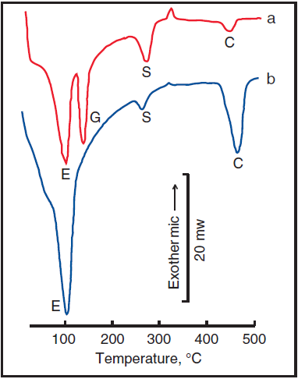
Differential Scanning Analysis
Notes:
In differential scanning calorimetry (DSC), the heat absorbed or released is measured directly as a function of temperature or time and compared to a reference. Like DTA, DSC can be used to determine what phases are present at different stages of hydration.
The chart shows a differential scanning calorimetry thermogram of a portland cement paste after (a) 15 minutes and (b) 24 hours of hydration. C = calcium hydroxide; E = ettringite; G = gypsum; and S = syngenite.

Slide 82
Virtual Cement Testing
Notes:
Example two-dimensional digital microstructures showing four stages of hydration in a microstructural model of C₃S hydration. The degrees of hydration are: (furthest left) – 0 %, (middle left) – 20 %, (middle right) – 50%, (furthest right) – 87%. In these images, colors are assigned as follows:
Red = unreacted cement, blue = CH, yellow = C-S-H, and black = porosity (Garboczi and others 2014).

Slide 83
Transportation
Notes:
Around 100 million metric tons of cement are shipped per year throughout the United states. Most portland cements are shipped in bulk by rail, truck, barge, or ship. Bulk cement is measured by the metric ton or short ton.

Slide 84
Packaging
Notes:
A small amount of cement is shipped in bags, primarily for masonry applications and for small projects.

Slide 85
Storage
Notes:
Cement is a moisture-sensitive material.; while dry, it will retain its quality indefinitely. When stored outdoors, bags should be placed on pallets and covered with a waterproof covering.

Slide 86
Hot Cement
Mill grinding raises temperature
Slow heat dissipation in storage
May still be hot when delivered
Tests show effect is negligible
Notes:
When cement clinker is pulverized in the grinding mill during cement manufacture, the friction of the particle grinding mechanism generates heat. This heat dissipates slowly while the cement is in storage. During the summer months when demand is high, cement may still be hot when delivered to a ready mixed concrete plant or jobsite. However, tests have shown that the effect of hot cement on the workability and strength development of concrete is negligible.

Slide 87
Summary
Manufacture of portland cement
Types of cement
Selecting and specifying cement
Chemistry of portland cement
Physical properties of cement
Thermal analysis
Virtual testing
Transportation, packaging, and storage
Notes:
In summary, this module provided an overview of the manufacture of portland cement and the role of cement in sustainable development. The different types of hydraulic cement available in the United States and how to select and specify them was also covered, followed by an in depth look at the chemistry of portland cement and the physical properties of portland cement and the associated tests, including thermal analysis and virtual testing.

Slide 88
?

