Slide 1
High-Performance Concrete
Design and Control of Concrete Mixtures – Chapter 19

Slide 2
Overview
Introduction to high-performance concrete
High-durability concrete
High-early-strength concrete
High-strength concrete
High-performance concrete construction
Self-consolidating concrete
Ultra-high-performance concrete
Notes:
This presentation will discuss various types of high-performance concrete. The discussion will begin with an overview of high-performance concrete and the drive behind the technology. Next, specific types of high-performance concrete will be discussed, namely high-durability, high-early-strength, and high-strength concrete. We will then review the differences in construction procedures necessary for handling high-performance concrete. The presentation will conclude with brief mentions of self-consolidating concrete and ultra-high-performance concrete.

Slide 3
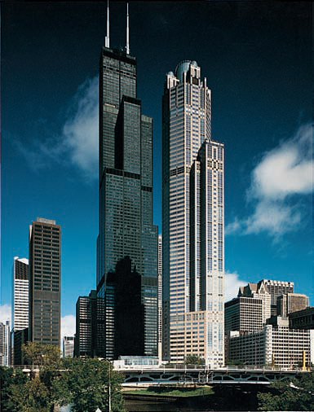
High-Performance Concrete
Notes:
High-performance concrete (HPC) exceeds the properties and constructability of normal concrete. Normal and special materials are used to make these specially designed concretes that must meet a combination of performance requirements. Special mixing, placing, and curing practices may be needed to produce and handle high-performance concrete. Performance tests are usually required to demonstrate compliance with specific project needs. High-performance concrete has been primarily used in bridges, and tall buildings for its durability, strength, and high modulus of elasticity. It has also been used in shotcrete repair, poles, tunnels, parking garages, and agricultural applications. High-performance concrete characteristics are defined, categorized, or developed for particular applications and environments; some of the characteristics that may be required include: enhanced durability, such as high abrasion resistance, low permeability and diffusion, resistance to chemical attack, high resistance to freeze-thaw, and deicer scaling damage, and resistance to alkali silica reactivity; enhanced engineering properties, such as high strength, high early strength, high modulus of elasticity, toughness and impact resistance, and volume stability; and other enhanced properties, such as ease of placement, temperature control, compaction without segregation, and inhibition of bacterial and mold growth.

Slide 4
Notes:
High-performance concretes are made with carefully selected high-quality ingredients and optimized mixture designs; these are batched, mixed, placed, compacted and cured to the highest industry standards. Typically, they will have low water-cementing materials ratios of 0.20 to 0.45. High-range water reducers are usually used to make these concretes fluid and workable at lower w/cm. High-performance concrete almost always has greater durability than normal concrete. This greater durability may be accompanied by normal strength or it may be partnered with high strength. Note that strength is not always the primary required property. For bridge decks, a normal strength concrete with very high durability and very low permeability is considered high performance concrete. This table lists materials often used in high-performance concrete and their selection criteria.

Slide 5
Notes:
This table lists properties that can be selected for high-performance concrete. Typical mix designs and member properties for many bridges can be found in an FHWA report compiling results for HPC bridges. Not all properties can be achieved concurrently. High-performance concrete specifications should be performance oriented. However, many specifications are a combination of performance requirements and prescriptive requirements.

Slide 6
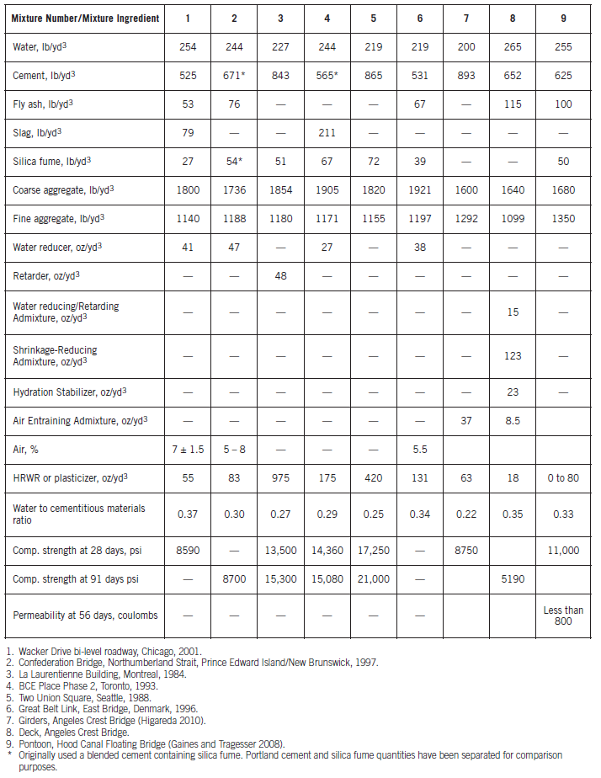
Notes:
This table provides examples of high-performance concrete mixtures used in a variety of structures. HPC concrete today is more on concretes with high durability in mild, moderate, or severe environments. For example, the Confederation Bridge across the Northumberland Strait between Prince Edward Island and New Brunswick, Canada has a 100-year design life (Mix No.2 in table).

Slide 7
High-Durability Concrete
Abrasion resistance
Permeability
Diffusion
Freeze-thaw resistance
Alkali-aggregate reactivity
Notes:
The following slides review durability issues that high-performance concrete can address, including abrasion resistance, permeability, diffusion, freeze-thaw resistance, and alkali-aggregate reactivity.

Slide 8
Abrasion Resistance
High strength HPC ideal
Incorporates silica fume
Steel fibers can be used
Useful for spillways, stilling basins, pavements subjected to studs and chains
Concrete strengths of 100-120 MPa (14,500-17,000 psi) correlate to abrasion resistance of granite
Notes:
Abrasion resistance is related to the strength of concrete. This makes high strength HPC ideal for abrasive environments. The abrasion resistance of HPC incorporating silica fume is especially high. This makes silica fume concrete particularly useful for spillways and stilling basins, bridge decks subject to studded tires or tires with chains, and concrete pavements or concrete pavement overlays subjected to heavy or abrasive traffic. In a particular stilling basin of a dam, repairs using fiber-reinforced concrete were not durable. The new HPC mixtures used to repair the structure the second time contained 386 kg/m³ (650 lb/yd³) of cement, 70 kg/m³ (118 lb/yd³) of silica fume, and admixtures; had a water-to-cementitious materials ratio of 0.28; and had a 90-day compressive strength exceeding 103 MPa (15,000 psi). The addition of fibers to silica fume mortars to optimize abrasion resistance was studied and the best results were obtained with a mixture using slag cement, steel fibers, and silica fume. Mortar strengths ranged from 75 MPa to 100 MPa (11,000 psi to 14,500 psi). In addition to better erosion resistance; less drying shrinkage, high freeze-thaw resistance, and good bond to the substrate were achieved. In Norway steel studs are allowed in tires. This causes severe abrasion wear on pavement surfaces, with resurfacing required within one to two years. Tests using an accelerated road-wear simulator showed that in the range of 100 MPa to 120 MPa (14,500 psi to 17,000 psi), concrete had the same abrasion resistance as granite. Abrasion-resistant highway mixtures usually contain between 320 kg/m³ and 450 kg/m³ (539 lb/yd³ and 758 lb/yd³) of cement, plus silica fume or fly ash. They have water to cementing materials ratios of 0.22 to 0.36 and compressive strengths in the range of 85 MPa to 130 MPa (12,000 psi to 19,000 psi).Applications have included new pavements and overlays to existing pavements.

Slide 9
Permeability
Low permeability is oft specified using coulombs
ASTM C1202 – RCPT
Example – maximum 1000 coulombs
Achieved using:
Low w/cm
Ternary mixtures
Latex-modified concrete
Notes:
The durability and service life of steel reinforced concrete exposed to weather is related to the permeability of the concrete cover protecting the reinforcement. HPC typically has very low permeability to air, water, and chloride ions. Low permeability is often specified through the use of a coulomb value, such as a maximum of 1000 coulombs. Test results obtained on specimens from a concrete column specified to be 70 MPa (10,000 psi) at 91 days and which had not been subjected to any wet curing were as follows:
Water permeability of vacuum-saturated specimens:
Age at test: 7 years
Applied water pressure: 0.69 MPa
Permeability: 7.6 x 10⁻¹³ cm/s
Rapid chloride permeability (ASTM C1202):
Age at test, years Coulombs
1 303
2 258
7 417
The dense pore structure of high-performance concrete, gives it characteristics that make it eminently suitable for uses where a high quality concrete would not normally be considered. Ternary mixtures achieve lower permeabilities more easily for a given w/cm. Latex-modified HPC is able to achieve these same low levels of permeability at normal strength levels without the use of supplementary cementing materials.

Slide 10
Diffusion
Diffusion coefficient tested according to ASTM C1556
SCMs are helpful, especially silica fume
Low diffusion slows ingress of ions, such as chloride
Notes:
Aggressive ions, such as chloride, in contact with the surface of concrete will diffuse through the concrete until a state of equilibrium is achieved. If the concentration of ions at the surface is high, diffusion may result in corrosion-inducing concentrations at the level of the reinforcement. The lower the water-cementing materials ratio the lower the diffusion coefficient will be for any given set of materials. Supplementary cementing materials, particularly silica fume, further reduce the diffusion coefficient. Typical values for diffusion for HPC are as follows:
Type of Concrete Diffusion Coefficient (ASTM C1556)
Portland cement-fly-ash silica fume mix: 1000 x 10⁻¹⁵ m²/s
Portland cement-fly ash mix: 1600 x 10⁻¹⁵ m²/s

Slide 11
Freeze-Thaw Resistance
High resistance due to low w/cm
True for systems with and without SCMs
Studies suggest air entrainment is not needed, yet still recommended
No-slump dry-pack mortar used in Chicago sidewalks shows little damage after 90 years
Notes:
Because of its very low water-cementing materials ratio (0.20 to 0.45), it is widely believed that HPC should be highly resistant to both scaling and physical breakup due to freezing and thawing. There is ample evidence that properly air-entrained high performance concretes are highly resistant to freezing and thawing and to scaling. 27 mixtures were tested using cement and silica fume with water-cementing materials ratios of 0.30, 0.26, and 0.23 and a wide range of quality in air-voids systems. All specimens performed exceptionally well in salt-scaling tests, confirming the durability of high-performance concrete, and suggesting that air-entrainment is not needed. ASTM C666 (Procedure A) tests were conducted on non-air-entrained high performance concretes with water-cementing materials ratios between 0.22 and 0.31. All were found to be extremely resistant to freeze-thaw damage and again it was suggested that air-entrainment is not needed. It was found that non-air-entrained concrete with a w/c of 0.25 was deicer-scaling resistant with no supplementary cementing materials present. They found that higher strength portland cement concretes needed less air than normal concrete to be frost and scale resistant. Sidewalks constructed in Chicago in the 1920s used 25-mm (1-in.) thick toppings made of no-slump dry-pack mortar rammed into place. The concrete contained no air entrainment. Many of these sidewalks are still in use today; they are in good condition after 90 plus years of exposure to frost and deicers. No documentation exists on the water to cement ratio; however, it can be assumed that the water-to-cement ratio was comparable to that of modern HPC. While the above experiences prove the excellent durability of certain high-performance concretes to freeze-thaw damage and salt scaling, it is considered prudent to use air-entrainment. No well-documented field experiments have been made to prove that air-entrainment is not needed. Until such data are available, current practice for air-entrainment should be followed. It has been shown that the prime requirement of an air-void system for HPC is a preponderance of air bubbles of 200 μm size and smaller. If the correct air bubble size and spacing can be assured, then a moderate air content will ensure durability and minimize strength loss. The best measure of air entrainment is the spacing factor.

Slide 12
Alkali-Silica Reactivity
Two characteristics aid against ASR:
Very low w/cm
Self-desiccation
ASR requires moisture
Typically high SCM contents
SCMs tend to mitigate ASR
Must be verified
Notes:
Reactivity between certain siliceous aggregates and alkali hydroxides can affect the long-term performance of concrete. Two characteristics of HPC that help combat alkali-silica reactivity are:
HPC concretes at very low water to cement ratios can self desiccate (dry out) to a level that does not allow ASR to occur (relative humidity less than 80%). The low permeability of HPC also minimizes external moisture from entering the concrete.
HPC concretes can use significant amounts of supplementary cementing materials that may have the ability to control alkali-silica reactivity. However, this must be demonstrated by test. HPC concretes can also use ASR inhibiting admixtures to control ASR.
HPC concretes are not immune to alkali-silica reactivity and appropriate precautions must be taken. Procedures are available for determining the potential reactivity of aggregates and limiting ASR

Slide 13
High-Early-Strength Concrete
Notes:
High-early-strength concrete, also called fast-track concrete, achieves its specified strength at an earlier age than normal concrete. The time period in which a specified strength should be achieved may range from a few hours (or even minutes) to several days. High-early-strength can be attained using traditional concrete ingredients and concreting practices, although sometimes special materials or techniques are needed. High-early-strength can be obtained using one or a combination of the following, depending on the age at which the specified strength must be achieved and on job conditions:
Type III or HE high-early-strength cement
High cement content (400 kg/m³ to 600 kg/m³ [675 lb/yd³ to 1000 lb/yd³])
Low water-cementing materials ratio (0.20 to 0.45 by mass)
Higher freshly mixed concrete temperature
Higher curing temperature
Chemical admixtures
Silica fume (or other SCM)
Steam or autoclave curing
Insulation to retain heat of hydration
Special rapid hardening cements
High-early-strength concrete is used for prestressed concrete to allow for early stressing, precast concrete for rapid production of elements, high-speed cast-in-place construction, rapid form reuse, cold-weather construction, rapid repair of pavements (to reduce traffic downtime), fast-track paving, and several other uses. In fast-track paving, use of high-early-strength mixtures allows traffic to open just hours after concrete is placed. An example of a fast-track concrete mixture used for a bonded concrete highway overlay consisted of 380 kg (640 lb) of Type III cement, 42 kg (70 lb) of Type C fly ash, 6½% air, a water reducer, and a water-to-cementing materials ratio of 0.4. Strength data for this 40-mm(1½ in.) slump concrete are given in this table.

Slide 14
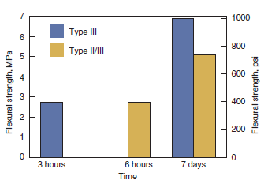
High-Early-Strength Concrete
Notes:
These figures illustrate early strength development of concretes designed to open to traffic within 4 hours after placement. The figure on the left shows strength development of a high-early strength concrete mixture using 390 kg/m³ (657 lb/yd³) of rapid hardening cement, 676 kg/m³ (1140 lb/yd³) of sand, 1115 kg/m³ (1879 lb/yd³) of 25 mm (1 in.) nominal max. size coarse aggregate, a water to cement ratio of 0.46, a slump of 100 to 200 mm (4 to 8 in.), and a plasticizer and retarder. Initial set was at one hour. The figure on the right shows strength development of high-early strength concrete mixtures made with 504 to 528 kg/m³ (850 to 890 lb/yd³) of Type III or Type II/III cement, a nominal maximum size coarse aggregate of 25 mm (1 in.), a water to cement ratio of 0.30, a plasticizer, a hydration control admixture, and an accelerator. Initial set was at one hour.

Slide 15
High-Early-Strength Concrete
Notes:
This figure illustrates the benefits of blanket curing to develop early strength for patching or fast-track applications. The concrete had a Type I cement content of 421kg/m³ (710 lb/yd³) and a water to cement ratio of 0.30. When designing early-strength mixtures, strength development
is not the only criteria that should be evaluated; durability, early stiffening, camber of pretensioned members, autogenous shrinkage, drying shrinkage, temperature rise, and other properties also should be evaluated for compatibility with the project. Special curing procedures, such as fogging, may be needed to control plastic shrinkage cracking.

Slide 16
High-Strength Concrete
Notes:
The definition of high strength changes over the years as concrete strength used in the field increases. This publication considers high-strength concrete (HSC) as a strength significantly beyond what is used in normal practice. About 90% of ready mixed concrete has a 28-day specified compressive strength ranging from 20 MPa (3000 psi) to 40 MPa (6000 psi), with most of it between 20 MPa (3000 psi) and 35 MPa (5000 psi). Most high-strength concrete applications are designed for compressive strengths of 70 MPa (10,000 psi) or greater. For bridges, the AASHTO LRFD Specifications state that the minimum allowable compressive strength for bridge decks and prestressed concrete members is 28 MPa (4000 psi). Therefore, HSC considered here has a minimum design strength of at least 55 MPa (8000 psi). For high strength concrete, stringent application of the best practices is required. Compliance with the guidelines and recommendations for preconstruction laboratory and field-testing procedures described in ACI 363.2 are essential. Concrete with a design strength of 131 MPa (19,000 psi) has been used in buildings.

Slide 17
Notes:
Traditionally, the specified strength of concrete has been based on 28-day test results. However, in high-rise concrete structures, the process of construction is such that the structural elements in lower floors are not fully loaded for periods of a year or more. For this reason, compressive strengths based on 56- or 91-day test results are commonly specified in order to achieve significant economy in material costs. For bridges, the specified strength of concrete has also been based on 28-day test results. However, because of the use of fly ash and slag cement, which may hydrate slower than the cement, 56-day strengths have been specified on bridge projects. When later ages are specified, supplementary cementing materials are usually incorporated into the concrete mixture. This produces additional benefits in the form of reduced heat generation during hydration. With use of low-slump or no-slump mixtures, high compressive-strength concrete is produced under careful control in precast concrete plants. Superplasticizing admixtures are invariably added to HPC mixtures to produce workable and often flowable mixtures. The producer must know the factors affecting compressive strength and know how to vary those factors for best results. Each variable should be analyzed separately in developing a mix design. An optimum mix design is then developed keeping in mind the economic advantages of using locally available materials. Selection of cement for high-strength concrete should not be based only on mortar-cube tests but should also include tests of comparative strengths of concrete at 28, 56, and 91 days. Cement that yields the highest concrete compressive strength at extended ages (91 days) is preferable. Trial mixtures with cement contents between 400 kg/m³ and 550 kg/m³ (675 lb/yd³ to 930 lb/yd³) should be made for each cement being considered for the project. Other than decreases in sand content as cement content increases, the trial mixtures should be as nearly identical as possible. Fly ash, silica fume, or slag cement are frequently used and are sometimes mandatory in the production of high-performance concrete. These supplementary cementing materials are usually added at dosage rates of 5% to 20% or higher by mass of cementing material. Some specifications only permit use of up to 10% silica fume, unless evidence is available indicating that concrete produced with a larger dosage rate will have satisfactory strength, durability, and volume stability. The water-to-cementing materials ratio should be adjusted so that equal workability becomes the basis of comparison between trial mixtures. Blended cements containing fly ash, silica fume, slag, or calcined clay can be used to make high-strength concrete with or without the addition of supplementary cementing materials.

Slide 18
Notes:
In high-strength concrete, careful attention must be given to aggregate size, shape, surface texture, mineralogy, and cleanness. To find the optimum size, trial batches should be made with 19 mm (3⁄4 in.) and smaller coarse aggregates and varying cement contents. Combining single sizes of aggregate to produce the required grading is recommended for close control and reduced variability in the concrete. In high-strength concretes, the strength of the aggregate itself and the bond between the paste and aggregate become important factors. Tests have shown that crushed-stone aggregates produce higher compressive strength in concrete due to a superior aggregate-to-paste bond. Because of the high percentage of cementitious material in high-strength concrete, an increase in coarse aggregate content beyond values recommended in standards for normal-strength mixtures is necessary and allowable. In high-rise buildings and in bridges, the stiffness of the structure is an important structural concern. The modulus achievable is affected significantly by the properties of the aggregate and also by the mixture proportions. If an aggregate has the ability to produce a high modulus, then the optimum modulus in concrete can be obtained by using as much of this aggregate as practical, while still meeting workability and cohesiveness requirements. If the coarse aggregate used is a crushed rock, and manufactured fine aggregate of good quality is available from the same source, then a combination of the two can be used to obtain the highest possible modulus. Sand with a fineness modulus (FM) of about 3.0 has been found to be satisfactory for producing good workability and high compressive strength. Finer sand with a FM of between 2.5 and 2.7 may produce lower-strength, sticky mixtures. High performance lightweight concrete has been used for bridges. This concrete typically uses normal-weight sand and lightweight coarse aggregate. Its lower mass also makes it an attractive option in seismic regions. The use of chemical admixtures such as water reducers, retarders, high-range water reducers, or superplasticizers is necessary. They make more efficient use of the large amount of cementitious material in high-strength concrete and help to obtain the lowest practical water to cementing materials ratio. The use of air-entraining admixtures where durability in a freeze-thaw environment is required is mandatory. However, air is not necessary or desirable in high-strength concrete protected from the weather. Because air entrainment decreases concrete strength of rich mixtures, testing to establish optimum air contents and spacing factors may be required. Certain high-strength concretes may not need as much air as normal-strength concrete for equivalent frost resistance.

Slide 19
High-Performance Concrete Construction
Proportioning
Watch out for workability
Mixing
Sticky mixtures can build-up in mixers
Adjust charging sequence
Notes:
The trial mixture approach is best for selecting proportions for high-performance concrete. To obtain high performance, it is necessary to use a low water to cementing materials ratio and, often, a high portland cement content. The unit strength obtained for each unit of cement used in a cubic meter (yard) of concrete can be plotted as strength efficiency to evaluate mixture designs. The water requirement of concrete increases as the fine aggregate content is increased for any given size of coarse aggregate. Because of the high cementing materials content of these concretes, the fine aggregate content can be kept low. A slump of around 200 mm (8 in.) will provide adequate workability for most applications. High-performance concrete has been successfully mixed in transit mixers and central mixers. However, many of these concretes that have higher cementitious contents tend to be sticky and may cause build-up in these mixers, especially when silica fume is used. Where dry, uncompacted silica fume has been batched into a mixture, balling of the mixture has occurred and mixing has been incomplete. In these instances it has been necessary to experiment with the charging sequence, and the percentage of each material added at each step in the batching procedure. Where truck mixing is unavoidable, the best practice is to reduce loads to 90% of the rated capacity of the trucks.

Slide 20
High-Performance Concrete Construction
Placing
Batch adjustments supervised by producer – no retempering
Delays eliminated – smaller batches if necessary
Consolidating
More concern with under-vibration than over-vibration
Finishing
Sticky mixtures difficult to finish
Use fresno instead of bullfloat
Curing
Very important step – more so than with conventional mixtures
Low w/cm – requires evaporation control
Notes:
Final adjustment of the concrete should be supervised by the concrete producer’s technicians at the site, by a concrete laboratory, or by a consultant familiar with the performance and use of high-strength concrete. It may be necessary to reduce batch sizes if placing procedures are slower than anticipated. Rigid surveillance must be exercised at the jobsite to prevent any addition of retempering water. Increases in workability should only be achieved by the addition of a superplasticizer. This should be done by the supplier’s technician. The contractor must be prepared to receive the concrete and understand the consequences of exceeding the specified slump and water-cementitious materials ratio. Consolidation is very important in achieving the potential of high-performance concrete. Concrete must be vibrated as quickly as possible after placement in the forms. Over-vibration of workable normal-strength concrete often results in segregation, loss of entrained air, or both. High-performance concrete without a superplasticizer will be relatively stiff and contain little air. Consequently, inspectors should be more concerned with under-vibration rather than over-vibration. High-performance concrete can be difficult to finish. High cementitious materials contents, large dosages of admixtures, low water contents, and air entrainment all contribute to the concrete sticking to the trowels and other finishing equipment. When this occurs, finishing activities should be minimized. The finishing sequence should be modified to include the use of a fresno trowel in place of a bullfloat. Curing of high-performance concrete is even more important than curing normal-performance concrete. Where very low water-cement ratios are used in flatwork there will be little if any bleeding before or after finishing. It is imperative that fog curing or evaporation retarders be applied to the concrete immediately after the surface has been struck off. The temperature history of HPC is an integral part of its curing process. Advantage should also be taken of recent developments in curing technology.

Slide 21
High-Performance Concrete Construction
Temperature Control
Temperature history figures into strength and durability
Mass concrete concerns
Quality Control
More rigorous – leads to low variance
Notes:
The quality, strength, and durability of HPC are highly dependent on its temperature history from the time of delivery to the completion of curing. In principle, favorable construction and placing methods will enable: (1) a low temperature at the time of delivery; (2) the smallest possible maximum temperature after placing; (3) minimum temperature gradients after placing; and (4) a gradual reduction to ambient temperature after maximum temperature is reached. Excessively high temperatures and gradients can cause excessively fast hydration and micro- and macro-cracking of the concrete. It has been a practice on major high-rise structures incorporating concrete with specified strengths of 70 MPa to 85 MPa (10,000 psi to 12,000 psi) to specify a maximum delivery temperature of 18°C (64°F). Experience with very-high-strength concrete suggests that a delivery temperature of no more than 25°C (77°F), preferably 20°C (68°F), should be allowed. The specifier should state the required delivery temperature. In HPC applications such as high-rise buildings, column sizes are large enough to be classified as mass concrete. Normally, excessive heat generation in mass concrete is controlled by using a low cement content. When high cement-content HPC mixtures are used under these conditions, other methods of controlling maximum concrete temperature must be employed. A comprehensive quality-control program is required at both the concrete plant and onsite to guarantee consistent production and placement of high-performance concrete. Inspection of concreting operations from stockpiling of aggregates through completion of curing is important. Closer production control than is normally obtained on most projects is necessary. Also, routine sampling and testing of all materials is particularly necessary to control uniformity of the concrete. In testing high-strength concrete, some changes and more attention to detail are required. The quality control necessary for the production of high compressive strength concrete will, in most cases, lead to low variance in test results. Strict vigilance in all aspects of quality control on the part of the producer and quality testing on the part of the laboratory are necessary on high-strength concrete projects.

Slide 22
Self-Consolidating Concrete
Notes:
Self-consolidating concrete (SCC), also referred to as self-compacting concrete, is able to flow and consolidate under its own weight. At the same time it is cohesive enough to fill spaces of almost any size and shape without segregation or bleeding. This makes SCC particularly useful wherever placing is difficult, such as in heavily reinforced concrete members or in complicated formwork. This technology is based on increasing the amount of fine material without changing the water content. This changes the rheological behavior of the concrete. SCC must have a low yield value to ensure high flowability; a low water content ensures high viscosity, so the coarse aggregate can float in the mortar without segregating. To achieve a balance between deformability and stability, the total content of particles finer than the 150 μm (No. 100) sieve is typically high, usually about 520 kg/m³ to 560 kg/m³ (880 lb/yd³ to 950 lb/yd³). Generally, the higher the required flowability of the SCC, the higher the amount of fine material needed to produce a stable mixture. However, in some cases, a viscosity-modifying admixture (VMA) can be used instead of, or in combination with, an increased fine content to stabilize the concrete mixture. High-range water reducers based on polycarboxylate ethers are typically used to plasticize the mixture. This figure shows an example of mixture proportions used in self-consolidating concrete as compared to a conventional concrete mixture.

Slide 23
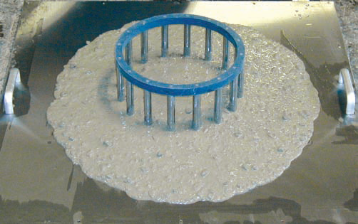
Self-Consolidating Concrete
Notes:
Since SCC is characterized by special fresh concrete properties, many new tests have been developed to measure flowability, viscosity, blocking tendency, self-leveling, and stability of the mixture. The slump flow test (ASTM C1611) is performed to measure filling ability and stability. The test is performed similarly to the conventional slump test (ASTM C143). However, instead of measuring the slumping distance vertically, the mean diameter of the resulting concrete patty is measured horizontally. This number is recorded as the slump flow. The J-Ring test (ASTM C1621) measures passing ability. The J-Ring consists of a ring of reinforcing bar such that it will fit around the base of a standard slump cone, as shown here. The slump flow with and without the J-Ring is measured, and the difference calculated. ASTM C1610 evaluates static stability of a concrete mixture by quantifying aggregate segregation. A column is filled with concrete and allowed to sit after placement. The column is then separated into three pieces. Each section is removed individually and the concrete from that section is washed over a 4.75 mm (No. 4) sieve and the retained aggregate weighed. A non-segregating mixture will have a consistent aggregate mass distribution in each section. A segregating mixture will have higher concentrations of aggregate in the lower sections. An earlier assessment of the segregation resistance is ASTM C1712. A 45 g hollow cylinder device is placed on top of an inverted slump mold containing SCC. The distance the weight sinks in 30 seconds correlates to the static segregation resistance of the mixture. If the penetration depth is less than 10 mm, the mixture is considered segregation resistant. A penetration value above 25 mm signals a mixture that is probably prone to segregation.

Slide 24
Self-Consolidating Concrete
Notes:
Strength and durability of well-designed SCC are almost similar to conventional concrete. Without proper curing, SCC tends to have higher plastic shrinkage cracking than conventional concrete. Research indicates greater tensile creep for SCC, resulting in a reduced tendency to crack. The use of fly ash as a filler compared to limestone as a filler seems to be advantageous; it results in higher strength and higher chloride resistance. The production of SCC is more expensive than regular concrete and it is difficult to keep SCC in the desired consistency over a long period. However, construction time is shorter and production of SCC is environmentally friendly. Furthermore, SCC produces a good surface finish. These advantages make SCC particularly attractive for use in precasting plants. SCC has been used successfully in tall buildings including the Trump International Hotel and Tower in Chicago, Illinois. Cast-in-place SCC has been used in the construction of inclined pylons for a cable-stayed pedestrian bridge, in Virginia. It has also been used for many drilled shaft foundations for bridges, including those of the new I-35W St. Anthony Falls Bridge in Minneapolis, Minnesota. SCC was also used to speed construction of precast prestressed bulb-tee girders in the replacement of the Biloxi Bay Bridge in Mississippi after the original bridge was destroyed by Hurricane Katrina. SCC has also been successfully used in a number of rehabilitation projects in Canada.

Slide 25
Ultra-High Performance Concrete
Notes:
Ultra-high performance concrete (UHPC) is also known as reactive powder concrete. Reactive-powder concrete was first patented by a French construction company in 1994. It is characterized by high strength and very low permeability, obtained by optimized particle packing and by a low water content. The properties of UHPC are achieved by: (1) eliminating the coarse aggregates-–only very fine powders are used (sand, crushed quartz, and silica fume), all with particle sizes between 0.02 and 300 μm; (2) optimizing the grain size distribution to densify the mixture; (3) using post-set heat-treatment to improve the microstructure; (4) addition of steel and synthetic fibers (about 2% by volume); and (5) use of superplasticizers to decrease the water to cement ratio-–usually to less than 0.2-–while improving the rheology of the paste. This picture shows a typical fresh UHPC.

Slide 26
Ultra-High Performance Concrete
Notes:
The compressive strength of UHPC is typically around 200 MPa (29,000 psi), but can be produced with compressive strengths up to 810 MPa (118,000 psi). However, the low comparative tensile strength requires prestressing reinforcement in severe structural service. This table compares hardened concrete properties of RPC with those of an 80-MPa (11,600-psi) concrete. The Federal Highway Administration studied multiple properties of UHPC, namely compressive and tensile strengths, creep and shrinkage, chloride ion penetration, and freeze-thaw durability. The 28-day compressive strengths ranged from 126 to 193 MPa (18,000 to 28,000 psi), depending upon whether or not a secondary heat treatment was used to further develop compressive strength. The tensile strength was approximately 6.2 MPa (900 psi) without secondary heat treatment and 9.0 MPa (1,300 psi) after secondary heat treatment. The UHPC showed excellent resistance to chloride ion penetration, exhibited good long-term creep and shrinkage behavior, and held up well in freeze-thaw testing.

Slide 27
Ultra-High Performance Concrete
Notes:
UHPC has been used in the beams and decks of U.S. bridges. The first bridge in the U.S. to use UHPC was the Mars Hill Bridge in Wapello County, Iowa. This 33.5-m (110-ft.) bridge used three 107-cm (42-in.) modified Iowa bulb-tee girders, and opened to traffic in 2006. The second bridge was the Cat Point Creek Bridge in Richmond County, Virginia. This ten-span bridge opened to traffic in 2008 and contained one span with five UHPC bulb-tee girders. The third bridge was the Jakway Park Bridge in Buchanan County, Iowa. This 15.7-m (51.5-ft.) long bridge used UHPC pi-girders. Other uses for UHPC in bridges include waffle deck panels in Iowa and cast-in-place UHPC connections between full-depth deck panels in New York. UHPC has also been used in pedestrian bridges, such as this one in Quebec. The low porosity of RPC also gives excellent durability and transport properties, which makes it a suitable material for the storage of nuclear waste. A low-heat type of reactive-powder concrete has been developed to meet needs for mass concrete pours for nuclear reactor foundation mats and underground containment of nuclear wastes.

Slide 28
Summary
Introduction to high-performance concrete
High-durability concrete
High-early-strength concrete
High-strength concrete
High-performance concrete construction
Self-consolidating concrete
Ultra-high-performance concrete
Notes:
This presentation discussed various types of high-performance concrete. The discussion began with an overview of high-performance concrete and the drive behind the technology. Next, specific types of high-performance concrete were discussed, namely high-durability, high-early-strength, and high-strength concrete. We then reviewed the differences in construction procedures necessary for handling high-performance concrete. The presentation concluded with brief mentions of self-consolidating concrete and ultra-high-performance concrete.

Slide 29
Questions
?

